Slide 1
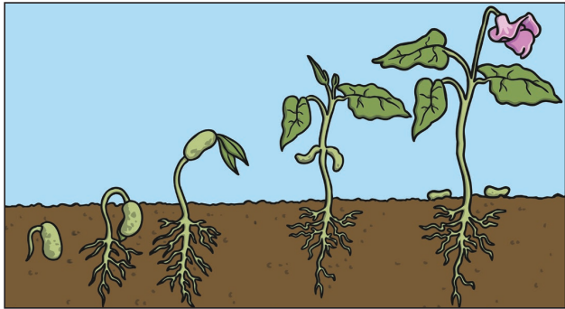
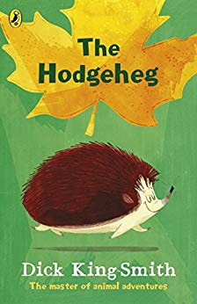
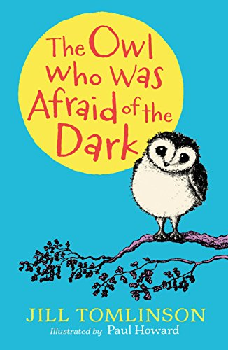


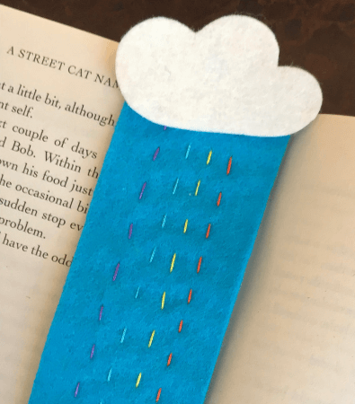
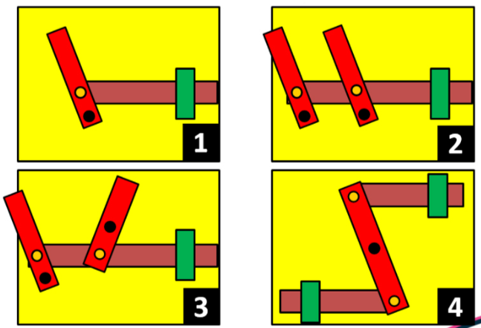
Year 2 Long Term Plan 2024 – 2025
 | Autumn 1 | Autumn 2 | Spring 1 | Spring 2 | Summer 1 | Summer 2
English | Phonics / Spelling Reading Writing including grammar and punctuation | Phonics / Spelling Reading Writing including grammar and punctuation | Phonics / Spelling Reading Writing including grammar and punctuation | Phonics / Spelling Reading Writing including grammar and punctuation | Phonics / Spelling Reading Writing including grammar and punctuation | Phonics / Spelling Reading Writing including grammar and punctuation
Maths | Place Value Addition Subtraction | Multiplication Division Money | Multiplication Division Fractions | Shape Time Length and Height | Mass, Capacity and Temperature Position and Direction | Statistics Problem Solving
Science | Animals, including humans ​ | Materials​ | Living things and their habitats​ | ​Living things and their habitats​ | ​Plants​ | ​Plants​
History and Geography | Seas and Oceans | The Great Fire of London | Seven Continents | Queens that Shaped Britain | Significant People: Mary Seacole and Florence Nightingale | Hot and Cold Places
Art and Design and Technology | Drawing: David Hockney | Food and Nutrition: Bread | Painting: Sir Frank Bowling | Mechanisms: Moving Monster | Print Making: Angela Harding | Textiles: Book Mark
Religion and Worldviews | Why do we need to give thanks? | What do candles mean to people? | How do we know some people have a special connection to God? | What is a prophet? | How do some people talk to God? | Where do some people talk to God?
PSHE | Being Me In My World | Celebrating Difference | Healthy Me | Staying Safe | Relationships | Changing Me
Computing | IT Around Us | Digital Writing | Robot Algorithms | Pictograms | Digital Photography | Programming Quizzes
Physical Education | Fundamentals / Dance | Yoga / Ball Skills | Team Building / Gymnastics | Sending and Receiving / Tennis | Striking and Fielding / Invasion Games | Target Games / Athletics
Music | Pulse, Rhythm and Pitch | Playing in an Orchestra | Inventing a Musical Story | Recognising Different Sounds | Exploring Improvisation | Our Big Concert

