Slide 1
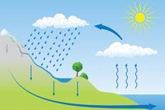
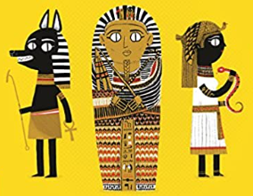




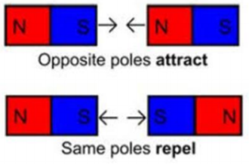
Year 3 Long Term Plan 2024 – 2025
 | Autumn 1 | Autumn 2 | Spring 1 | Spring 2 | Summer 1 | Summer 2
English | Reading Writing including grammar, spelling and punctuation | Reading Writing including grammar, spelling and punctuation | Reading Writing including grammar, spelling and punctuation | Reading Writing including grammar, spelling and punctuation | Reading Writing including grammar, spelling and punctuation | Reading Writing including grammar, spelling and punctuation
Maths | Place Value Addition Subtraction | Money Length Perimeter | Multiplication Division | Mass and Capacity Shape | Fractions Time | Fractions Statistics
Science | Animals, including humans​ | ​Animals, including humans​ | Forces and magnets​ | Rocks​ | ​Plants​ | ​​Light​
History and Geography | Stone Age to Iron Age | The UK Regions | Ancient Egypt | Water Cycle | Ancient Greece | Settlements
Art and Design and Technology | Drawing: Emma Fitzpatrick | Food and Nutrition: Eating Seasonally | Sculpture: Carole Peace | Construction: Castles | Painting: Van Gogh | Textiles: Cushions
Religion and Worldviews | What makes us human? | Where do morals come from? | Is scripture central to religion? | What happens if we do wrong? | Why is water symbolic? | Why is fire used ceremonially?
PSHE | Being Me In My World | Celebrating Difference | Healthy Me | Staying Safe | Relationships | Changing Me
Computing | Connecting Computers | Animation | Digital Writing | Branching Databases | Desktop Publishing | Events and Actions in Programs
Physical Education | Ball Skills / Fundamentals | Basketball / Yoga | OAA / Football | Dance / Tag Rugby | Athletics / Tennis | Gymnastics / Golf
Music | Writing Music | Playing in a Band | Compose Using Your Imagination | More Musical Styles | Enjoying Improvisation | Opening Night
French | Core Unit 1 |  | Core Unit 2 |  | Core Unit 3

