Slide 1
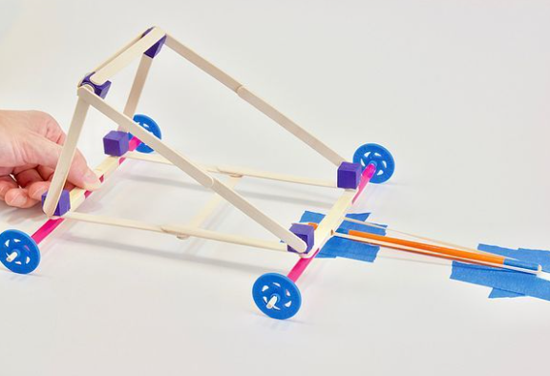
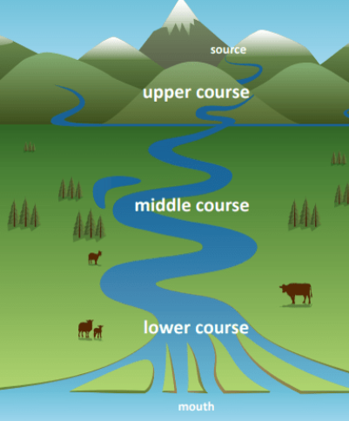

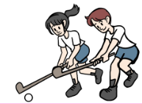


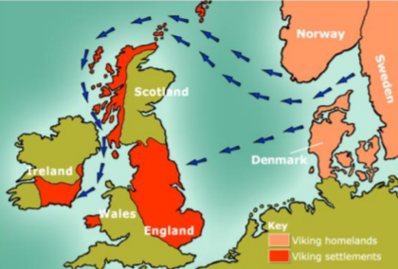
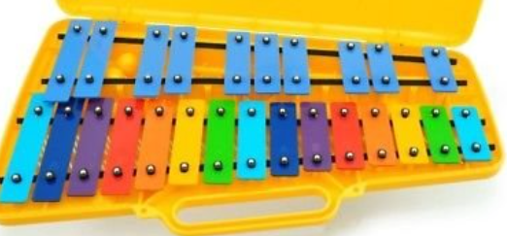
Year 4 Long Term Plan 2024 – 2025
 | Autumn 1 | Autumn 2 | Spring 1 | Spring 2 | Summer 1 | Summer 2
English | Reading Writing including grammar, spelling and punctuation | Reading Writing including grammar, spelling and punctuation | Reading Writing including grammar, spelling and punctuation | Reading Writing including grammar, spelling and punctuation | Reading Writing including grammar, spelling and punctuation | Reading Writing including grammar, spelling and punctuation
Maths | Place Value Addition Subtraction | Multiplication Division Length and Perimeter | Multiplication Division Area | Fractions Decimals Statistics | Money Time | Shape Position and Direction
Science | ​Living things and their habitats​ | ​Animals, including humans​ | ​Electricity​ | ​Sound​ | ​States of matter​ | ​States of matter​
History and Geography | Roman Britain | Rivers | Natural Resources | Anglo Saxons | Europe | Vikings
Art and Design and Technology | Drawing: Phlegm | Mechanisms: Slingshot Car | Collage: Danielle Vaughn | Construction: Pavilion | Painting: Emma Carlisle | Food and Nutrition: Biscuits
Religion and Worldviews | Are all religions equal? | What makes some texts sacred? | Just how important are our beliefs? | Who was Jesus? | Why is the bible the best-selling book of all time? | Does the language of scripture matter?
PSHE | Being Me In My World | Celebrating Difference | Healthy Me | Staying Safe | Relationships | Changing Me
Computing | The Internet | Audio Production | Repetition in Shapes | Data logging | Photo editing | Repetition in Games
Physical Education | Fitness / Tag Rugby | Dance / OAA | Swimming / Yoga | Swimming / Football | Cricket / Athletics | Tennis / Golf
Music | Musical Structures | Exploring Feelings When You Play | Compose With Your Friends | Feelings Through Music | Expression Through Improvisation | The Show Must Go On
French | People and Our Bodies |  | Where I Live |  | My School

