Slide 1

Year 1 Curriculum
Summer 1 2024 - 2025

Slide 2
Swallowdale Curriculum
Dear Families,
This booklet contains the Long Term Plan, information for English, maths and the knowledge organisers which outline the units of work that your child will be covering in our wider curriculum this half term. These will show you the main elements of learning for your child and we hope you find them useful.
Please note that history and geography, art, and design and technology are taught in alternate half terms.
To support your child’s learning at home please read with them regularly and sign your child’s reading diary.
More information about our curriculum can be found on the school’s website.
Thank you for your support.

Slide 3



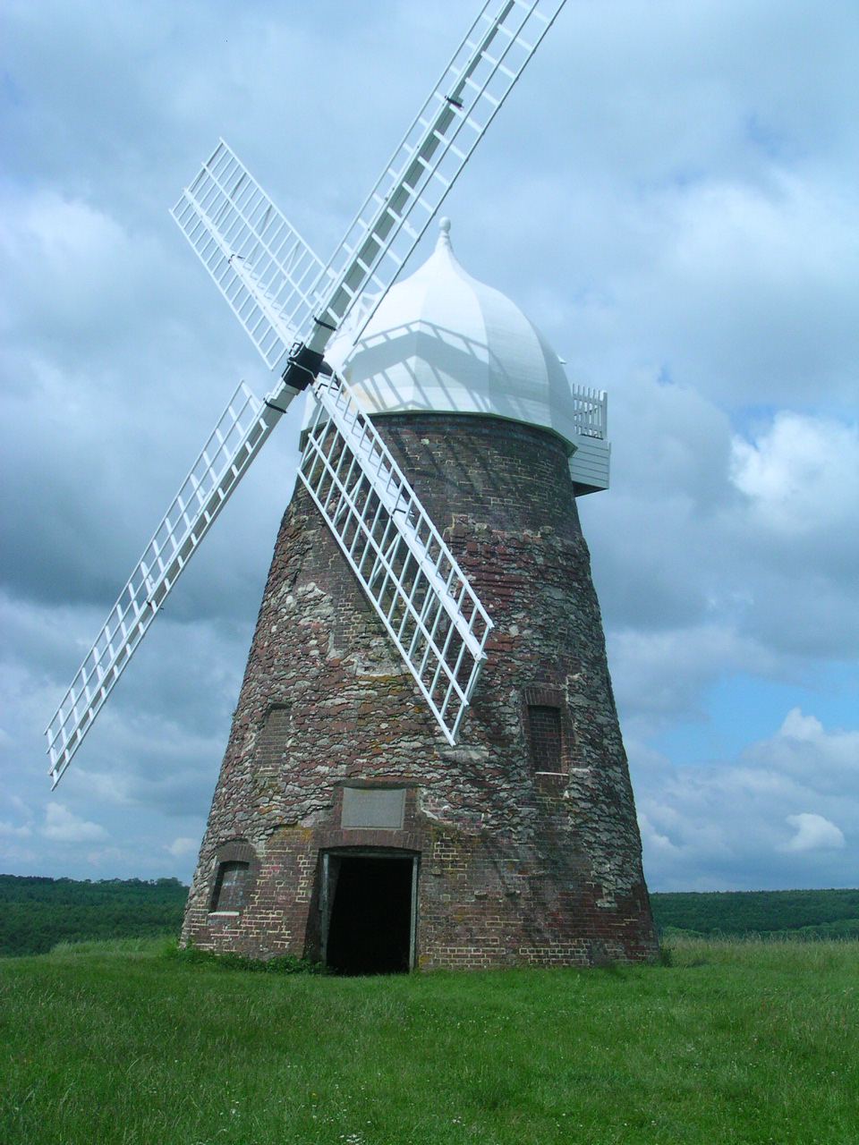
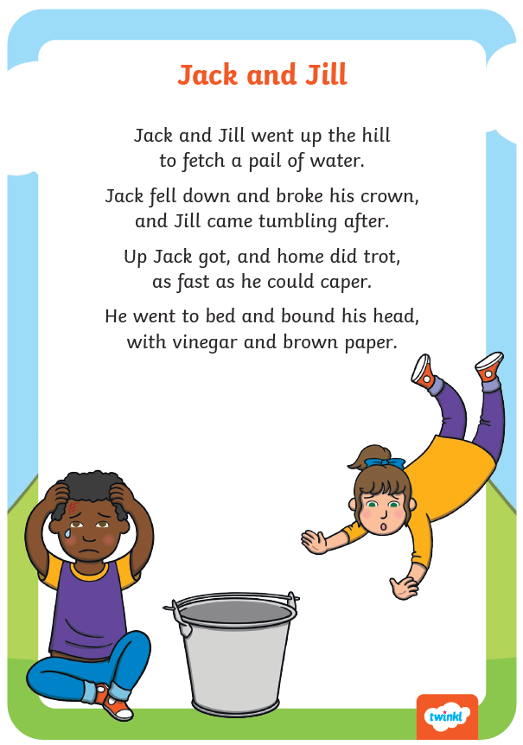
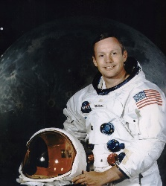

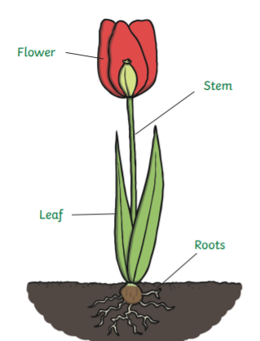
Year 1 Long Term Plan 2024 – 2025
 | Autumn 1 | Autumn 2 | Spring 1 | Spring 2 | Summer 1 | Summer 2
English | Phonics Reading Writing including grammar and punctuation | Phonics Reading Writing including grammar and punctuation | Phonics Reading Writing including grammar and punctuation | Phonics Reading Writing including grammar and punctuation | Phonics Reading Writing including grammar and punctuation | Phonics Reading Writing including grammar and punctuation
Maths | Place Value Addition Subtraction | Addition Subtraction Shape | Place Value Addition Subtraction | Place Value Length and Height Mass and Volume | Multiplication Division ‘Fractions | Position and Direction Place Value Money Time
Science | Seasonal Changes Everyday Materials | Seasonal Changes Animals - Humans | Seasonal Changes​ Forces​ | Seasonal Changes Plants​​ | Seasonal Changes Animals | Seasonal Changes
History and Geography | My School | Travel and Transport | My Town | History of Toys | Great Explorers | The UK
Art and Design and Technology | Drawing: Angelina A’Court | Food and Nutrition: Fruit Salad | Collage: Henri Matisse | Mechanisms: Moving Pictures | Sculpture: Barbara Hepworth | Construction: Windmill House
Religion and Worldviews | How did the world begin? | What do some people believe God looks like? | What is God’s job? | Why should we care for the world? | How do we know that new babies are special? | Why should we care for others?
PSHE | Being Me In My World | Celebrating Difference | Healthy Me | Staying Safe | Relationships | Changing Me
Computing | Technology Around Us | Digital Painting | Moving a Robot | Digital Writing | Grouping Data | Animation
Physical Education | Fundamentals / Gymnastics | Yoga / Ball Skills | Team Building / Invasion Games | Striking and Fielding / Gymnastics | Fundamentals / Invasion Games | Athletics / Target Games
Music | My Musical Heartbeat | Dance, Sing and Play | Exploring Sounds | Learning to listen | Having Fun with Improvisation | Let’s Perform Together

Slide 4




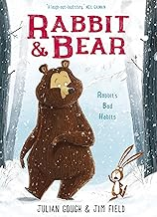

Year 1 English Reading
Reading Lessons
Following the RWI scheme, I will read daily a book that is matched to my phonetic knowledge. I will practise sounds I already know and apply these to words. I will also practise red words that I know and learn new red words. My fluency will be developed through daily reading of the same book within a small group. During lessons and when sharing books, I will begin to understand what a good reader does in the moment of reading and after reading. These skills will be modelled and practised during my lesson. I will read a range of fiction and non-fiction.
Independent Reading
I will have a book linked to my reading level which I may read in school and at home. The reading level of my book is shown by the coloured mark at the front and back of the book. My reading level is assessed at school using a phonics assessment and this will be checked every half term. My reading book should not be too tricky as this book is for me to read fluently. I should read the same book several times to develop my word recognition and fluency skills. This will help me understand what I am reading so I can enjoy it. There are questions in the back of my book to discuss at home. I should record my independent reading in my school reading diary each week and show my teacher.
Our Class Poetry Books
Reading for Pleasure
We will share and discuss lots of different books this term in Year 1 including …

Slide 5
Year 1 Red Words (common exception words)
the a do to today of said says are were was is his has I | you your they be he me she we no go so by my here there | where love come some one once ask friend school put push pull full house our

Slide 6

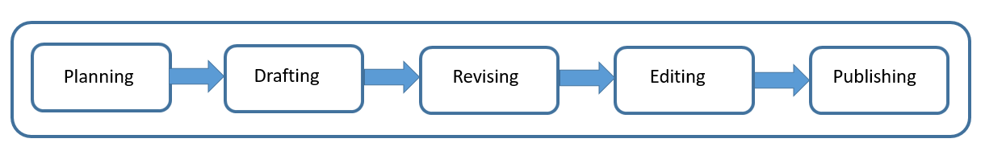
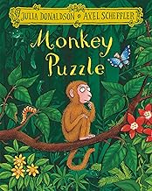
Year 1 English Writing
At Swallowdale, we follow a five-stage process for writing and in Y1 I will write for different purposes: to entertain and to inform.
Content to be taught and applied in writing this year
Word | Regular plural noun suffixes –s or –es (e.g. dog, dogs; wish, wishes) including the effects of these suffixes on the meaning of the noun Suffixes that can be added to verbs where no change is needed in the spelling of root words (e.g. helping, helped, helper) How the prefix un- changes the meaning of verbs and adjectives (e.g. untie, unkind) Adjectives are used to describe nouns
Sentence | How words can combine to make sentences Joining words and joining clauses using and
Text | Sequencing sentences to form short narratives or non-narrative writes
Punctuation | Separation of words with spaces Use of capital letters, full stops, question marks and exclamation marks to demarcate sentences Use of capital letters for names and the personal pronoun I
Terminology | letter, capital letter noun, adjective, singular, plural sentence punctuation, full stop, question mark, exclamation mark
Spelling
I will continue to learn phonics using the Read Write Inc scheme. I will also learn the statutory common exception words for Y1. Words will be sent home with my reading diary for me to practise at home.
Handwriting
In year 1, I will continue to learn correct letter and number formation.
What will I be writing?
I will be learning to write factual information about animals. I will use capital letters, full stops and question marks in my sentences.

Slide 7
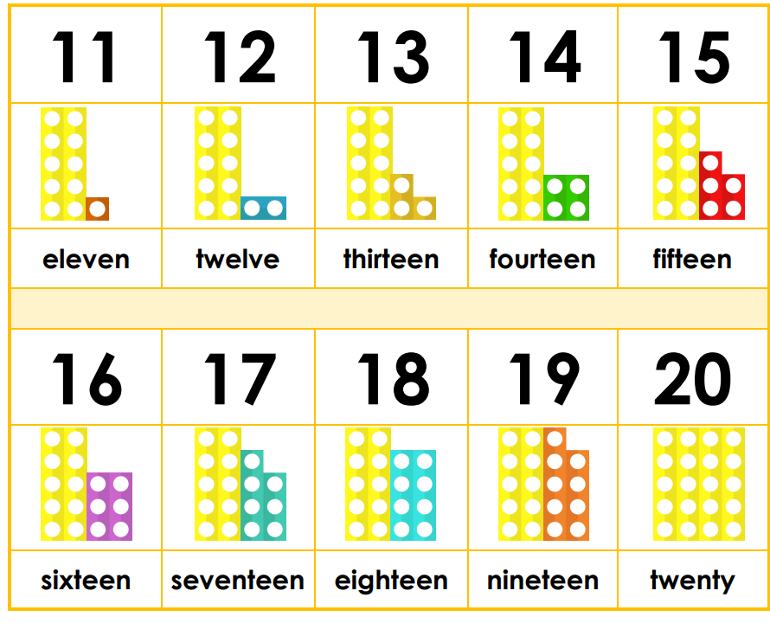
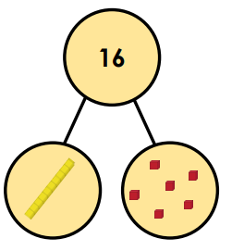
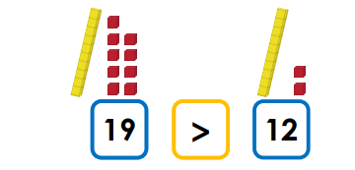
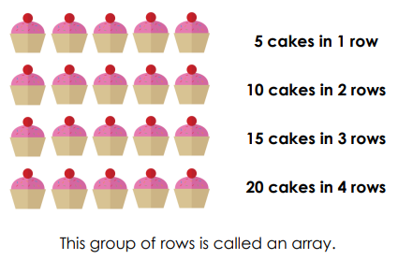
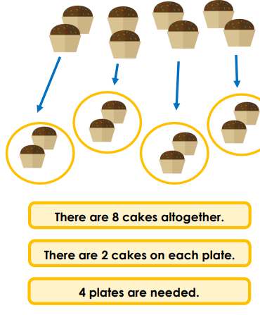

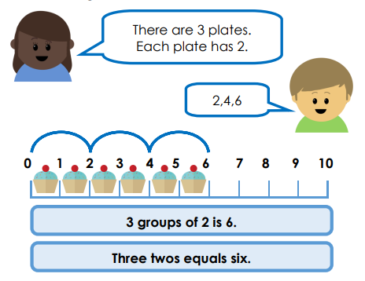
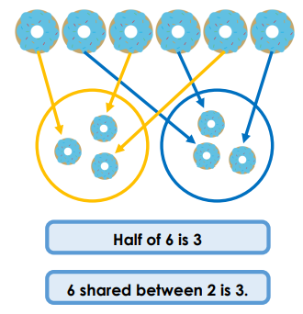
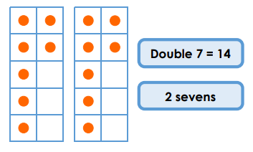



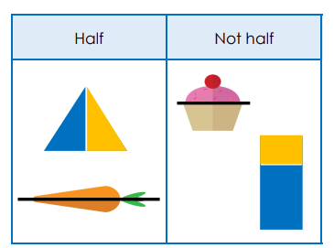

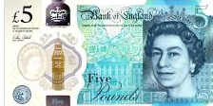
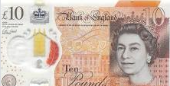
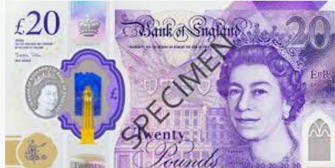
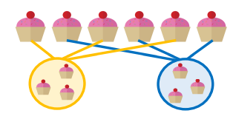
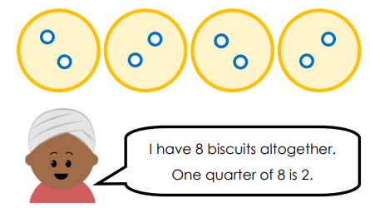
Year 1 Mathematics - Summer
Place Value
I will recognise, represent, partition, read and write numbers to 100.
I will use the symbols < and > > to compare numbers.
< = less than
> = greater than
Multiplication and Division
Solve one-step problems involving multiplication and division, by calculating the answer using concrete objects, pictorial representations and arrays with support
Fractions
Recognise, find and name a half as one of two equal parts of an object, shape or quantity. Recognise, find and name a quarter as one of four equal parts of an object, shape or quantity.
Money
.
Recognise and know the value of different denominations of coins and notes.
Which show one quarter?

Slide 8

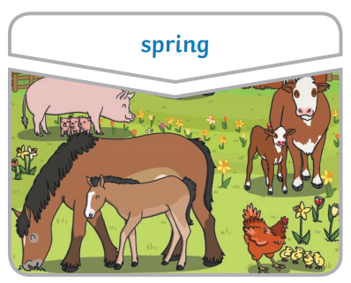
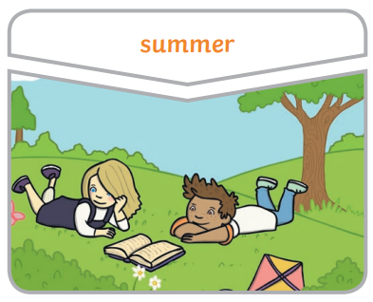
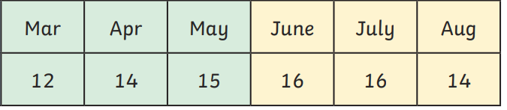
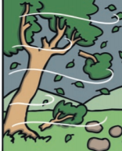

Year 1 Science Knowledge Organiser
Seasonal Changes: Spring and Summer
Key vocabulary
seasons: The 4 seasons are autumn, winter, spring and summer. spring : The weather starts to get warmer and plants start to grow. Baby animals can be seen. summer: The weather is hot. There are lots of flowers, bees, butterflies and birds. Tree branches are covered in leaves. environment: The place where you live. weather: The weather includes the temperature outside as well as wind, sun, rain, hail and snow. thermometer: A device used for measuring temperature. temperature: How hot or cold a place is.
I already know:
There are things in my environment which change through the year.
Key knowledge
March April May June July August Number of daylight hours in spring and summer.
I need to know:
I need to be able to observe changes across the four seasons. I need to observe and describe how the weather and the amount of daylight changes in each season.
Links with the world around us:
This will help me to know what clothes to wear and what activities I can enjoy outside in each season.
In the spring the temperature
starts to get warmer but it can still be rainy.
In the summer the sun is much hotter. This is the warmest season.

Slide 9







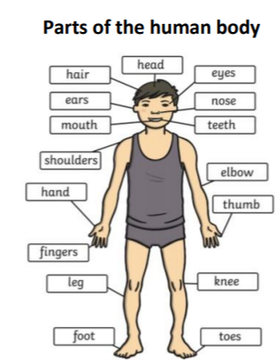

Year 1 Science Knowledge Organiser
Animals, including humans
Key vocabulary
mammal: Animals which grow hair or fur and feed on mother’s milk as a baby. amphibian: Animals which don't have hair, scales or feathers and can live on water and in land. reptile: Animals which have scales and are cold blooded. fish: Animals which live in the water. The have fins to help them to swim. bird: Animals which have feathers and wings. carnivore: Animals which eat meat. herbivore: Animals which eat plants. omnivore: Animals which eat meat and plants. touch: Your skin lets you know if things are hot, cold, rough or smooth. taste: Your tongue tells you if food tastes bitter, salty, sour or sweet. smell: Your nose tells you if things smell nice or not. sight: Your eyes let you see things. hear: Your ears listen to the sounds around you.
I already know:
Animals change as they grow. All animals look and act differently.
Key knowledge
mammals amphibian reptile fish bird
I need to know:
I need to identify and name common mammals, fish, birds, reptiles and amphibians. I need to recognise some animals which are carnivores, herbivores and omnivores and know what they eat. I need to identify and label parts of the human body and know about the five senses.
Links with the world around us:
This will help me to know more about animals and understand how I can take care of them to keep them healthy.

Slide 10

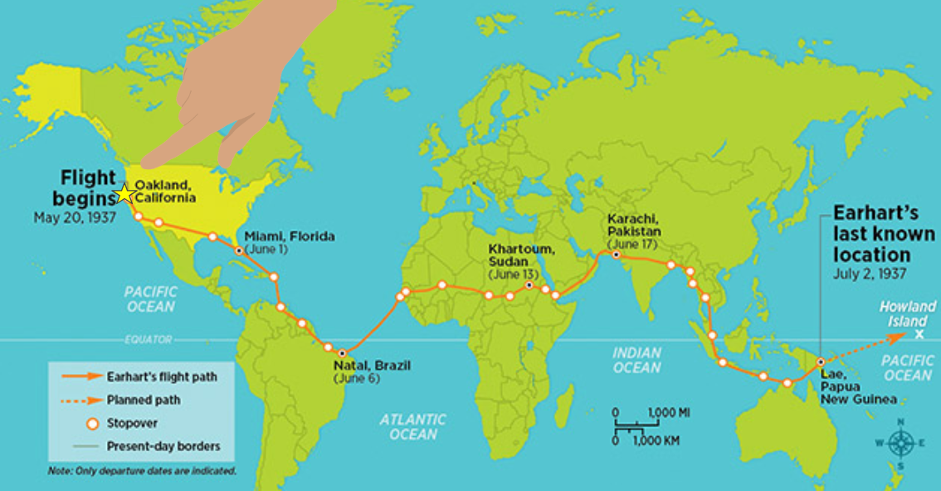
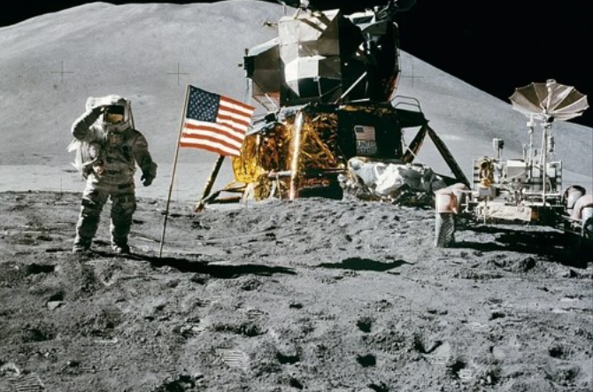
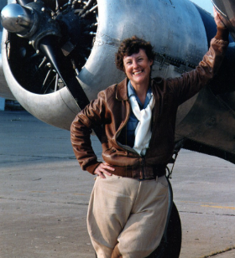
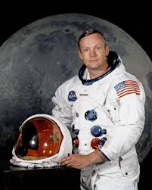
Year 1 History Knowledge Organiser
Significant People: Great Explorers
Enquiry Question
Is it always important for people to explore our world and beyond?
Key Historical Threads
Societal Change Invention
Key Vocabulary
astronaut: a person who goes into space commander: person in charge explorer: person who sets out to discover a new or unfamiliar area navigator: a person who directs a vehicle and uses maps to find out where to go orbit: to go around pilot: a person who flies a plane or a spacecraft voyage: a long journey involving travel by sea or space
What will I know by the end of the unit?
I will find out about Neil Armstrong’s landing on the moon and the impact this had on the world. I will learn about Amelia Earhart’s journey and why it was important at the time and beyond. I will be able to compare the lives and achievements of Earhart and Armstrong.
Amelia Earhart attempted an around-the-world flight in 1937.
Key Knowledge
Amelia Earhart and Neil Armstrong are two significant explorers from the 20th century. Their achievements in exploration are still talked about as two of the greatest the world has ever seen. Neil was the first man to walk on the moon and Amelia was the first woman to fly solo across the Atlantic ocean.
Neil Armstrong becomes the first human to step on the moon in 1969.

Slide 11


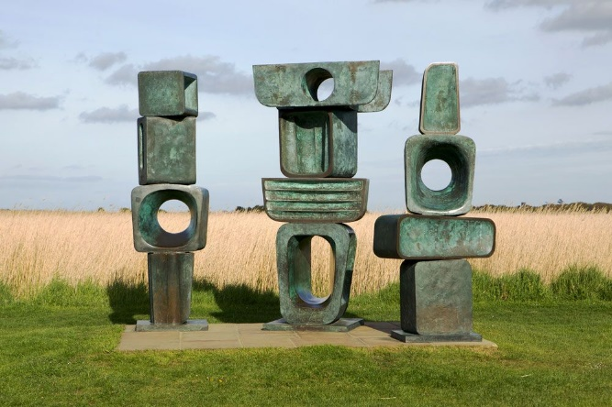
Art Knowledge Organiser: Year 1 Sculpture
I will begin to experiment with techniques.
Artist Focus: Barbara Hepworth
Barbara Hepworth is a British artist, known for her curved and pierced abstract forms. Her sculptures are often found in rural landscapes throughout Britain especially in St Ives and her hometown of Wakefield where there is a dedicated gallery called The Hepworth Wakefield.
During my art lessons I will:
Use tools to create patterns and texture.
Use clay imaginatively.
Roll clay evenly.
Use materials from nature to create art.
Join materials in a variety of ways.
Vocabulary | Definition
sculpture | The art of making a 2D OR 3D object by carving stone or wood or by casting metal or plaster.
land art | Art made in the landscape by sculpting the land itself or by making structures using a variety of materials.
form | The shape of something.

Slide 12
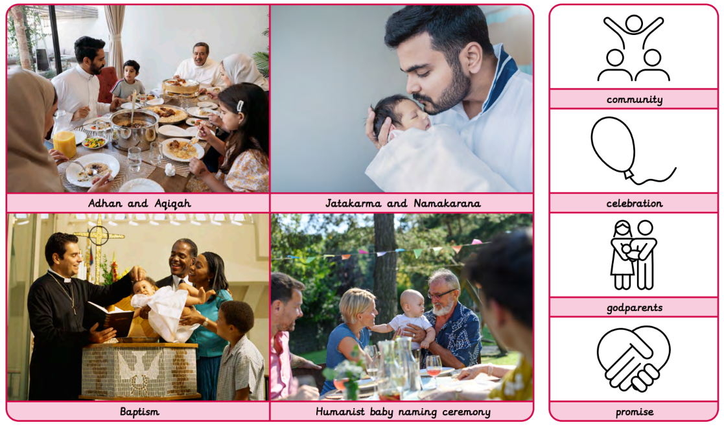

Slide 13

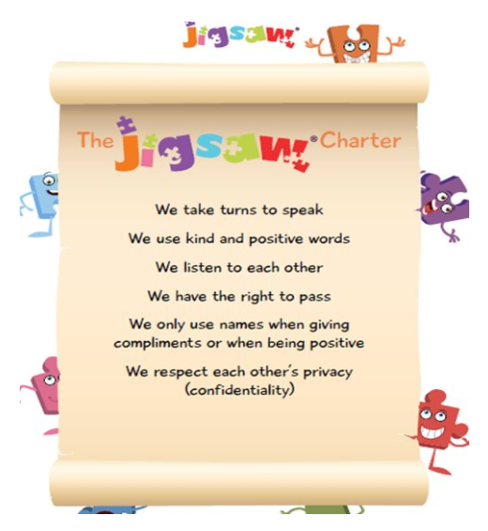
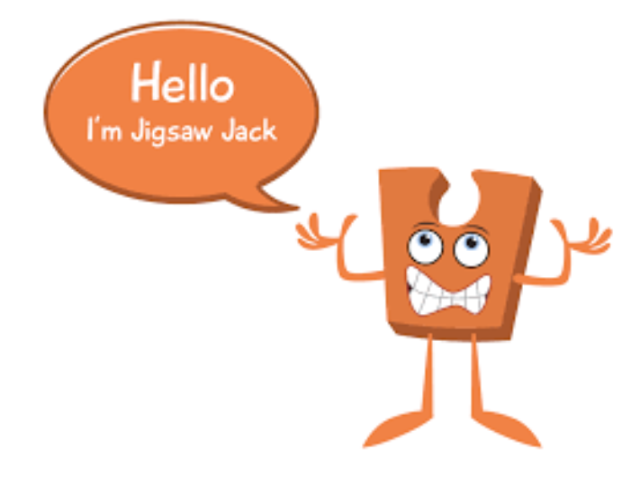
Year 1 Jigsaw Unit 5 Relationships
I will learn to… | Next I will learn to…
I can identify the members of my family and understand there are lots of different types of families. | I understand there are lots of forms of physical contact within a family and some of this is acceptable and some is not.
I know appropriate ways of physical contact to greet my friends and know which ways I prefer. | I understand sometimes it is good to keep a secret and sometimes it is not.
I know who can help me in my school community. | I recognise and appreciate people who can help me in my family, my school and my community.
I will understand this vocabulary…
family | A family is a group of people who are related or have a close relationship with each other.
belong | To feel comfortable and happy in a particular situation or with a particular group of people.
friend | A person you know well and like, and who is not usually a member of your family.
caring | When you are kind, helpful and show you care about other people.
hug | To put your arms around somebody and hold them tightly, especially to show that you like or love them.
touch | To put your hand or another part of your body on to somebody or something.
secret | Known about by only a few people; kept and hidden from others.
like/ dislike | Someone’s opinion whether they like something or not.
I can answer these reflective questions…
Can someone still be a part of your family but not live at your house?
Who is a friend?
Can you say what you like and dislike?

Slide 14

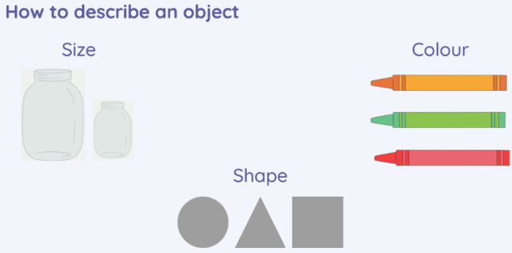
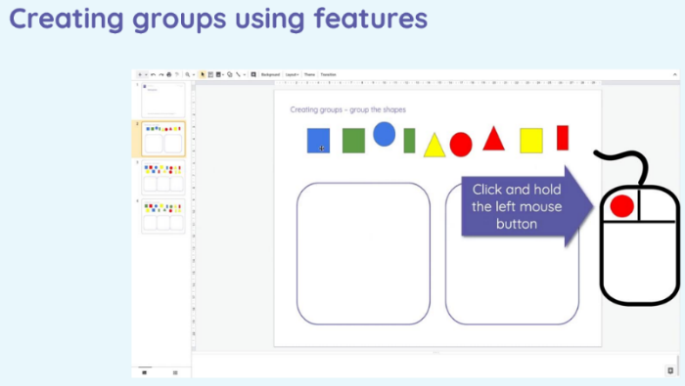
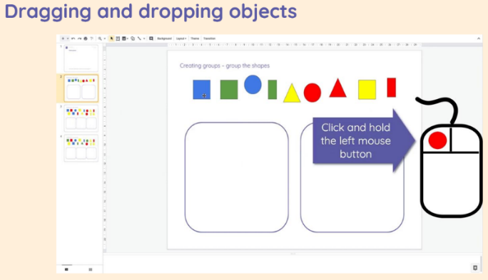
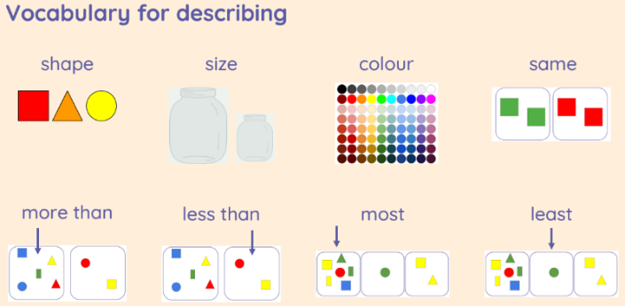
Year 1 Computing Knowledge Organiser: Grouping Data
What should I already know?
how to log on to a computer
how to use a keyboard and mouse
how to save work in a folder
What will I learn?
I will learn how to use labels to put objects into groups
I will learn how to count a small number of objects, before and after objects are grouped
I will learn how to sort objects into different groups, based on their properties
I will learn how to sort objects into different groups and answer questions about data.
Key Vocabulary
data | data is information and can be numbers, words or figures
labels | labels are used to place next to a group of objects
sort | to organise into groups
describing objects
Creating groups and sorting objects

Slide 15
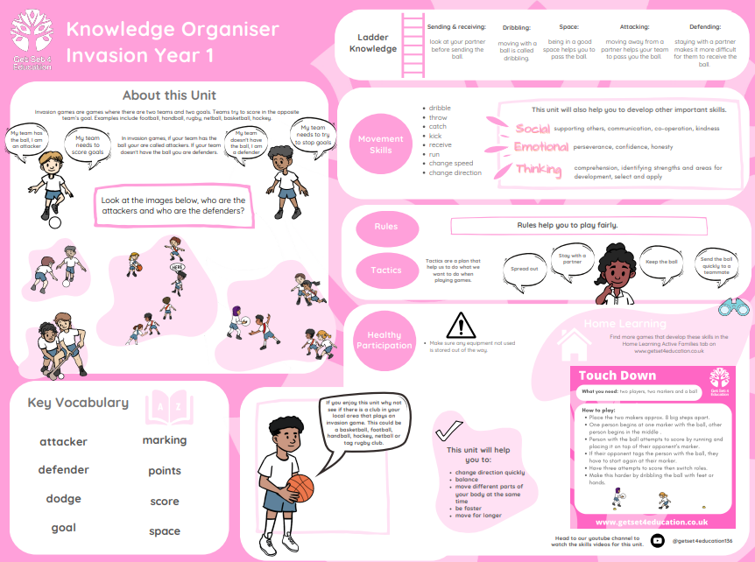

Slide 16
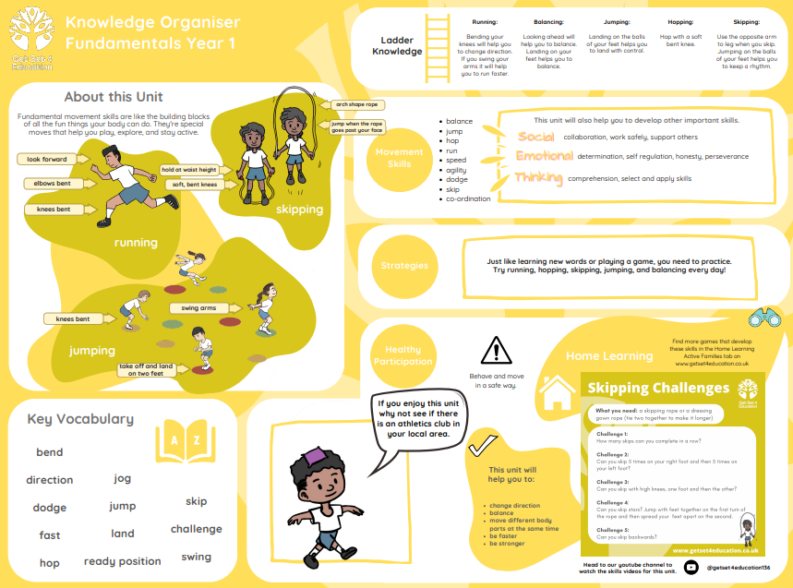

Slide 17
