Slide 1

Year 2 Curriculum
Summer 1 2024 - 2025

Slide 2
Swallowdale Curriculum
Dear Families,
This booklet contains the Long Term Plan, information for English, maths and the knowledge organisers which outline the units of work that your child will be covering in our wider curriculum this half term. These will show you the main elements of learning for your child and we hope you find them useful.
Please note that history and geography, art, and design and technology are taught in alternate half terms.
To support your child’s learning at home please read with them regularly and sign your child’s reading diary.
More information about our curriculum can be found on the school’s website.
Thank you for your support.

Slide 3
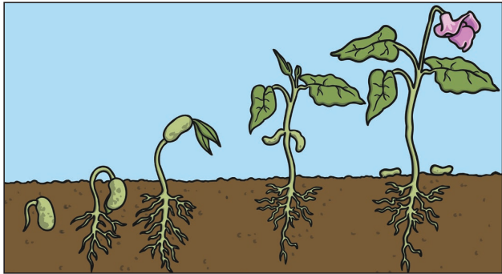




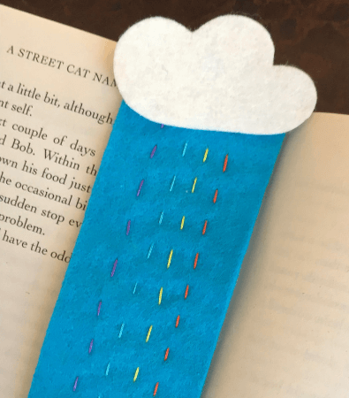
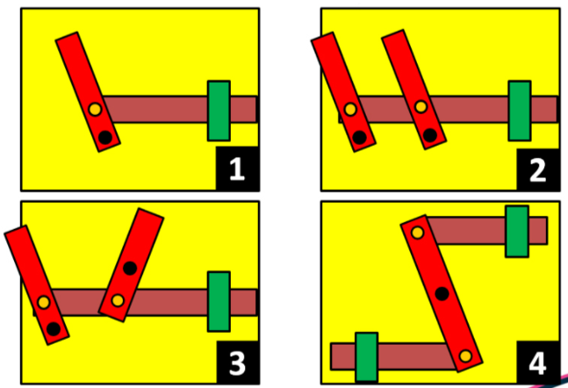
Year 2 Long Term Plan 2024 – 2025
 | Autumn 1 | Autumn 2 | Spring 1 | Spring 2 | Summer 1 | Summer 2
English | Phonics / Spelling Reading Writing including grammar and punctuation | Phonics / Spelling Reading Writing including grammar and punctuation | Phonics / Spelling Reading Writing including grammar and punctuation | Phonics / Spelling Reading Writing including grammar and punctuation | Phonics / Spelling Reading Writing including grammar and punctuation | Phonics / Spelling Reading Writing including grammar and punctuation
Maths | Place Value Addition Subtraction | Multiplication Division Money | Multiplication Division Fractions | Shape Time Length and Height | Mass, Capacity and Temperature Position and Direction | Statistics Problem Solving
Science | Animals, including humans ​ | Materials​ | Living things and their habitats​ | ​Living things and their habitats​ | ​Plants​ | ​Plants​
History and Geography | Seas and Oceans | The Great Fire of London | Seven Continents | Queens that Shaped Britain | Significant People: Mary Seacole and Florence Nightingale | Hot and Cold Places
Art and Design and Technology | Drawing: David Hockney | Food and Nutrition: Bread | Painting: Sir Frank Bowling | Mechanisms: Moving Monster | Print Making: Angela Harding | Textiles: Book Mark
Religion and Worldviews | Why do we need to give thanks? | What do candles mean to people? | How do we know some people have a special connection to God? | What is a prophet? | How do some people talk to God? | Where do some people talk to God?
PSHE | Being Me In My World | Celebrating Difference | Healthy Me | Staying Safe | Relationships | Changing Me
Computing | IT Around Us | Digital Writing | Robot Algorithms | Pictograms | Digital Photography | Programming Quizzes
Physical Education | Fundamentals / Dance | Yoga / Ball Skills | Team Building / Gymnastics | Sending and Receiving / Tennis | Striking and Fielding / Invasion Games | Target Games / Athletics
Music | Pulse, Rhythm and Pitch | Playing in an Orchestra | Inventing a Musical Story | Recognising Different Sounds | Exploring Improvisation | Our Big Concert

Slide 4
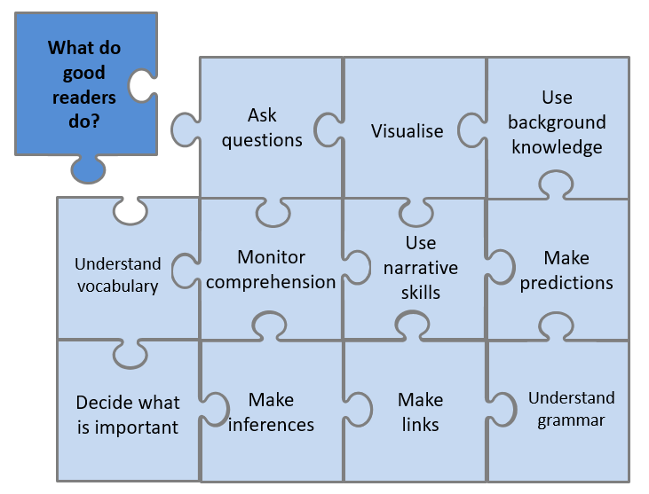



Year 2 English Reading
Reading Lessons
The skills from our school jigsaw will be modelled and explored during my reading lessons.
I will practise reading aloud to develop my fluency and prosody. I will read a range of fiction, non-fiction and poetry each term. My reading work will be recorded in my reading journal.
Independent Reading
I will have a book linked to my reading level which I may read in school and at home. The reading level of my book is shown by the colour at the back or side of the book. My reading level is assessed at school using a Phonics/Benchmarking assessment and this will be checked throughout the year. My reading book should not be too tricky as this book is for me to read fluently and to understand what I have read so I can enjoy it. It is important that I reread the same book to improve fluency and comprehension. My reading at home should be recorded in my school reading diary each week and will count towards my reading champion reward.
Our Class Poetry Books
Reading for Pleasure - Our Class Book
We will share and discuss lots of different books this term but this is the book we will read together first.
It's the first day at PIRATE SCHOOL for Ziggy, Smudge, Carkella and Flo and they have lots of new things to contend with. Their head teacher is the scary Patagonia Clasterbotton and they have to take lessons include walking the plank and hand-to-hand fighting. When out on the pirate ship a storm blows up, resulting in the children having to rescue Patagonia when she's swept overboard, and they learn that really Patagonia is not so scary after all!

Slide 5
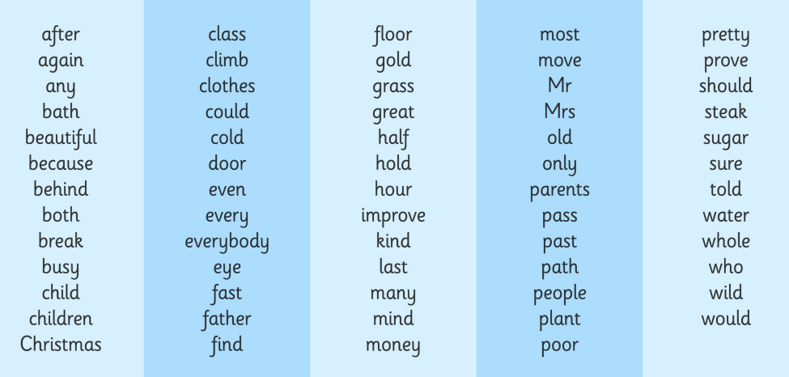
Common Exception Words for Year 2

Slide 6

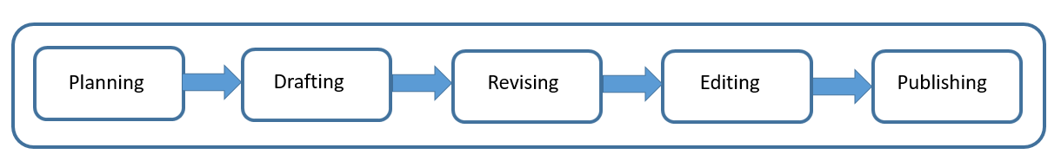
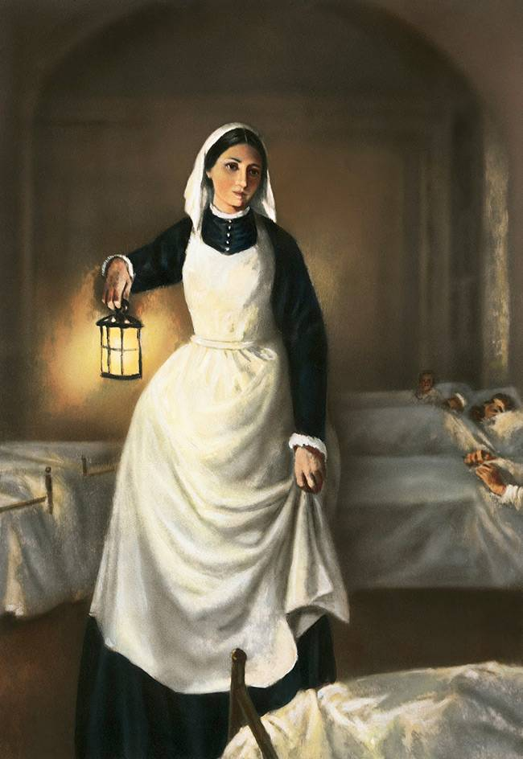
Year 2 English Writing
At Swallowdale, we follow a five-stage process for writing and in Y2 I will write for different purposes: to entertain and to inform.
Content to be taught and applied in writing this year
Word | Formation of nouns using suffixes such as –ness, –er and by compounding (e.g. whiteboard, superman) Formation of adjectives using suffixes such as –ful, –less Use of the suffixes –er, –est in adjectives Use of –ly in Standard English to turn adjectives into adverbs Correct use of homophones
Sentence | Subordination (using when, if, that, because) and co-ordination (using or, and, but) Expanded noun phrases for description and specification (e.g. the blue butterfly, the man in the moon) How the grammatical patterns in a sentence indicate its function as a statement, question, exclamation or command
Text | Correct choice and consistent use of present tense and past tense throughout writing Grouping of related ideas together in sections for non-fiction texts which begins to develop an awareness of paragraphs Use of the progressive form of verbs in the present and past tense to mark actions in progress (e.g. she is drumming, he was shouting]
Punctuation | Use of capital letters, full stops, question marks and exclamation marks to demarcate sentences Commas to separate items in a list Apostrophes to mark omission/contraction (e.g. don’t) Apostrophes to mark singular possession in nouns (e.g. the dog’s name]
Terminology | noun phrase, adverb, verb, conjunction, statement, question, exclamation, command tense (past, present) apostrophe, comma
Spelling
I will continue to use phonics in my spelling lessons and when I am writing. I will also learn the statutory common exception words for Y2.
What will I be writing?
I will be writing a report about Florence Nightingale. I will be learning to group information together in sections. I will be using coordinating and subordinating conjunctions to extend the details in sentences I write.

Slide 7
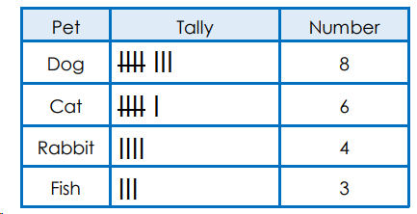
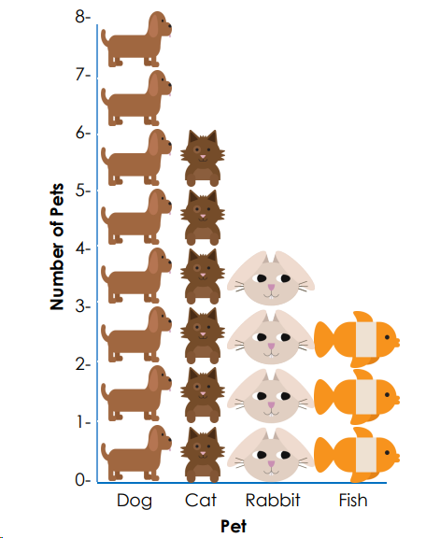
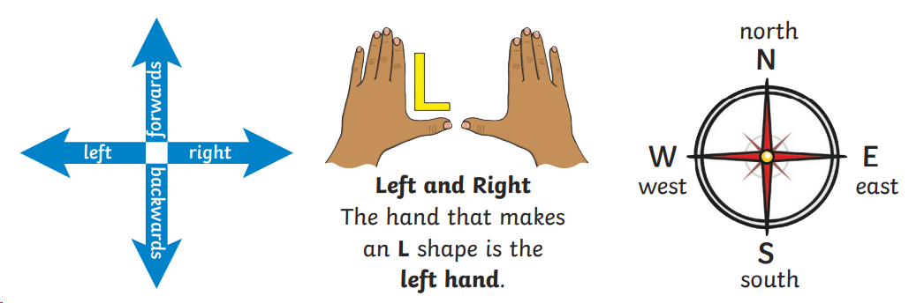
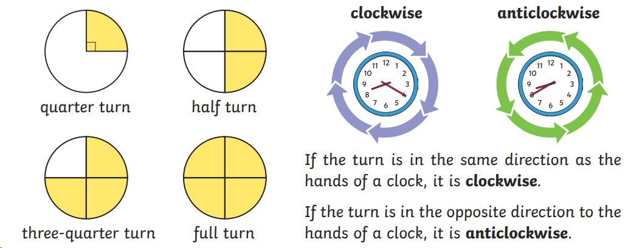
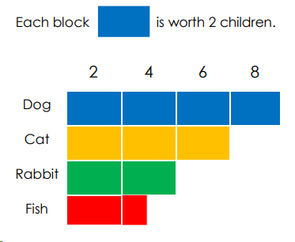
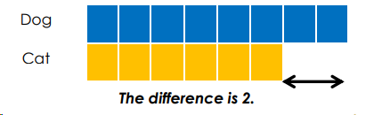
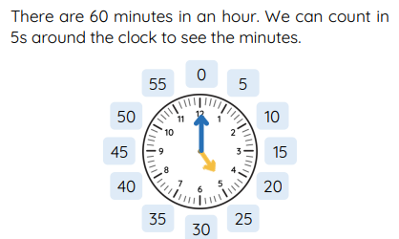
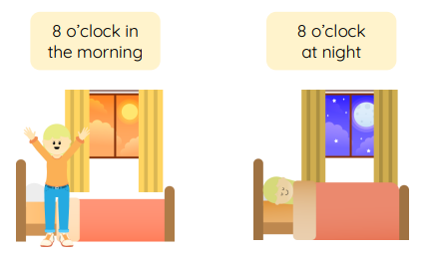

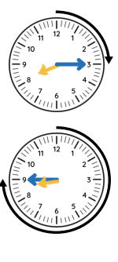


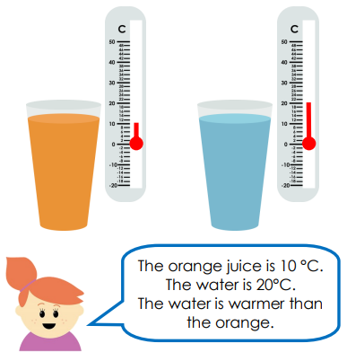
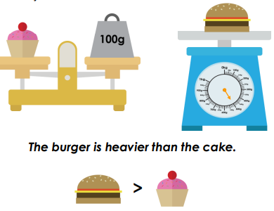
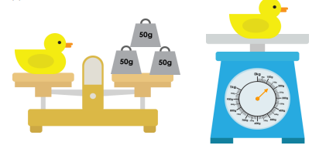

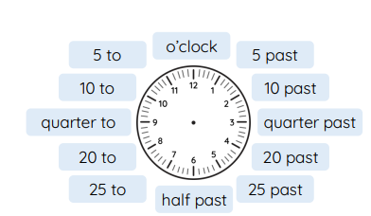

Year 2 Mathematics - Summer
Statistics
Interpret and construct simple pictograms, tally charts, block diagrams and simple tables. Ask and answer simple questions by counting the number of objects in each category and sorting the categories by quantity. tally chart
pictogram block graph
c
Cccccccccccccc comparing data
Position and direction
Describe movement which goes forwards, backwards, left and right. Describe ¼, ½, ¾ and full turns. Know turns can go clockwise and anti clockwise.
Time
Tell and write the time to five minutes, including quarter past / to the hour. Draw the hands on a clock face to show times. Know the number of minutes in an hour and the number of hours in a day. Compare and sequence intervals of time.
Measures
Choose and use appropriate standard units to estimate and measure length/height in any direction mass temperature capacity (litres/ml) to the nearest appropriate unit, using rulers, scales, thermometers and measuring vessels. Compare and order lengths, mass, volume/capacity and record the results using >, < and = .
There are 24 hours in a day.

Slide 8

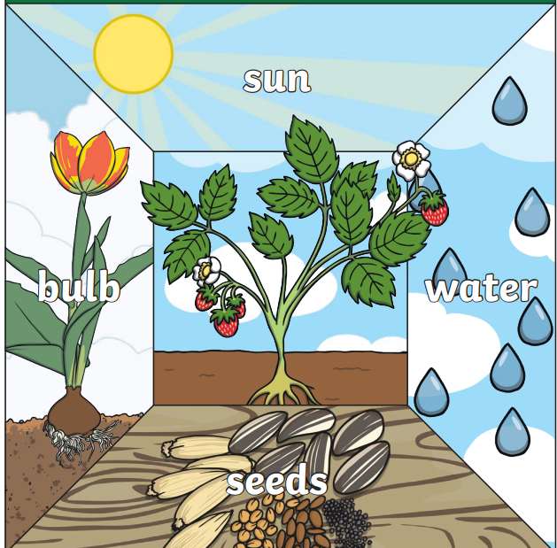
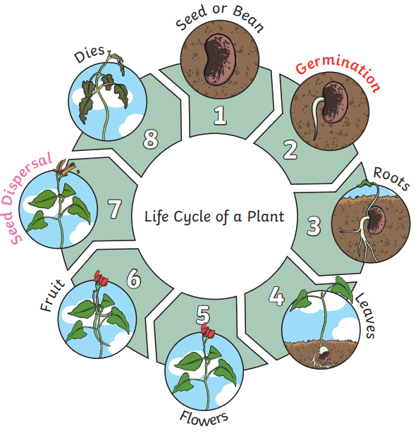
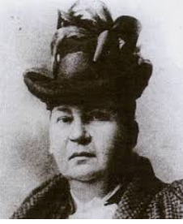
Year 2 Science Knowledge Organiser
Plants
Key vocabulary
sunlight: All plants need light from the sun to grow well. water: All plants need water. Without water they will not germinate. temperature: How warm or cold somewhere is. Different plants need different temperature to survive. nutrition: The food a plant needs to grow. Plants make their own food. germination: A seed soaks up water and swells. A new plant bursts out of the seed. shoot: A shoot grows upwards towards the sunlight. sprout: A plant grows new shoots. seed dispersal: Seeds move away from the parent plant. Gertrude Jekyll - a British horticulturalist (1842-1932) who designed more than 400 gardens around the world.
I already know:
Identify and name a variety of common wild and garden plants, including deciduous and evergreen trees. Identify and describe the basic structure of a variety of common flowering plants including trees.
Key knowledge
What seeds and bulbs need to grow Life cycle of a plant
I need to know:
Observe and describe how seeds and bulbs grow into mature plants. Find out and describe how plants need water, light and a suitable temperature to grow and stay healthy.
Key Scientist
Links with the world around us:
This learning will help me to look after plants in my environment and understand how new plants grow.

Slide 9

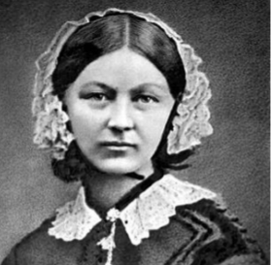
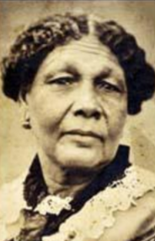
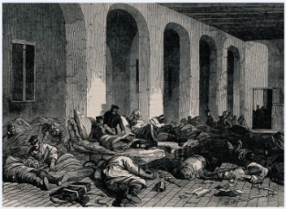
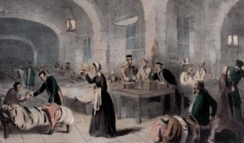
Year 2 History Knowledge Organiser
Significant People: Florence Nightingale and Mary Seacole
Enquiry Question
Why should we remember both Florence Nightingale and Mary Seacole?
Key Historical Threads
Invention Societal Change
Key Vocabulary
battlefront: the front line of a battle, where the action takes place conditions: how good or bad a place is disease: an illness caused by germs infection: an illness caused and spread by germs medicine: something you take to get better from an illness nurse: a person whose job is to care for people who are ill The Red Cross: a group of people who help those affected by war, flood or disease
Who are the significant people?
Florence Nightingale Mary Seacole
Key Knowledge
The Horrendous Hospitals The hospitals where they worked were not like ours today. There was not enough medicine to help the poorly people. Mary made her own herbal remedies. There were not enough beds for patients to sleep in. The food was not good quality so the people became more ill in hospital. What the nurses did They wanted to make the conditions in hospital better. They cleaned the hospitals from top to bottom. They made sure patients were served better food. Florence made sure all the nurses washed their hands thoroughly to help with sanitisation.
What will I know by the end of the unit?
I will discover who Mary Seacole was and why she is remembered today. I will discover who Florence Nightingale was and why she is remembered today, including what she did to improve the lives of the soldiers she cared for. I will explore how Florence Nightingale and Mary Seacole were similar and how they were different.
Timeline
1805 | 1820 | 1853 | 1854 |  | 1856 | 1860
Mary Seacole is born | Florence Nightingale is born | Florence Nightingale becomes a nurse and the Crimean War begins | Florence goes to nurse soldiers in the Crimean War | Mary Seacole pays for herself to travel to treat soldiers in the Crimean War | Crimean War ends and Mary Seacole returns to England | Florence Nightingale sets up her nursing school

Slide 10

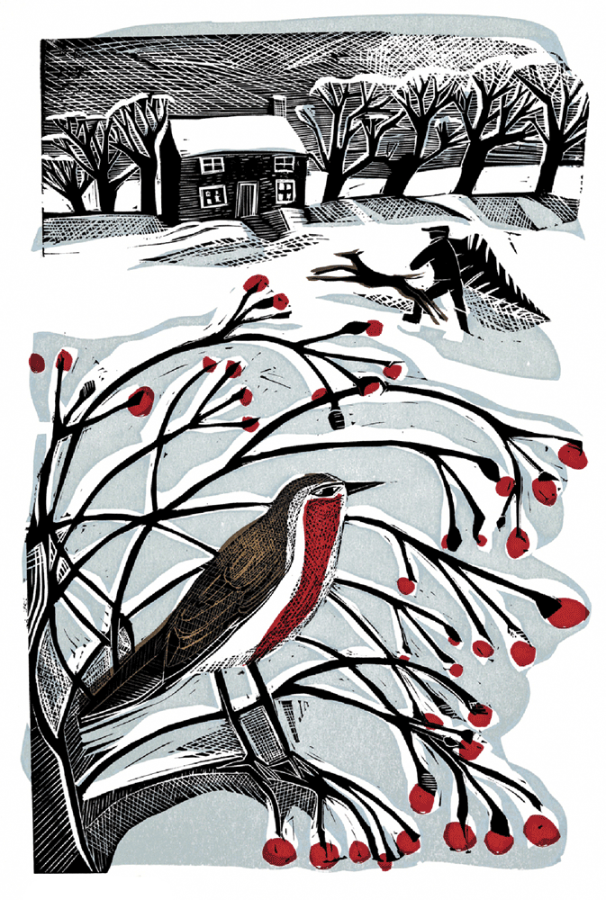
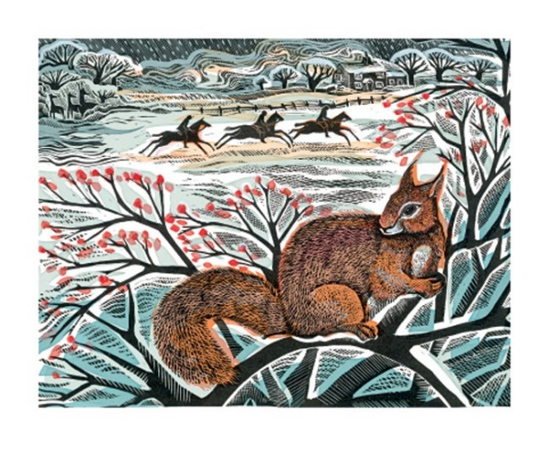
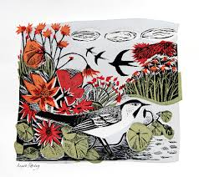
Art Knowledge Organiser: Year 2 Printing
I will begin to experiment with printing techniques.
During my art lessons I will:
Explore techniques such as repeating, overlapping, rotating and arranging shapes.
Make organised printing patterns by printing using found objects.
Use more than one colour in my printing.
Look at printed materials around us and in everyday use.
Artist Focus: Angela Harding
Angela Harding is a print maker from Rutland. She creates prints using a range of different print methods. The inspiration for Angela's work is nature and the British countryside.
Vocabulary | Definition
lino printing | Printing that involves carving a pattern or design into a linoleum, rubber or vinyl surface that can then be printed from.
print making | Imprinting (usually with paint or ink) an image onto paper.
comic strip | A collection of images that tell a story.

Slide 11
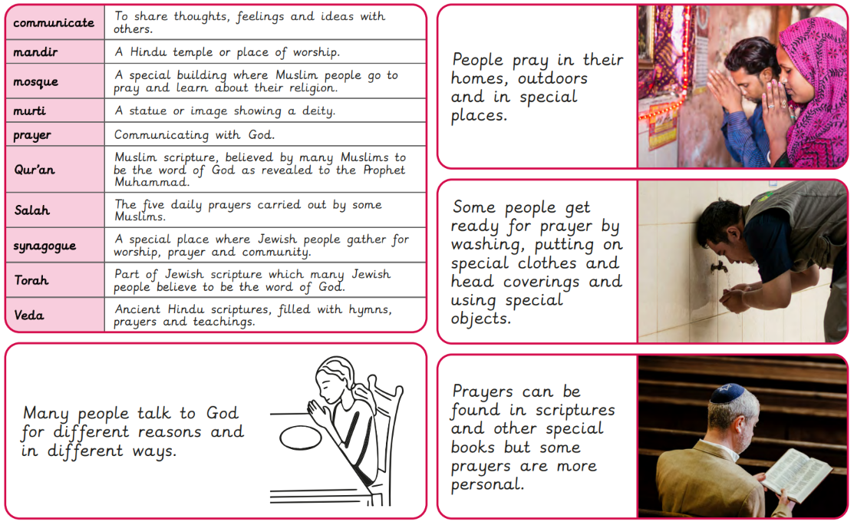

Slide 12

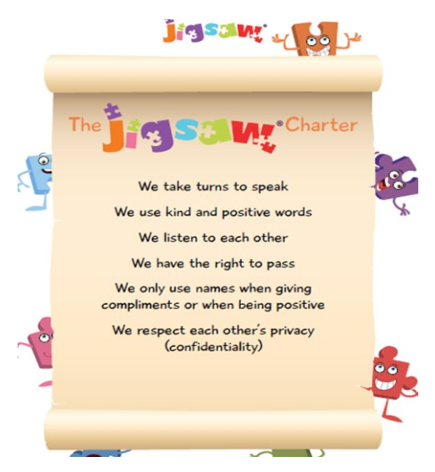
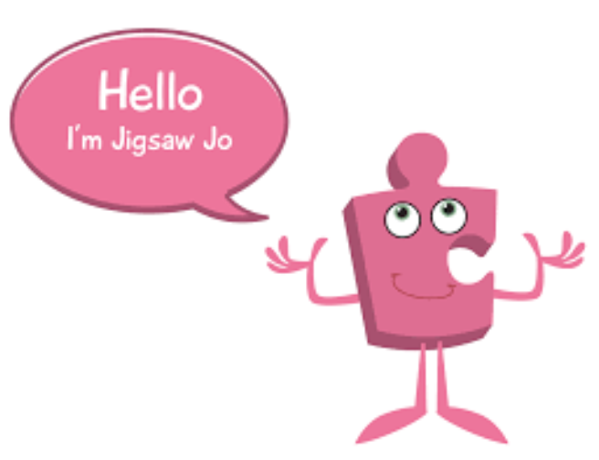
Year 2 Jigsaw Unit 5 Relationships
I have already learnt to… | Now I will learn to… | Next I will learn to…
I can identify the members of my family and understand there are lots of different types of families. | I understand there are lots of forms of physical contact within a family and some of this is acceptable and some is not. | I can identify the roles and responsibilities of each member of my family and can reflect on the expectations for males and females.
I know appropriate ways of physical contact to greet my friends and know which ways I prefer. | I understand sometimes it is good to keep a secret and sometimes it is not. | I know and can use some strategies for keeping myself safe.
I know who can help me in my school community. | I recognise and appreciate people who can help me in my family, my school and my community. | I understand how my needs and rights are shared by children around the world and can identify how our lives may be different.
I will understand this vocabulary…
family | A family is a group of people who are related or have a close relationship with each other.
relationship | A close connection between people.
special | More important than others.
touch | To put your hand or another part of your body on to somebody or something.
hug | To put your arms around somebody and hold them tightly, especially to show you like or love them.
friend | A person you know well and like, and who is not usually a member of your family.
secret | Known about by only a few people; kept hidden from others.
worry | To keep thinking about unpleasant things that might happen or about problems you have.
I can answer these reflective questions…
Who is special to you?
What kinds of touch do you like and why?
What sort of things cause friends to fall out sometimes and how can we resolve this?

Slide 13

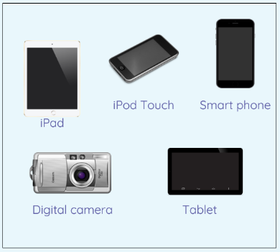

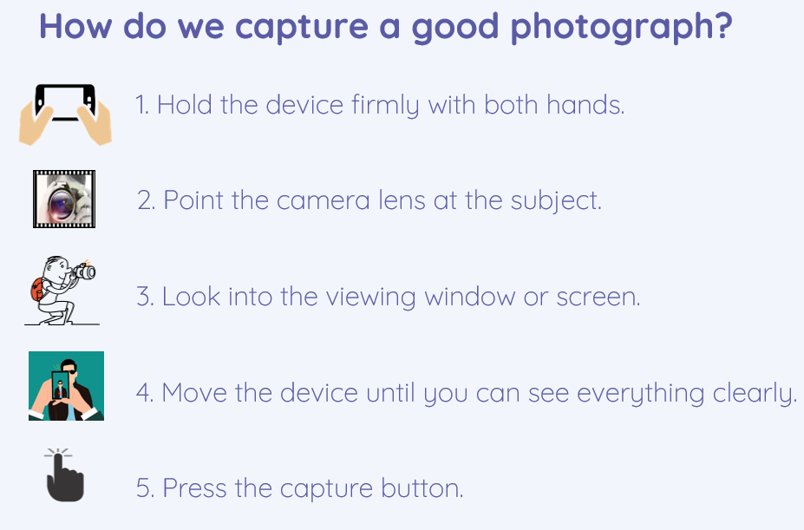
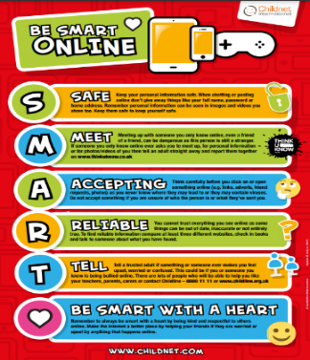
Year 2 Computing Knowledge Organiser: Digital Photography
What should I already know?
about different types of information technology and how they work with computers
What will I learn?
that different devices can be used to capture photographs
to capture, edit, and improve photos
to understand that images seen may not be real.
to use the software PIXLR.
Devices
There are a number of modern devices that can be used to take, store and edit digital images.
.
Key Vocabulary
digital | a digital device is an electronic device that can receive, store, process or send digital information
photograph | the word 'photo' comes from the Greek word for light, and when talking about photography it is used to describe a single image
editing | making changes to improve and correct
subject | who or what something is about
zoom | to make something larger or smaller
focusing | the moving of the lens elements until the sharpest possible image is achieved

Slide 14
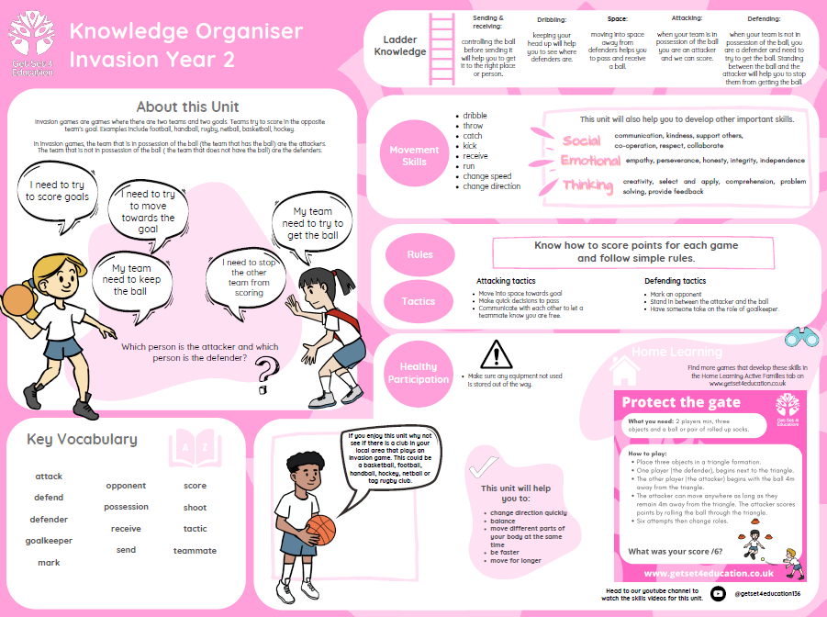

Slide 15
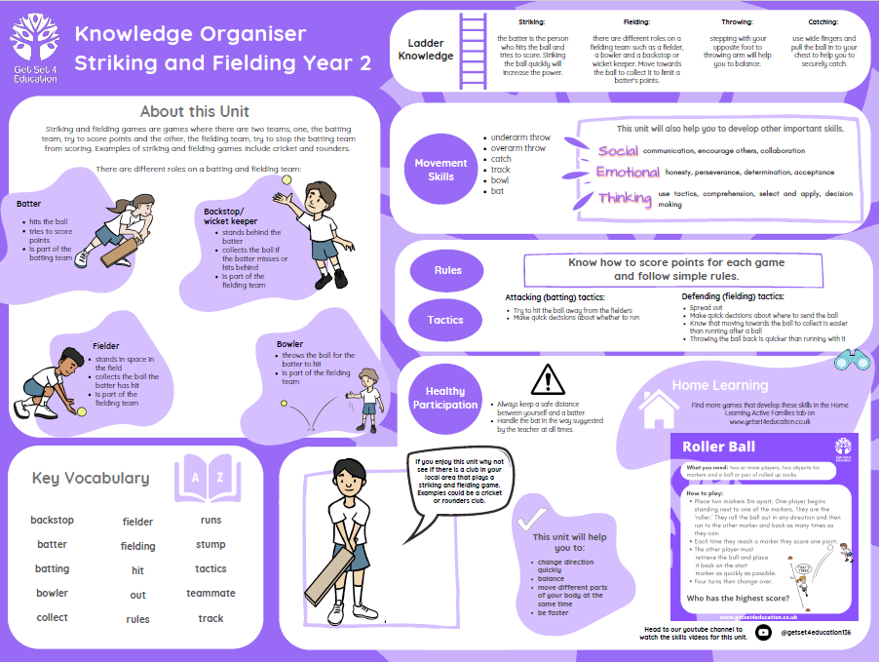

Slide 16
