Slide 1

Year 3 Curriculum
Summer 1 2024 - 2025

Slide 2
Swallowdale Curriculum
Dear Families,
This booklet contains the Long Term Plan, information for English, maths and the knowledge organisers which outline the units of work that your child will be covering in our wider curriculum this half term. These will show you the main elements of learning for your child and we hope you find them useful.
Please note that history and geography, art, and design and technology are taught in alternate half terms.
To support your child’s learning at home please read with them regularly and sign your child’s reading diary.
More information about our curriculum can be found on the school’s website.
Thank you for your support.

Slide 3
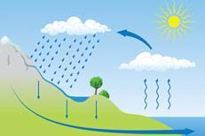
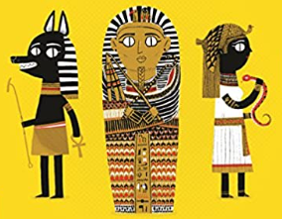




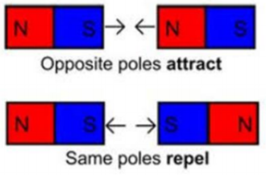
Year 3 Long Term Plan 2024 – 2025
 | Autumn 1 | Autumn 2 | Spring 1 | Spring 2 | Summer 1 | Summer 2
English | Reading Writing including grammar, spelling and punctuation | Reading Writing including grammar, spelling and punctuation | Reading Writing including grammar, spelling and punctuation | Reading Writing including grammar, spelling and punctuation | Reading Writing including grammar, spelling and punctuation | Reading Writing including grammar, spelling and punctuation
Maths | Place Value | Addition / Subtraction Money Measurement | Multiplication Division | Mass and Capacity Shape | Fractions Time | Fractions Statistics
Science | Animals, including humans​ | ​Animals, including humans​ | Forces and magnets​ | Rocks​ | ​Plants​ | ​​Light​
History and Geography | Stone Age to Iron Age | The UK Regions | Ancient Egypt | Water Cycle | Ancient Greece | Settlements
Art and Design and Technology | Drawing: Emma Fitzpatrick | Food and Nutrition: Eating Seasonally | Sculpture: Carole Peace | Construction: Castles | Painting: Van Gogh | Textiles: Cushions
Religion and Worldviews | What makes us human? | Where do morals come from? | Is scripture central to religion? | What happens if we do wrong? | Why is water symbolic? | Why is fire used ceremonially?
PSHE | Being Me In My World | Celebrating Difference | Healthy Me | Staying Safe | Relationships | Changing Me
Computing | Connecting Computers | Animation | Digital Writing | Branching Databases | Desktop Publishing | Events and Actions in Programs
Physical Education | Ball Skills / Fundamentals | Basketball / Yoga | OAA / Football | Dance / Tag Rugby | Athletics / Tennis | Gymnastics / Golf
Music | Writing Music | Playing in a Band | Compose Using Your Imagination | More Musical Styles | Enjoying Improvisation | Opening Night
French | Core Unit 1 |  | Core Unit 2 |  | Core Unit 3

Slide 4
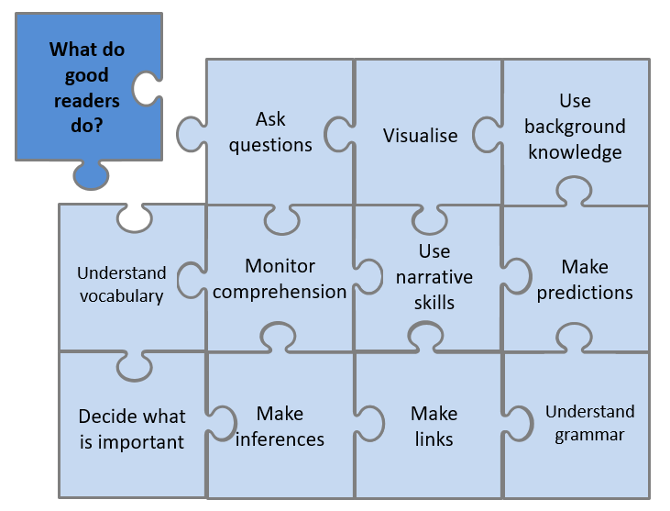



Year 3 English Reading
Reading Lessons
Using our school jigsaw, I will consider what good readers do in the moment of reading and after reading, and these skills will be modelled and practised during my lessons. I will practise reading aloud to develop my fluency and prosody. I will read a range of fiction, non-fiction and poetry each term. My reading work will be recorded in my reading journal.
Independent Reading
I will have a book linked to my reading level which I may read in school and at home. The reading level of my book is shown by the coloured dot at the back of the book. My reading level is assessed at school using a Benchmarking assessment and this will be checked throughout the year. My reading book should not be too tricky as this book is for me to read fluently and to understand what I have read so I can enjoy it.
I may also select a book from the class or school library. I should record my independent reading in my school reading diary each week and show my teacher.
Our Class Poetry Books
Reading for Pleasure - Our Class Book
When a goblin messenger arrives at The Nothing to See Here Hotel, announcing the imminent arrival of the goblin prince Grogbah, Frankie and his family rush into action to get ready for their important guest. But it soon becomes obvious that the Banister family are going to have their work cut out with the demanding prince and his never-ending entourage, especially when it turns out the rude little prince is hiding a secret...
This is the book we will read and discuss in class each day.

Slide 5
Statutory Spelling Words for Year 3 and Year 4
accident | business | eight | guide | medicine | possession | special
accidentally | calendar | enough | heard | mention | possible | straight
actual | caught | exercise | heart | minute | potatoes
actual | centre | experience | height | natural | pressure
actually | circle | experiment | history | naughty | probably
address | complete | extreme | imagine | notice | promise
answer | consider | famous | increase | occasion | purpose
appear | continue | favourite | important | occasionally | quarter
arrive | decide | February | interest | often | question
believe | describe | forward | island | opposite | recent
bicycle | different | forwards | knowledge | ordinary | regular
breath | difficult | fruit | learn | particular | reign
breathe | disappear | grammar | length | perhaps | remember
build | early | group | library | position | sentence
busy | earth | guard | material | possess | separate

Slide 6

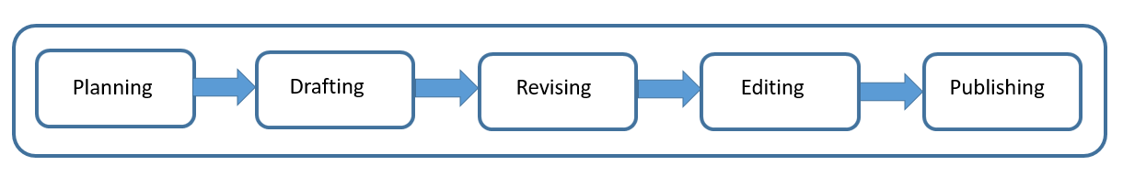
Year 3 English Writing
At Swallowdale, we follow a five-stage process for writing and in Y3 I will write for different purposes: to entertain, to inform, and to persuade.
Content to be taught and applied in writing this year
Word | Formation of nouns using a range of prefixes (e.g. super–, anti–, auto–) Use of the forms a or an according to whether the next word begins with a consonant or a vowel (e.g. a rock, an open box) Word families based on common words, showing how words are related in form and meaning (e.g. solve, solution, solver, dissolve) Correct use of more complex and near homophones Use of a wider range of subordinating conjunctions (e.g. when, if, although) Use of specific nouns for clarity (e.g. terrier not dog) Use of first/third person
Sentence | Expressing time, place and cause using conjunctions (e.g. when, before, after, while, so, because), adverbs (e.g. then, next, soon, therefore) and prepositions (e.g. before, after, during, in)
Text | Use of paragraphs as a way to group related material Use of headings and sub-headings to aid presentation Use of the present perfect form of verbs instead of the simple past (e.g. He has gone out to play. / He went out to play.)
Punctuation | Use of inverted commas to punctuate direct speech
Terminology | preposition, determiner, synonym word family, prefix, first/third person clause, subordinate clause, inverted commas , direct speech
Spelling
In year 3, we use Spelling Shed to build on our phonics knowledge and learn how to spell new words. I will also learn to read and spell the statutory words for LKS2.
What will I be writing?
With our class book as a spark, I will be learning to use persuasive techniques in my writing and will create a persuasive poster. I will also learn how to use quotes.

Slide 7
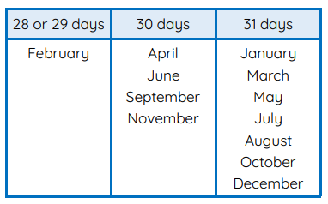

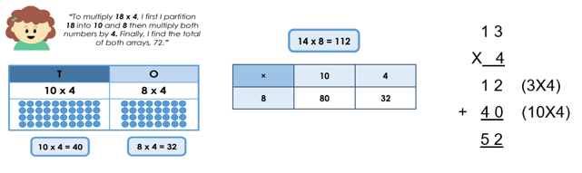

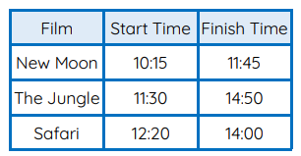
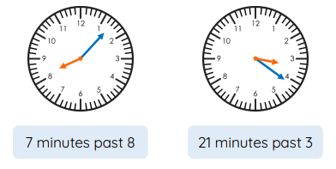
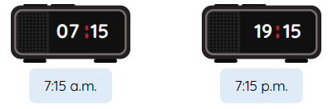
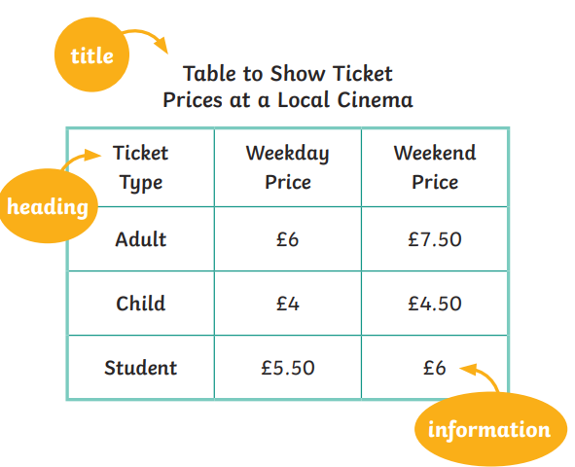
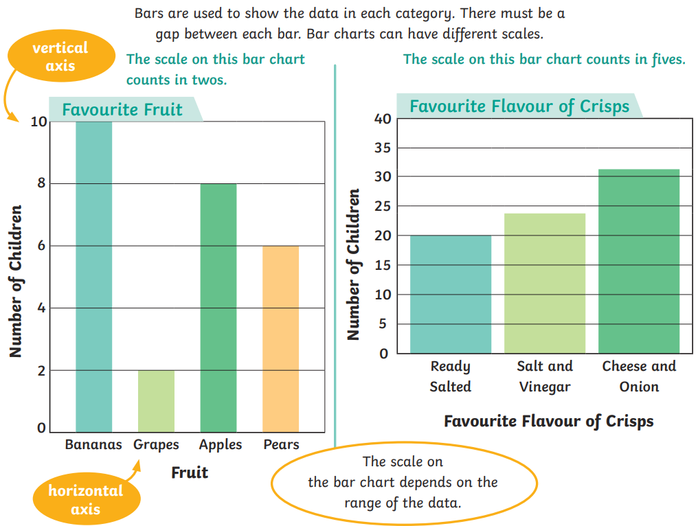
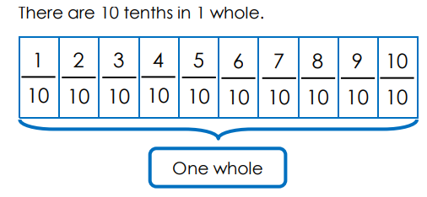
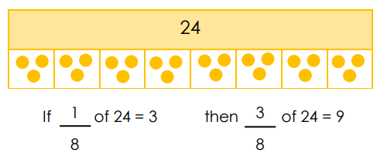
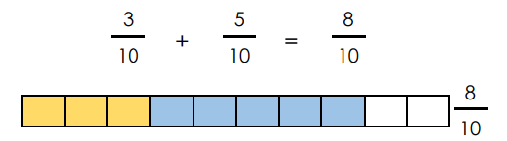
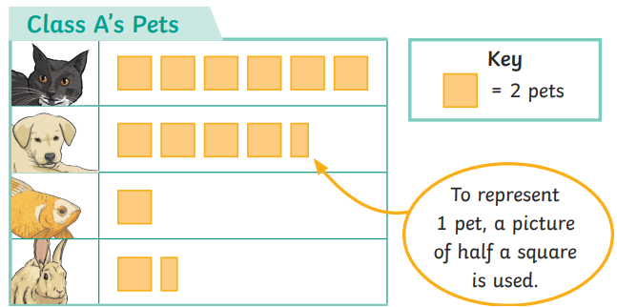
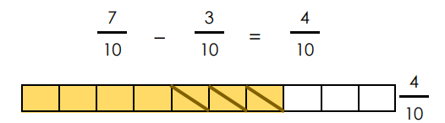

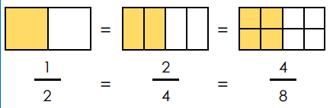
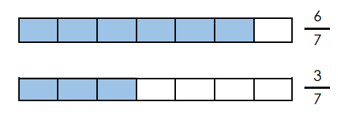

Year 3 Mathematics - Summer
Multiplication
Recall and use multiplication facts for the 2, 3, 4 and 5 multiplication tables.
Write and calculate mathematical statements for multiplication using the multiplication tables that they know, including for two-digit numbers times one-digit numbers using mental and progressing to formal written methods
Time
Tell and write the time from an analogue clock, including 12-hour and 24-hour clocks. Estimate and read time with increasing accuracy to the nearest minute; record and compare time in terms of seconds, minutes and hours. Know the number of seconds in a minute and the number of days in each month, year and leap year. Compare durations of events.
Fractions
Count up and down in tenths; recognise that tenths arise from dividing an object into 10 equal parts and in dividing one-digit numbers or quantities by 10.
Recognise and show, using diagrams, equivalent fractions with small denominators.
Add and subtract fractions with the same denominator within one whole.
Compare and order unit fractions, and fractions with the same denominators.
Statistics
To read and interpret bar charts, tables and pictograms.

Slide 8

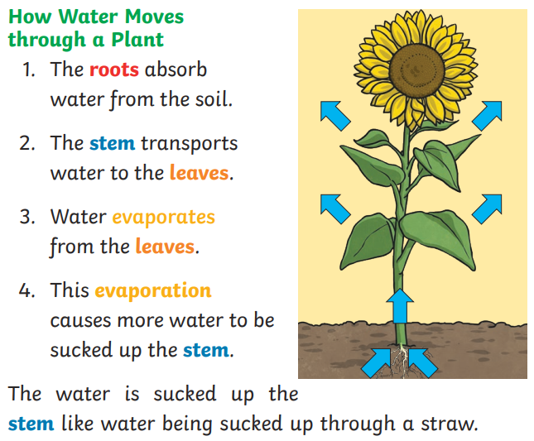
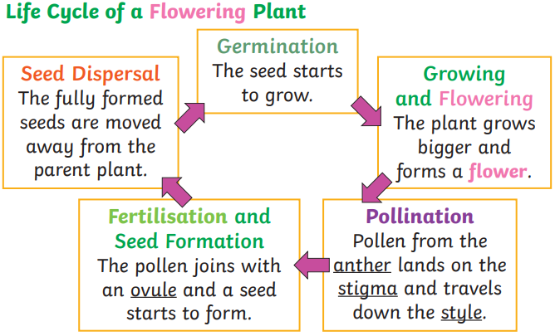
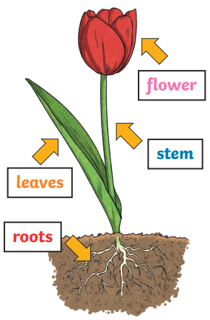
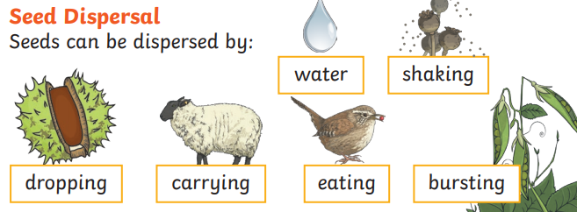
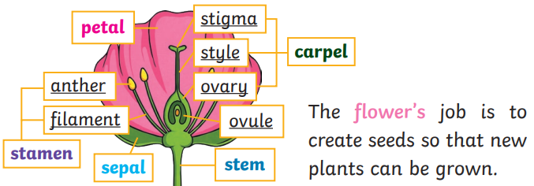
Year 3 Science Knowledge Organiser
Plants
What should I already know?
I can identify and name a variety of common wild and garden plants. I can describe the basic structure of a variety of common flowering plants including trees. I can talk about how seeds and bulbs grow into mature plants. I know that plants need water, light and the right temperature to grow and stay healthy
What will I know by the end of the unit?
Identify and describe the functions of different parts of flowering plants: roots, stem/trunk, leaves and flowers. Explore the requirements of plants for life and growth (air, light, water, nutrients from soil, and room to grow) and how they vary from plant to plant. Investigate the way in which water is transported within plants. Explore the part that flowers play in the life cycle of flowering plants, including pollination, seed formation and seed dispersal.
Key vocabulary
photosynthesis: The way in which plants make food in their leaves. pollen: A very fine powder that is produced by the male part of the flower. pollination: When pollen is transferred to females parts of the flower. seed formation: Seeds develop after pollination. They can be found in berries or fruits. seed dispersal: Moving seeds away from the parent plant. Animals, wind and water help this process. germination: When a seed starts to grow.

Slide 9

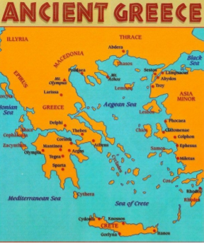
Year 3 History Knowledge Organiser
Ancient Greece
Enquiry Questions
Were all Ancient Greek societies the same?
Key Historical Threads
Settlement Empire Inventions Invasion
Key Vocabulary
ancient civilisation: the first settled and stable communities that became the basis for later states, nations, and empires Athens : a city-state in Ancient Greece which produced many writers and artists whose work has survived to this day citizens: people who belong to a place culture: a pattern of behaviour shared by a society, or group of people democracy: a system of government in which people choose who is in charge by voting in elections government: people who run a country Sparta: Sparta was a city-state in Ancient Greece that fought a long war against Athens
Key Knowledge
The Ancient Greeks were an ancient civilisation that began during the Bronze Age. Their legacy can be seen everywhere today, particularly in Western Europe. Ancient Greece was made up of separate city-states and conflict between them was frequent. Each city-state had their own leaders, laws and values. Greece is made up of a mainland and hundreds of small islands with a variety of different terrains.
What will I know by the end of the unit?
I can find out about every day life in Ancient Greece for men, women and children. I can use pictures of artefacts to make conclusions about Ancient Greece. I can compare the city-states of Athens and Sparta. I will name some key aspects that the Greek legacy has left behind for us today including democracy, language, architecture and art.
Timeline
2900-2000 BCE | 2500 BCE | 1200 BCE | 850 – 700 BCE | 776 BCE | 650 BCE | 600 BCE | 500 – 323 BCE | 490 BCE | 86 BCE
The Bronze Age when early Greek cultures start to emerge | The great Minoan civilisation | The Trojan War and the destruction of Troy | Development of the first alphabet | The first Olympic games staged | The rise of the Greek tyrants | Greek coin currency introduced | The Greek Classical period | The Greek/Persian wars led by Xerxes | The Roman general Sulla captures Athens

Slide 10

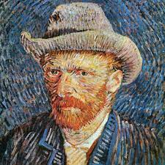
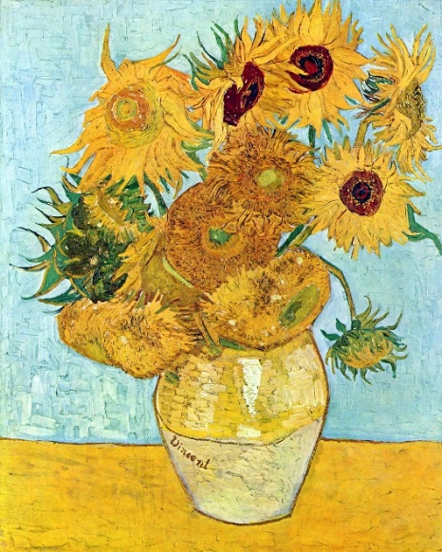
Art Knowledge Organiser: Year 3 Painting
I will begin to explore painting techniques.
During my art lessons I will:
Use a number of brush techniques with thin/thick brushes, to produce shapes, textures, patterns and lines.
Make notes in my sketchbook of how artists have used paint and techniques to produce pattern, colour, texture, tone, shape, space, form and line.
Look at and respond to the work of different artists.
Mix tertiary colours (mixing secondary colours).
Experiment with ways of applying paint and using techniques of other painters.
Artist Focus: Vincent Van Gough
Vincent Van Gough (1853–1890) was a Dutch artist who painted landscapes, portraits and still life using a colourful and impressionistic style. Even though Van Gough was not considered a good artist whilst he was alive, many people now think he is one of the greatest painters in the world and an important influence on modern art.
Vocabulary | Definition
Impressionism | A style of painting developed in France which aims to create an impression, rather than a photo realistic image, by using quick unblended brush strokes.
impasto | Using thick paint to create texture.
tertiary colours | Colours that are made by mixing secondary colours

Slide 11
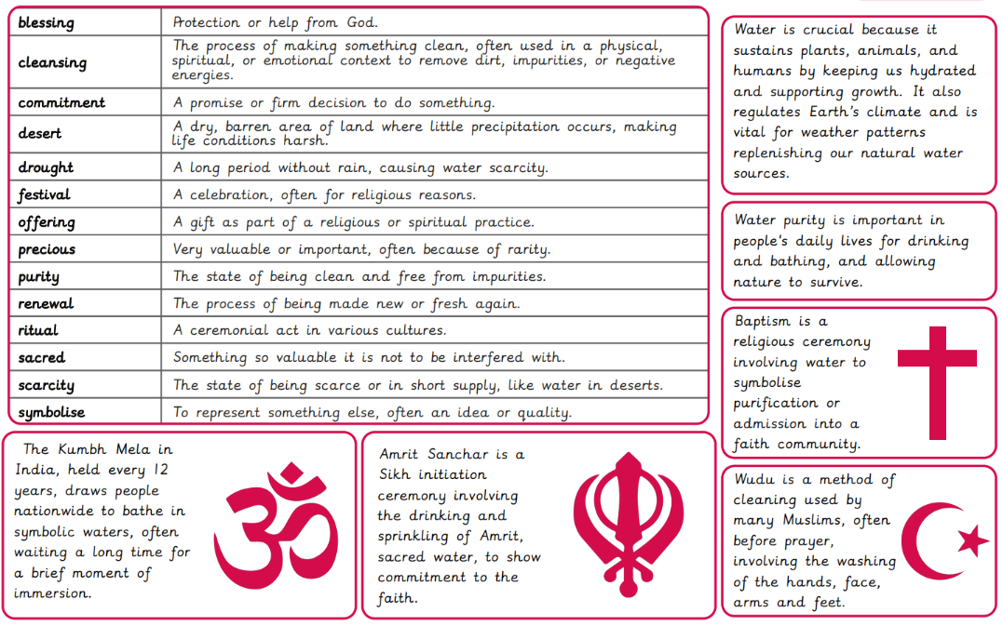

Slide 12

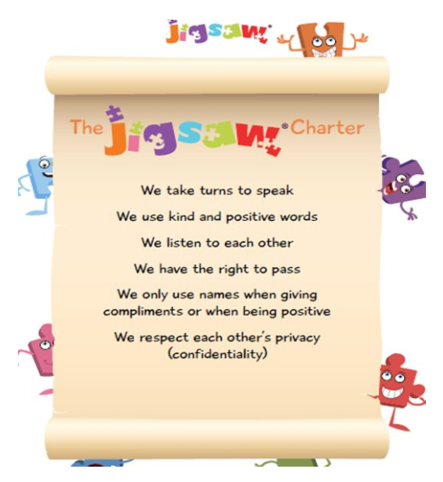
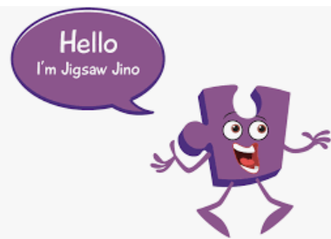
Year 3 Jigsaw Unit 5 Relationships
I have already learnt to… | Now I will learn to… | Next I will learn to…
I understand there are lots of forms of physical contact within a family and some of this is acceptable and some is not. | I can identify the roles and responsibilities of each member of my family and can reflect on the expectations for males and females. | I can identify the web of relationships I am proud of, starting from those closest to me and including those more distant.
I understand sometimes it is good to keep a secret and sometimes it is not. | I know and can use some strategies for keeping myself safe. | I can explain different points of view on an animal rights issue.
I recognise and appreciate people who can help me in my family, my school and my community. | I understand how my needs and rights are shared by children around the world and can identify how our lives may be different. | I know how to show love and appreciation to the people and animals who are special to me.
I will understand this vocabulary…
responsibilities | A duty to deal with or take care of somebody or something.
differences | The way in which two people or things are not like each other or differences of opinion.
conflict | A situation in which people, groups or countries disagree strongly or are involved in a serious argument.
solution | A way of solving a problem or dealing with a difficult situation.
unsafe | In danger of being harmed.
communications | Methods of sending information, especially phones, radio, computers
inequality | The unfair difference between groups of people in society, when some have more wealth, status or opportunities than others.
deprivation | The fact of not having something you need, like enough food, money or a home.
I can answer these reflective questions…
Are there some jobs only suitable for women and some for men? Why?
In what ways could you solve a problem?
Who will keep you safe and help you if you need it?

Slide 13

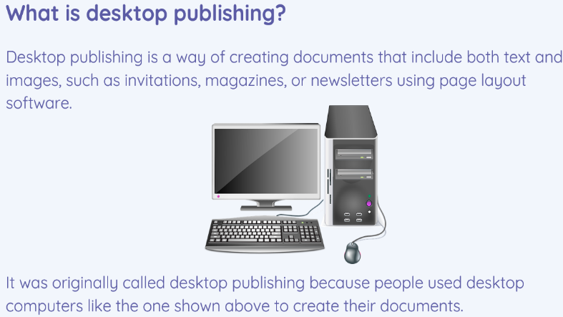
Year 3 Computing Knowledge Organiser: Desktop Publishing
What should I already know?
how to use a computer to create and edit text
more skilled at using a keyboard and mouse to enter and edit text
that different devices can be used to capture photographs and gained experience capturing, editing, and improving photos
recognise that images you see may not be real
What will I learn?
I will become familiar with the term ‘text’ and ‘images’ and understand that they can be used to communicate messages
I will use desktop publishing software and make careful choices about font size, colour and type to edit and improve premade documents
I will be introduced to the terms ‘templates’, ‘orientation’, and ‘placeholders’ and begin to understand how these can support you in making your own template for a magazine cover
I will start to add text and images to create your own pieces of work using desktop publishing software
I will look at a range of page layouts thinking carefully about the purpose of these and evaluate how and why desktop publishing is used in the real world
Key Vocabulary
text | the words you can see on screen
format | the ways images, text and objects are arranged on a screen
textbox | a box that you can input into a document and add words to
outline | a line you can add to a shape or text box
object | an object in publishing software can be a file, a chart or a spreadsheet for example
layout | the plan or design or arrangement of something laid out

Slide 14
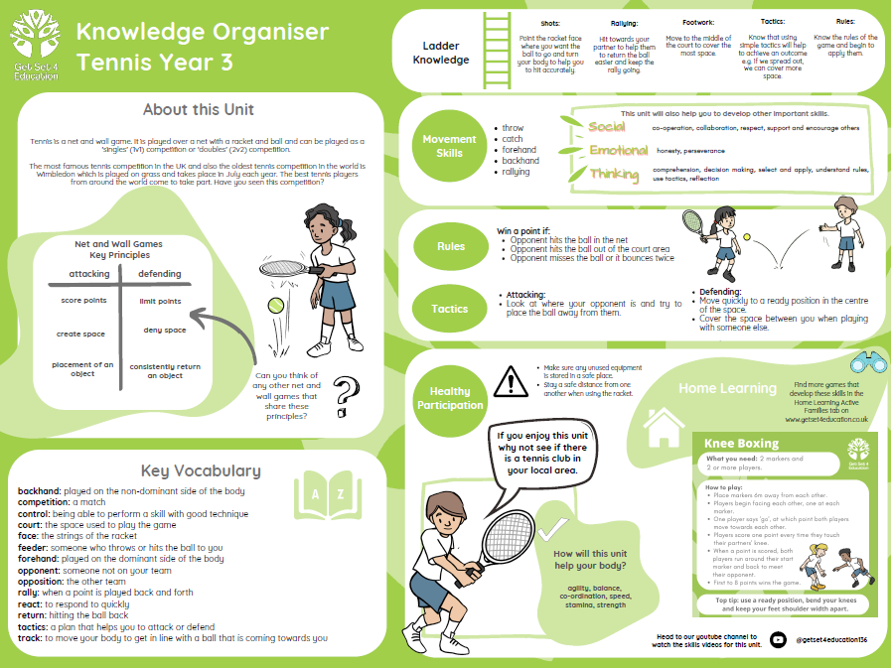

Slide 15
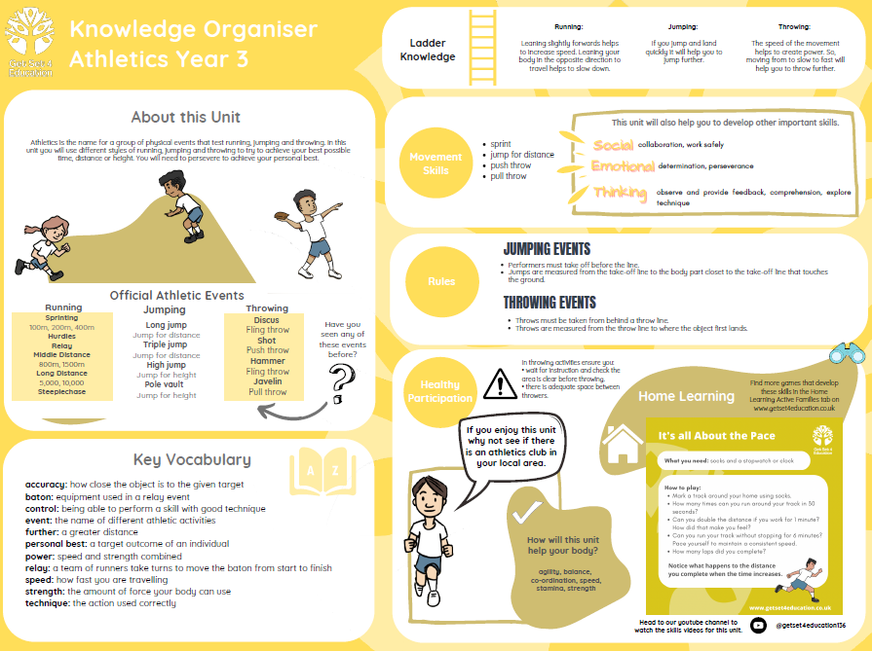

Slide 16
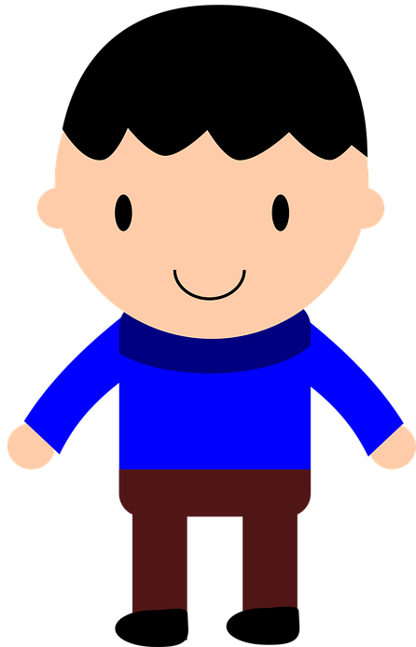
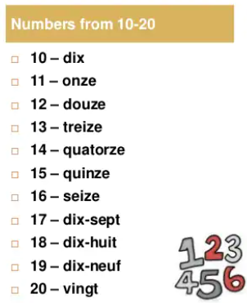
FRENCH KNOWLEDGE ORGANISER
Core Unit 3
Prior Learning
I will already know: French numbers up to 20 The song 'Head, Shoulders, Knees and Toes' The tune of 'Happy Birthday to You'
Key Vocabulary
Il a… | He has…
Ella a… | She has…
Key Learning
I will: Sing along and do the actions to a French song, with a visual aid. Recognise most of the French body parts when they’re spoken. Read the numbers 11-20 with some help. Say the name of the month I was born with some help.
la tête
les yeux
Grammar
Ce sont - they are Il y a - there is
le nez
la bouche
les oreilles
les épaules
les genoux
les pieds

Slide 17
