Slide 1

Year 4 Curriculum
Summer 1 2024 - 2025

Slide 2
Swallowdale Curriculum
Dear Families,
This booklet contains the Long Term Plan, information for English, maths and the knowledge organisers which outline the units of work that your child will be covering in our wider curriculum this half term. These will show you the main elements of learning for your child and we hope you find them useful.
Please note that history and geography, art, and design and technology are taught in alternate half terms.
To support your child’s learning at home please read with them regularly and sign your child’s reading diary.
More information about our curriculum can be found on the school’s website.
Thank you for your support.

Slide 3
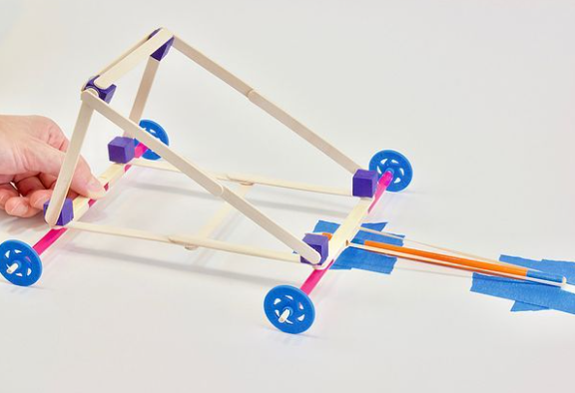
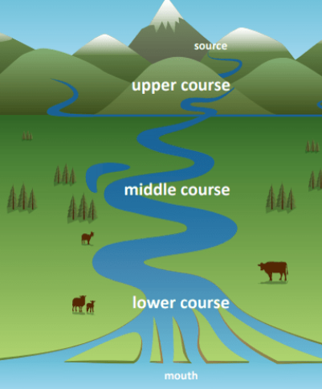

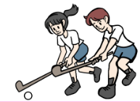


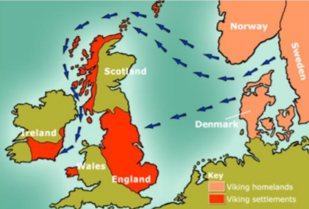
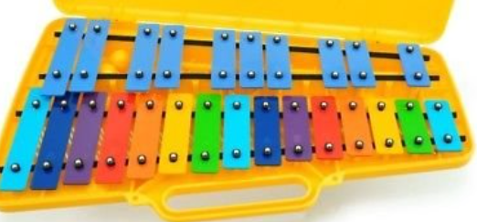
Year 4 Long Term Plan 2024 – 2025
 | Autumn 1 | Autumn 2 | Spring 1 | Spring 2 | Summer 1 | Summer 2
English | Reading Writing including grammar, spelling and punctuation | Reading Writing including grammar, spelling and punctuation | Reading Writing including grammar, spelling and punctuation | Reading Writing including grammar, spelling and punctuation | Reading Writing including grammar, spelling and punctuation | Reading Writing including grammar, spelling and punctuation
Maths | Place Value Addition Subtraction | Multiplication Division Length and Perimeter | Multiplication Division Area | Fractions Decimals Statistics | Money Time | Shape Position and Direction
Science | ​Living things and their habitats​ | ​Animals, including humans​ | ​Electricity​ | ​Sound​ | ​States of matter​ | ​States of matter​
History and Geography | Roman Britain | Rivers | Natural Resources | Anglo Saxons | Europe | Vikings
Art and Design and Technology | Drawing: Phlegm | Mechanisms: Slingshot Car | Collage: Danielle Vaughn | Construction: Pavilion | Painting: Pablo Picasso | Food and Nutrition: Biscuits
Religion and Worldviews | Are all religions equal? | What makes some texts sacred? | Just how important are our beliefs? | Who was Jesus? | Why is the bible the best-selling book of all time? | Does the language of scripture matter?
PSHE | Being Me In My World | Celebrating Difference | Healthy Me | Staying Safe | Relationships | Changing Me
Computing | The Internet | Audio Production | Repetition in Shapes | Photo editing | Data logging | Repetition in Games
Physical Education | Fitness / Tag Rugby | Dance / OAA | Swimming / Yoga | Swimming / Football | Cricket / Athletics | Tennis / Golf
Music | Musical Structures | Exploring Feelings When You Play | Compose With Your Friends | Feelings Through Music | Expression Through Improvisation | The Show Must Go On
French | People and Our Bodies |  | Where I Live |  | My School

Slide 4

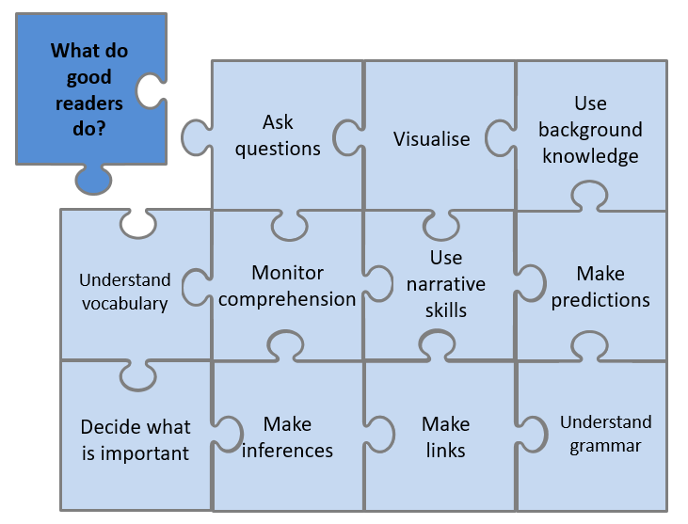


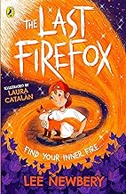
Year 4 English Reading
Reading Lessons
Using our school jigsaw, I will consider what good readers do in the moment of reading and after reading, and these skills will be modelled and practised during my lessons. I will practise reading aloud to develop my fluency and prosody. I will read a range of fiction, non-fiction and poetry each term. My reading work will be recorded in my reading journal.
Independent Reading
I will have a book linked to my reading level which I may read in school and at home. The reading level of my book is shown by the coloured dot at the back of the book. My reading level is assessed at school using a Benchmarking assessment and this will be checked throughout the year. My reading book should not be too tricky as this book is for me to read fluently and to understand what I have read so I can enjoy it.
I may also select a book from the class or school library. I should record my independent reading in my school reading diary each week and show my teacher.
Our Class Poetry Books
Reading for Pleasure - Our Class Book
This is the book we will read and discuss in class each day.
On Mondays, there will be a book quiz to help me remember the characters and plot of the story.
Between bullies at school and changes at home, Charlie Challinor finds life a bit scary. And when he's made guardian of a furry fox cub called Cadno, things get a whole lot scarier.
Because Cadno isn't just any fox: he's a firefox - the only one of his kind - and a sinister hunter from another world is on his trail.

Slide 5
Statutory Spelling Words for Year 3 and Year 4
accident | business | eight | guide | medicine | possession | special
accidentally | calendar | enough | heard | mention | possible | straight
actual | caught | exercise | heart | minute | potatoes
actual | centre | experience | height | natural | pressure
actually | circle | experiment | history | naughty | probably
address | complete | extreme | imagine | notice | promise
answer | consider | famous | increase | occasion | purpose
appear | continue | favourite | important | occasionally | quarter
arrive | decide | February | interest | often | question
believe | describe | forward | island | opposite | recent
bicycle | different | forwards | knowledge | ordinary | regular
breath | difficult | fruit | learn | particular | reign
breathe | disappear | grammar | length | perhaps | remember
build | early | group | library | position | sentence
busy | earth | guard | material | possess | separate

Slide 6

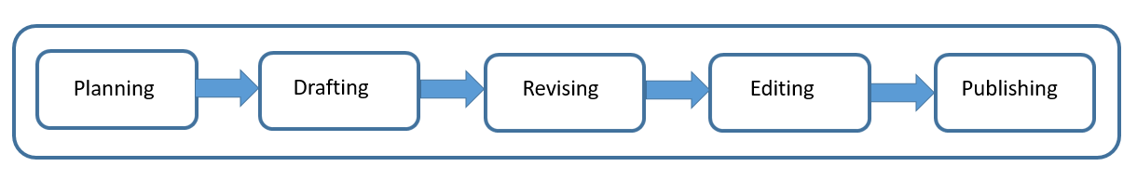

Year 4 English Writing
At Swallowdale, we follow a five-stage process for writing and in Y4 I will write for different purposes: to entertain, to inform, and to persuade.
Content to be taught and applied in writing this year
Word | The grammatical difference between plural and possessive –s Standard English forms for verb inflections instead of local spoken forms (e.g. we were instead of we was)
Sentence | Noun phrases expanded by the addition of modifying adjectives nouns preposition phrases Fronted adverbials (e.g. Later that day,)
Text | Use of paragraphs to organise ideas around a theme Appropriate choice of pronoun or noun within and across sentences to aid cohesion and avoid repetition
Punctuation | Use of inverted commas and other punctuation to indicate direct speech Apostrophes to mark plural possession (e.g. the girls’ names) Use of commas after fronted adverbials
Terminology | pronoun, antonym possessive adverbial
Spelling
I will use the Sounds and Syllables approach in my spelling lessons and when I am writing.
I will also learn to read and spell the statutory words for LKS2.
What will I be writing?
Using the book The Tunnel as a spark, I will be writing a narrative.
I will be consolidating the writing skills I have developed this year. This will include using paragraphs to structure my story, and fronted adverbials and prepositional phrases to add detail to my writing.

Slide 7
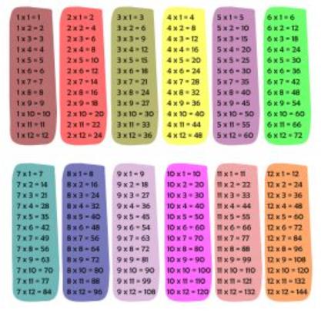


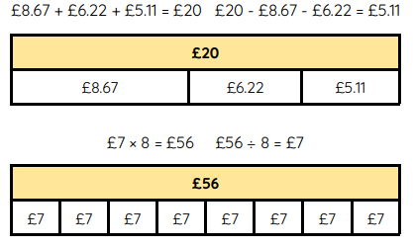

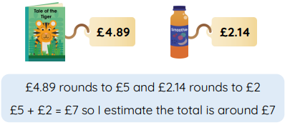
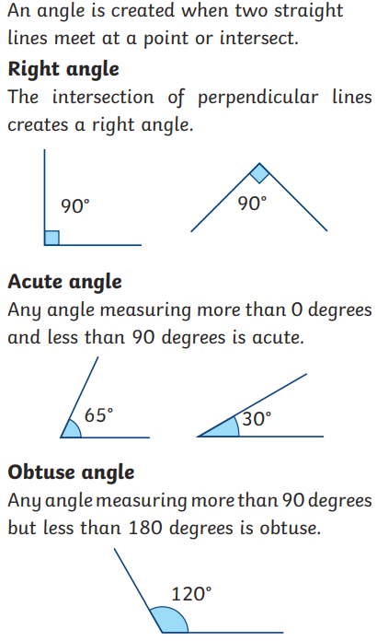
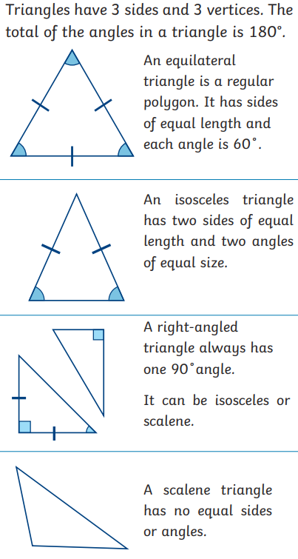
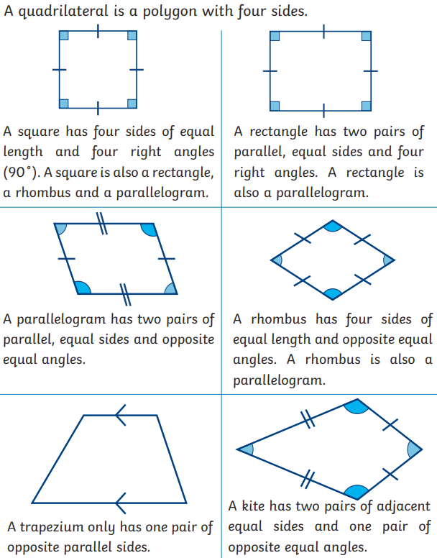
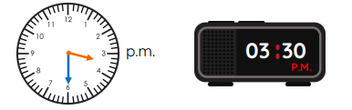
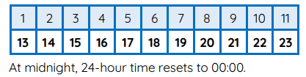
Year 4 Mathematics - Summer
Multiplication
In June all Year 4 children will sit the
National Multiplication check. This
is to check the fluency of their times
table knowledge. This check consists
of 25 times table questions.
Money
Build on understanding of place value and decimal notation to record money. Estimate, compare and calculate money in pounds and pence.
Properties of shape
To know the names and sizes of different angles, to recognize properties of different triangles and quadrilaterals and to find lines of symmetry in shape.
Time
Read, write and convert time between analogue and digital 12-hour and 24-hour clocks. Solve problems involving converting from hours to minutes; minutes to seconds; years to months; weeks to days.
Facts to know
60 seconds in one minute
60 minutes in one hour
7 days in a week
28 days in February and 29 in a leap year
April, June, September and November have 30 days.
All other months have 31 days.
365 days in a year and 366 in a leap year
12 months in a year
up of rectangles. up of rectangles.

Slide 8

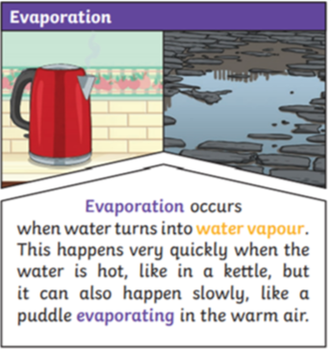
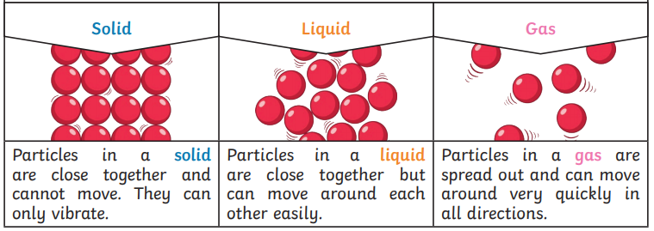
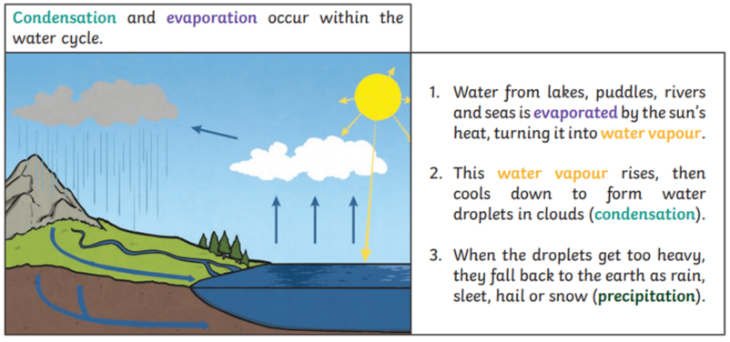
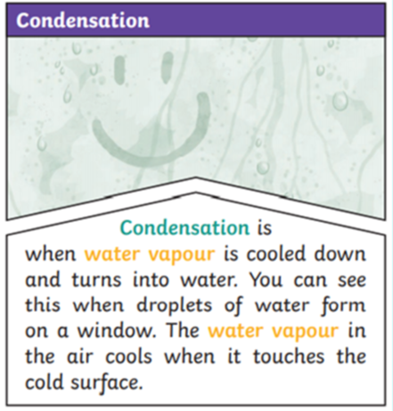
Year 4 Science Knowledge Organiser
States of matter
Key vocabulary
states of matter: Materials can be one of three states: solids, liquids or gases. solids: Materials that keep their shape unless a force is applied to them. They can be hard, soft or even squashy. Solids take up the same amount of space no matter what has happened to them. liquids: Liquids take the shape of their container. They can change shape but do not change the amount of space they take up. They can flow or be poured. gases: Gases can spread out to completely fill the container or room they are in. They do not have any fixed shape but they do have a mass. change of state: When a material changes from one state to another. melting: A solid changing into a liquid. freezing: When a liquid becomes cold enough to turn solid, it freezes. evaporation: When liquid changes into a gas. condensation: When a gas turns into a liquid, caused by cooling. precipitation: Liquid or solid particles that fall from a cloud, rain, sleet, hail or snow. water cycle: The never-ending process of water moving from the oceans, up into the atmosphere , and back to the Earth and the oceans.
What should I already know?
I can identify and compare the suitability of a variety of everyday materials, including wood, metal, plastic, glass, brick, rock, paper and cardboard for particular uses. I can describe how the shapes of solid objects made from some materials can be changed by squashing, bending, twisting and stretching.
What will I know by the end of the unit?
Compare and group materials together, according to whether they are solids, liquids or gases. Observe that some materials change state when they are heated or cooled, and measure or research the temperature at which this happens in degrees Celsius (°C). Identify the part played by evaporation and condensation in the water cycle and associate the rate of evaporation with temperature.
States of matter
The Water Cycle

Slide 9
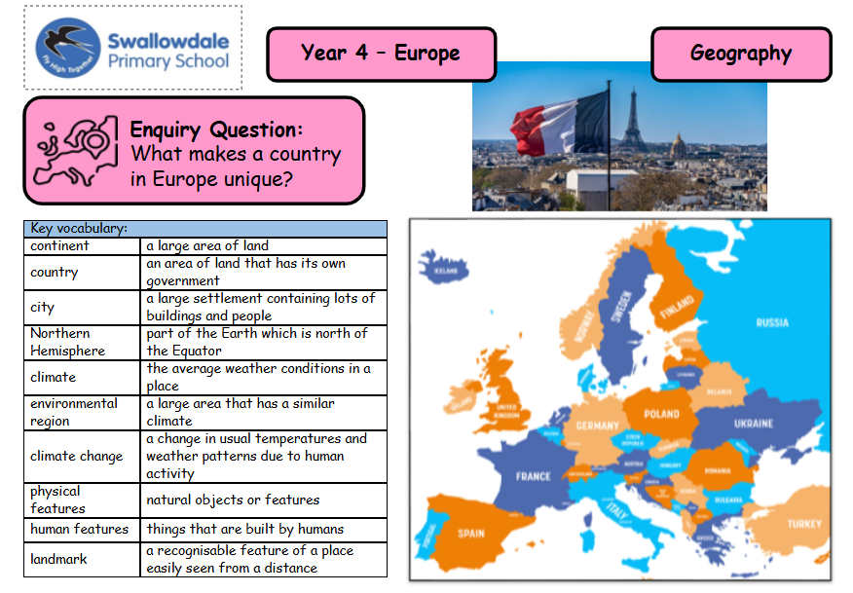

Slide 10

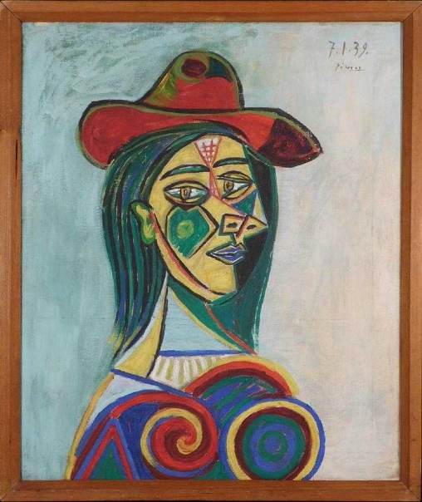
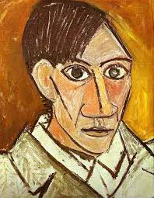
Art Knowledge Organiser: Year 4 Painting
I will explore painting techniques.
During my art lessons I will:
Use colour and shapes to reflect feelings and moods.
Sketch (lightly) before I paint so as to combine lines with colour to produce images that convey a purpose.
Mix and match colours using paint.
Discuss and explore cool, warm and hot shades.
Copy parts of other paintings.
Develop control of consistency and add more detail in my paintings.
Look at and respond to the work of different artists.
Artist Focus: Pablo Picasso
Picasso is considered one of the greatest artists of the 20th century. He is best known as the co-founder of Cubism. Even though Picasso was Spanish, he spent most of his career living and working in Paris.
Vocabulary | Definition
Cubism | Cubism is a style of art, in which objects are represented as if they could be seen from several different positions at the same time, using many lines and geometric shapes.
abstract | Not representing a subject.
block colour | Colours that do not change tone.

Slide 11
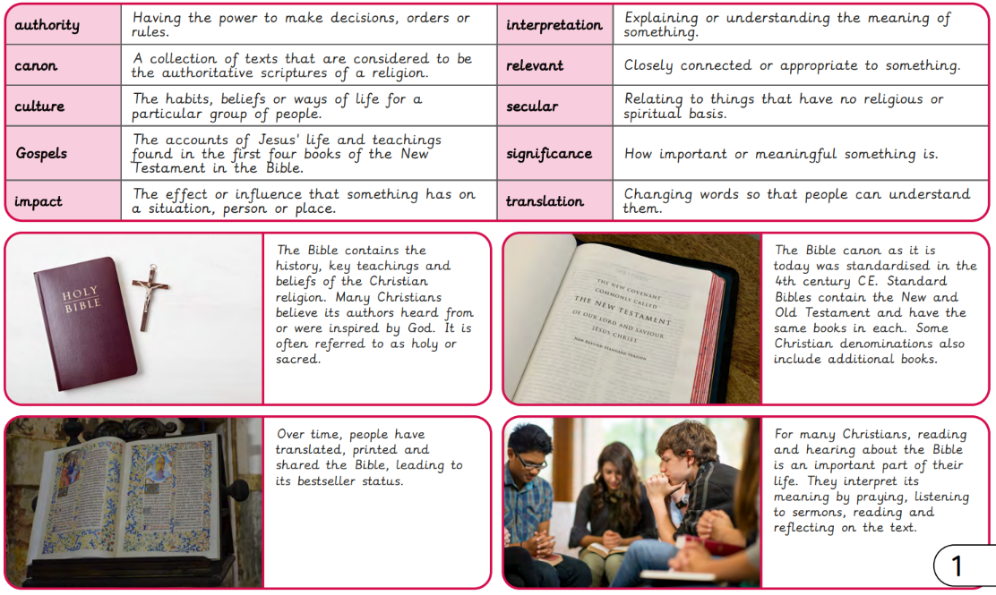

Slide 12
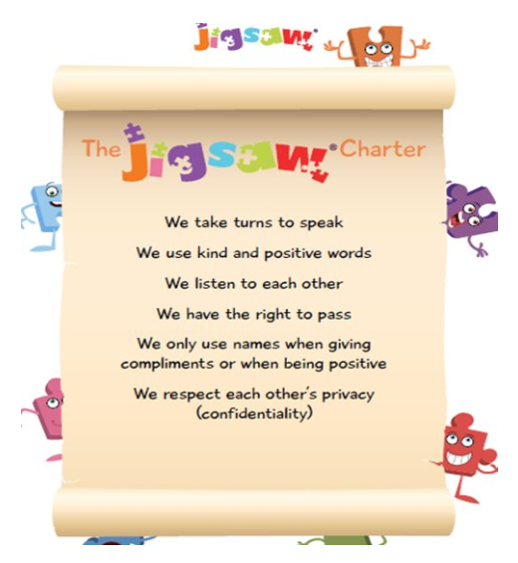

Year 4 Jigsaw Unit 5 Relationships
I have already learnt to… | Now I will learn to… | Next I will learn to…
I can identify the roles and responsibilities of each member of my family and can reflect on the expectations for males and females. | I can identify the web of relationships I am proud of, starting from those closest to me and including those more distant. | I have an accurate picture of who I am as a person in terms of my characteristics and personal qualities.
I know and can use some strategies for keeping myself safe. | I can explain different points of view on an animal rights issue. | I understand how it feels to be attracted to someone and what having a boyfriend or girlfriend means.
I understand how my needs and rights are shared by children around the world and can identify how our lives may be different. | I know how to show love and appreciation to the people and animals who are special to me. | I understand how to stay safe when using technology to communicate with my friends.
I will understand this vocabulary…
relationship | A close connection between people.
distant | Distant means far away.
belonging | The feeling of being comfortable and happy in a particular situation or with a particular group of people.
loss | No longer having something.
sadness | The feeling of being sad.
memorial | A thing that will continue to remind people of somebody or something.
vegetarian | A person who does not eat meat or fish.
debate | A discussion about an issue. In a debate two or more speakers express their views and sometimes there is a vote.
I can answer these reflective questions…
What does friendship mean to you?
How do you know who you are talking to online?
What are good ways I can keep myself safe when using technology?

Slide 13

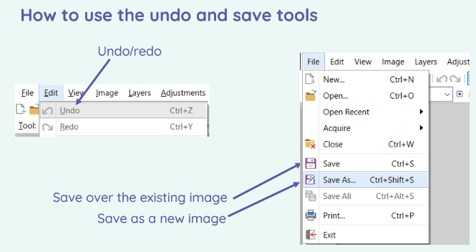
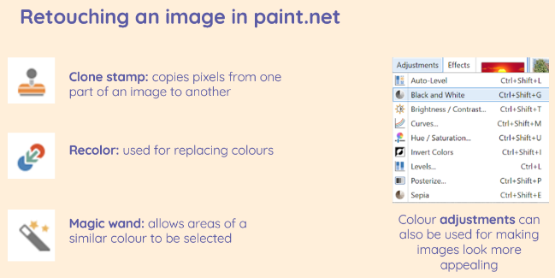
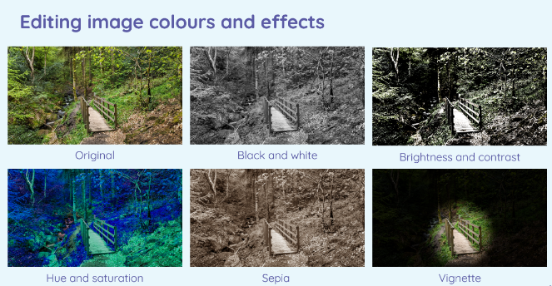
Year 4 Computing Knowledge Organiser: Photo Editing
What should I already know?
how to develop my understanding of tools that could be used for digital painting
How to use tools to create my own digital painting.
How to use different devices to capture photographs and learned how to edit and improve photos
how to use the techniques needed to create a stop-frame animation and then applied these techniques to create a story-based animation
What will I learn?
I will develop my understanding of how digital images can be changed and edited, and how they can then be resaved and reused
I will consider the impact that editing images can have, and evaluate the effectiveness of my choices
Key Vocabulary
crop | to cut out or resize parts of an image you don’t need
filters | change the colours of an image
contrast | tool to make an image or subject clearer
blur | to distort an image so your eyes
edit | to change an image
enlarge | to make an image or subject larger
rotate | to change the direction of a picture or image

Slide 14
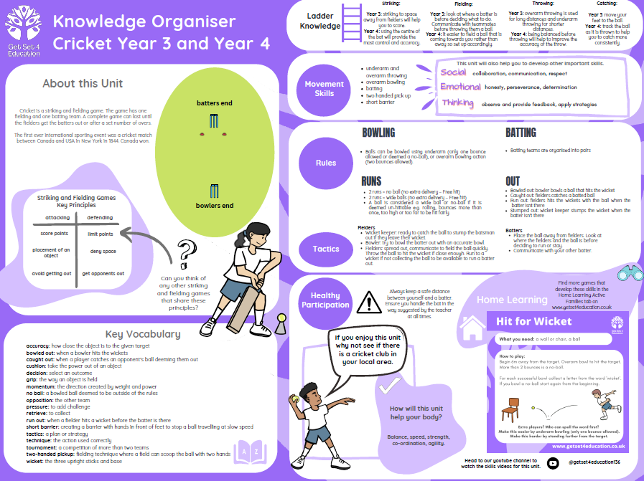

Slide 15
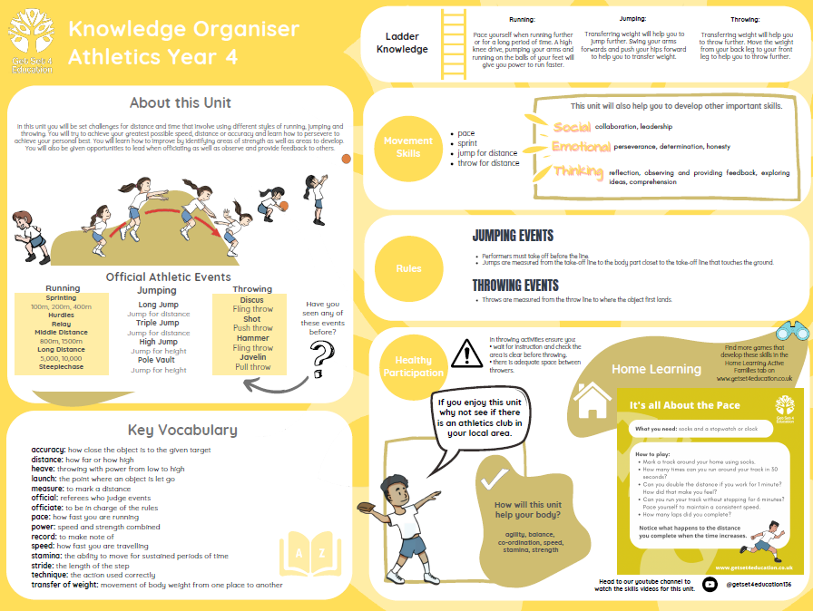

Slide 16
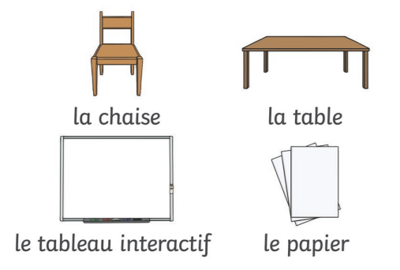
FRENCH KNOWLEDGE ORGANISER
My School
Prior Learning
I will already know: the days of the week the numbers 1-12 for telling the time how to use “Il y a…” how to use J’aime and Je n’aIme pas
Key Vocabulary
l'école | the school
la salle de classe | the classroom
la cour | the playground
la grande salle | the hall
la bibliothèque | the library
un sac | a bag
les mathématiques l'anglais le français (m) les sciences le sport le dessin l'informatique la musique | maths English French science PE art ICT music
Key Learning
I will: be able to say how I travel to school be able to name different subjects in school be able to name some of the rooms in school be able to name some of the objects which I use
Grammar
Je vais en/a - I go on/by Il est - It is J’ai/ Je n’ai pas and know how to use negatives

Slide 17
