Slide 1

Year 5 Curriculum
Summer 1 2024 - 2025

Slide 2
Swallowdale Curriculum
Dear Families,
This booklet contains the Long Term Plan, information for English, maths and the knowledge organisers which outline the units of work that your child will be covering in our wider curriculum this half term. These will show you the main elements of learning for your child and we hope you find them useful.
Please note that history and geography, art, and design and technology are taught in alternate half terms.
To support your child’s learning at home please read with them regularly and sign your child’s reading diary.
More information about our curriculum can be found on the school’s website.
Thank you for your support.

Slide 3

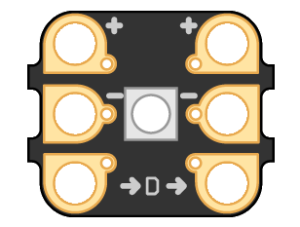


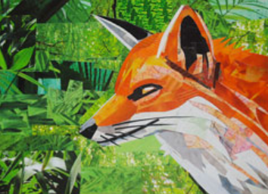


Year 5 Long Term Plan 2024 – 2025
 | Autumn 1 | Autumn 2 | Spring 1 | Spring 2 | Summer 1 | Summer 2
English | Reading Writing including grammar, spelling and punctuation | Reading Writing including grammar, spelling and punctuation | Reading Writing including grammar, spelling and punctuation | Reading Writing including grammar, spelling and punctuation | Reading Writing including grammar, spelling and punctuation | Reading Writing including grammar, spelling and punctuation
Maths | Place Value Addition Subtraction | Multiplication/Division Shape Fractions | Multiplication/Division Fractions Perimeter and Area | Decimals Percentages Volume | Position and Direction Decimals Converting Units | Negative Numbers Statistics
Science | ​Forces and Magnets​ | ​Earth and Space​ | ​Materials​ | ​Materials​ | Living things and their habitats​ ​ | ​​ Animals, including humans
History and Geography | Climate Zones | Ancient Maya | Crime and Punishment | Economic Activity | Richard III: Dynasty, Death and Discovery | North America
Art and Design and Technology | Drawing: Olivier Leger | Mechanisms: Electronic Cards | Painting: Paul Wright | Textiles: Stuffed Toy | Collage: Megan Coyle | Food and Nutrition: Improving a Pie Recipe
Religion and Worldviews | Why do people have to stand up for what they believe in? | Why doesn’t Christianity always look the same? | What happens when we die? | What happens when we die? | Who should be in charge? | Why are some places in the world significant?
PSHE | Being Me In My World | Celebrating Difference | Healthy Me | Staying Safe | Relationships | Changing Me
Computing | Systems and Searching | Video Production | Selection in Physical Computing | Flat file Data Bases | Introduction to Vector Graphics | Selection in Quizzes
Physical Education | Basketball / Fitness | OAA / Gymnastics | Yoga / Tag Rugby | Athletics / Netball | Swimming / Dance | Swimming / Cricket
Music | Getting Started with Music Tech | Sing and Play in Different Styles | Composing and Chords | Enjoying Musical Styles | Freedom to Improvise | Battle of the Bands
French | Food |  | Hobbies |  | All Around Me

Slide 4
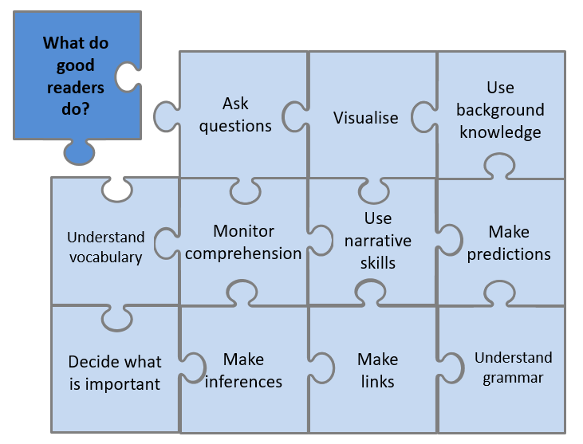



Year 5 English Reading
Reading Lessons
Using our school jigsaw, I will consider what good readers do in the moment of reading and after reading, and these skills will be modelled and practised during my lessons. I will practise reading aloud to develop my fluency and prosody. I will read a range of fiction, non-fiction and poetry each term. My reading work will be recorded in my reading journal.
Independent Reading
I will have a book linked to my reading level which I may read in school and at home. The reading level of my book is shown by the coloured dot at the back of the book. My reading level is assessed at school using a Benchmarking assessment and this will be checked throughout the year. My reading book should not be too tricky as this book is for me to read fluently and to understand what I have read so I can enjoy it.
I may also select a book from the class or school library. I should record my independent reading in my school reading diary each week and show my teacher.
Our Class Poetry Books
Reading for Pleasure - Our Class Book
This is the book we will continue to read and discuss in class this term.
lue Wing lives with her guardian Siringen, a shark caller, on the outskirts of her village. She’s desperate to become a shark caller herself to avenge the death of her parents, who were killed by a notorious shark, Xok. But it’s against tradition for a girl to become one, and Siringen believes Blue Wing still harbours too much anger in her heart.
When American Professor Atlas Hamelin and his daughter, Maple, arrive on the island, Blue Wing is charged with looking after the infuriating Maple and they find themselves on a journey to depths of the ocean, where Xok lies waiting.

Slide 5
Statutory Spelling Words for Year 5 and Year 6
accommodate | category | determined | forty | marvellous | programme | soldier
accompany | cemetery | develop | frequently | mischievous | pronunciation | stomach
according | committee | dictionary | government | muscle | queue | sufficient
achieve | communicate | disastrous | guarantee | necessary | recognise | suggest
aggressive | community | embarrass | harass | neighbour | recommend | symbol
amateur | competition | environment | hindrance | nuisance | relevant | system
ancient | conscience | equipment | identity | occupy | restaurant | temperature
apparent | conscious | equipped | immediate | occur | rhyme | thorough
appreciate | controversy | especially | immediately | opportunity | rhythm | twelfth
attached | convenience | exaggerate | individual | parliament | sacrifice | variety
available | correspond | excellent | interfere | persuade | secretary | vegetable
average | criticise | existence | interrupt | physical | shoulder | vehicle
awkward | curiosity | explanation | language | prejudice | signature | yacht
bargain | definite | familiar | leisure | privilege | sincere
bruise | desperate | foreign | lightning | profession | sincerely

Slide 6

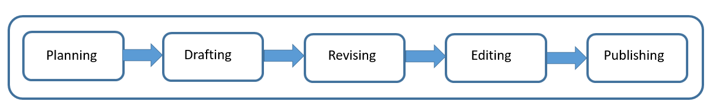
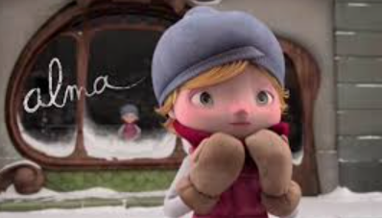
Year 5 English Writing
At Swallowdale, we follow a five-stage process for writing and in Y5 I will write for different purposes: to entertain, to inform, to discuss and to persuade. I will also write for a range of audiences.
Content to be taught and applied in writing this year
Word | Converting nouns or adjectives into verbs using suffixes (e,g, – ate, –ise, –ify) Verb prefixes (e.g. dis–, de–, mis–, over– and re–)
Sentence | Relative clauses beginning with who, which, where, when, whose, that, or an omitted relative pronoun Indicating degrees of possibility using adverbs (e.g. perhaps, surely) Modal verbs (e.g. might, should, will, must) There is correct subject and verb agreement when using singular and plural
Text | Use of linking words/phrases between sentences and paragraphs to build cohesion Linking ideas across paragraphs using adverbials of time, adverbials of place, adverbials of number and tense choices (e.g. he had seen her before)
Punctuation | Use of brackets Use of commas to indicate parenthesis Use of commas to clarify meaning or avoid ambiguity Punctuation of bullet points to list information
Terminology | modal verb, relative pronoun relative clause, cohesion parenthesis, bracket, ambiguity, bullet points
Spelling
I will use the Sounds and Syllables approach in my spelling lessons and when I am writing. I will also learn to read and spell the statutory words for UKS2.
What will I be writing?
Using the animated film Alma as a spark, I will be writing a narrative. I will create atmosphere in my writing by describing character and setting.

Slide 7
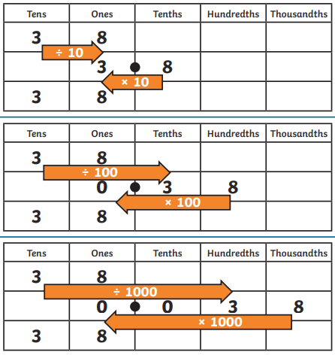
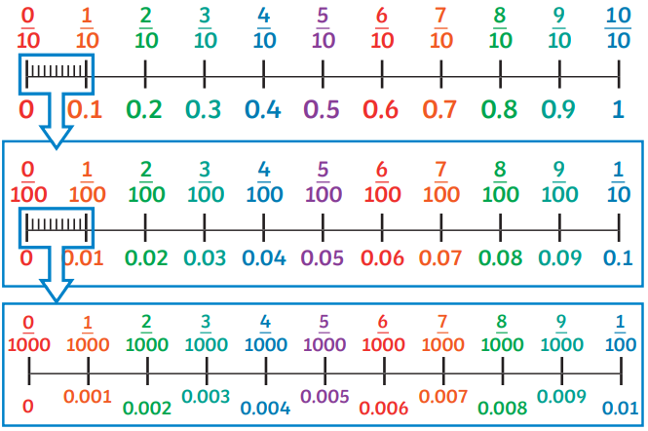
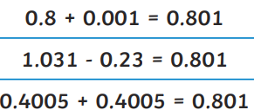
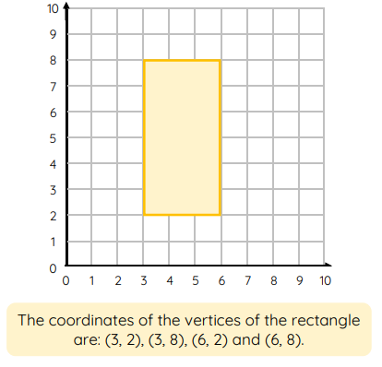
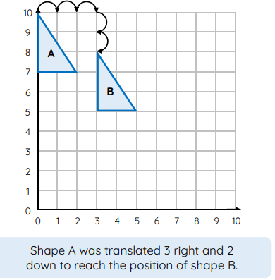
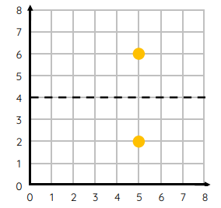
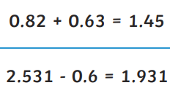
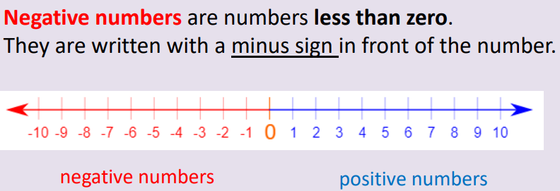
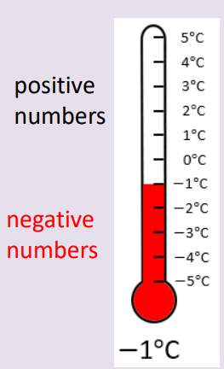
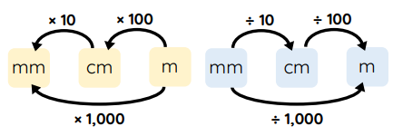

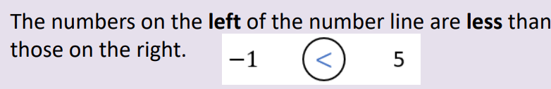
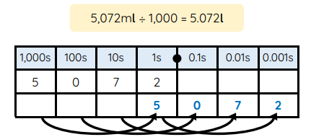

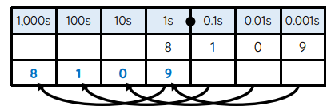

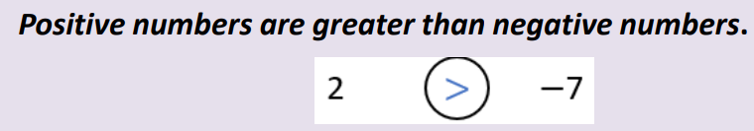

Year 5 Mathematics - Summer
Decimals
Add and subtract decimals. Multiply and divide decimals by 10, 100 and 1000.
Position and Direction
Identify, describe and represent the position of a shape following a reflection or translation, using the appropriate language, and know that the shape has not changed.
Reflection
Converting Units
Convert between different units of metric measures: kilometre and metre; centimetre and metre; centimetre and millimetre; gram and kilogram; litre and millilitre. Understand and use approximate equivalences between metric units and common imperial units such as inches, pounds and pints.
Negative Numbers
1Kg=1000g
1l=1000ml

Slide 8

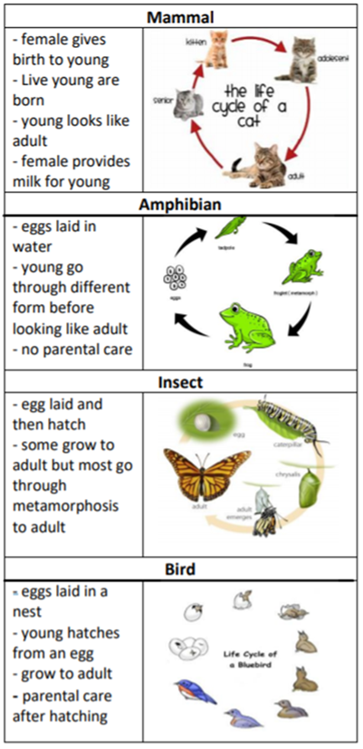
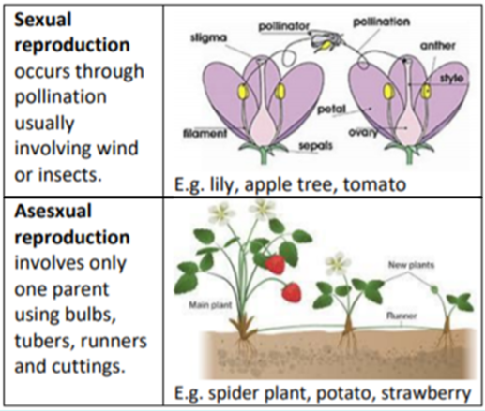
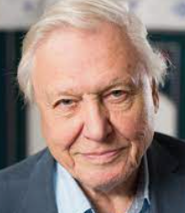
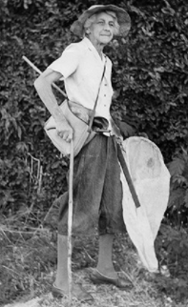
Year 5 Science Knowledge Organiser
Living things and their habitats
Key vocabulary
life cycle: The journey of changes that take place throughout the life of a living thing including birth, growing up and reproduction. reproduction: The process of new living things being made. fertilise: The action of fusing the male and female sex cells in order to develop an egg. sexual reproduction: Both the male and female are needed. Most animals sexually reproduce. asexual reproduction: Only one parent is needed. Thus occurs mostly in plants and bacteria. gestation: The length of pregnancy. pollination: The transfer of pollen to a stigma to allow fertilisation.
What should I already know?
I know that living things can be grouped in a variety of ways. I can explore and use classification keys to help group, identify and name a variety of living things in their local and wider environment. I know that environments can change and that this can sometimes pose dangers and have an impact on living things.
Life cycle of animals
What will I know by the end of the unit?
Describe the differences in the life cycles of a mammal, an amphibian, an insect and a bird. Describe the life process of reproduction in some plants and animals
Plants reproduce both sexually and asexually
Significant scientist
Sir David Attenborough born in 1926 is an English broadcaster and naturalist. He has made many famous wildlife programmes. He was knighted in 1985.
Lucy Evelyn Cheesman (1881-1969) was a British entomologist (someone who studies insects). She collected over 70,000 specimens of insects, plants and other animals.

Slide 9

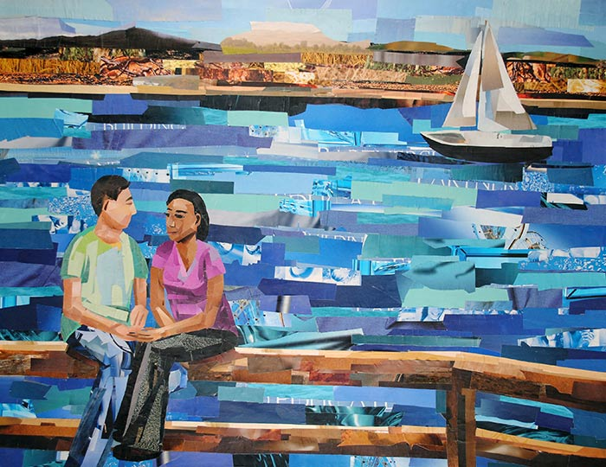
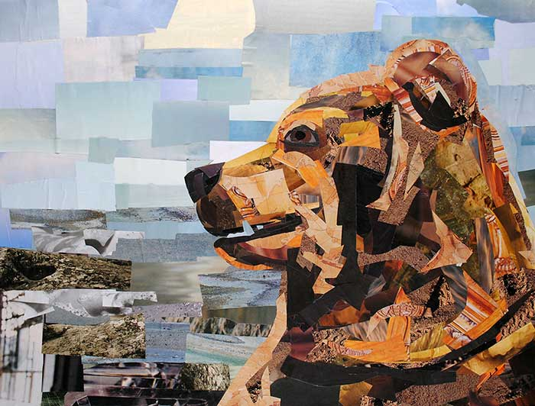
Art Knowledge Organiser: Year 5 Collage
I will begin to explore collage.
During my art lessons I will:
Use collage as part of the planning process.
Make collages using a range of materials.
Use the work of other artists as a stimulus for my collage work.
Use cut and torn papers and other materials to
make simple patterns and images.
Ensure my collage takes inspiration from artists or designers.
Artist Focus: Megan Coyle
Megan Coyle is an American artist who specialises in creating collage art. She uses old magazines, newspapers and different coloured paper to produce different images. Coyle depicts animals, landscapes and people in her work and is often inspired by subjects in her everyday life.
Vocabulary | Definition
collage | Creating an image by cutting/ripping paper or magazines and gluing them on paper or card in a different way.
texture | The way something feels.
foreground/ background | The front of a picture and the back of a picture. In the artwork on the right, the people are in the foreground, the hills are in the background.

Slide 10

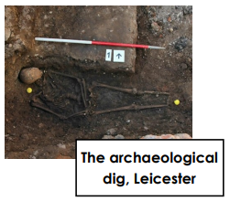
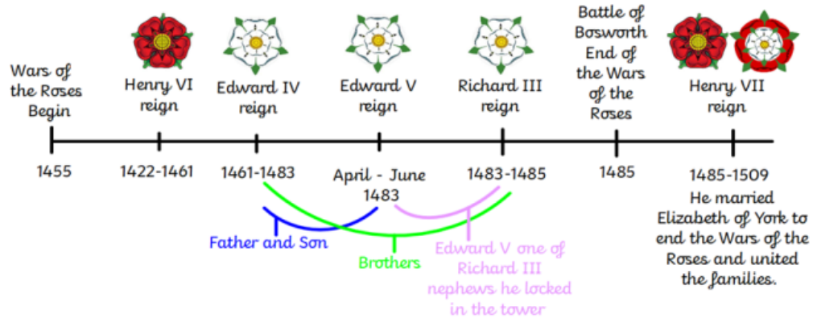
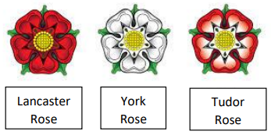
Year 5 History Knowledge Organiser
Local History: Richard III - Dynasty, Death and Discovery
Enquiry Question
Who was King Richard III and why was he found buried in a Leicester car park?
Key Historical Threads
Societal change Invasion
Key Vocabulary
archaeologist: a scientist who finds buried history Lancastrians: a follower of the House of Lancaster fighting on the side of Henry VII Yorkists: a supporter of the House of York fighting on the side of Richard III monarch: a ruler such as a king, queen or emperor who exercises authority and power Plantagenet: Royal ‘house’ originating from Anjou in France rebellion: a refusal to obey those in power often resulting in an armed fight Tudor: English royal ‘house’ of Welsh origin
Key Knowledge
Edward III, monarch from 1327 until 1377, had 7 sons and 5 daughters. Many of his sons wanted to claim the throne when their father died and were willing to fight each other for it.
The British throne passed between these two ‘Houses’ until Edward IV died leaving 2 young sons: Edward and Richard. Their uncle, Richard Duke of Gloucester became their guardian.
Richard III died at the Battle of Bosworth becoming not only the last Plantagenet king but also the last king to die in battle.
What will I know by the end of the unit?
I will discover who Richard III was and what the cause and consequence of his death was for England. I will explore different interpretations of Richard III and make conclusions about him as a king based on what I find. I will understand how the War of the Roses came to an end. I will discover how Richard III was eventually found by archaeologists.

Slide 11
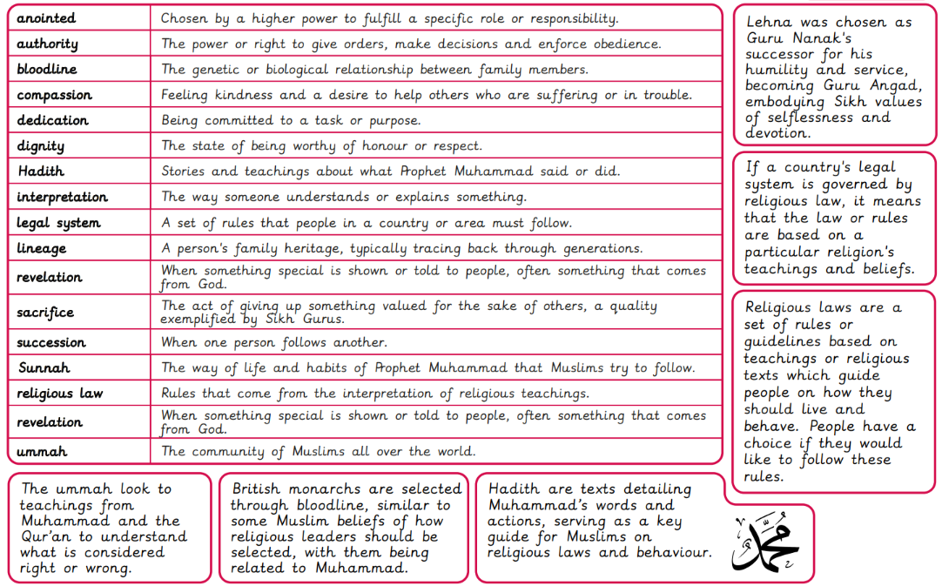

Slide 12

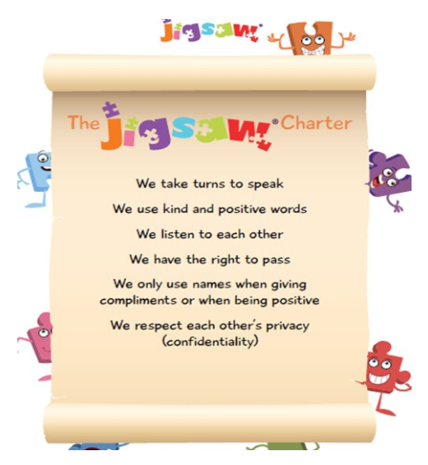
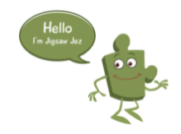
Year 5 Jigsaw Unit 5 Relationships
I have already learnt to… | Now I will learn to… | Next I will learn to…
I can identify the web of relationships I am proud of, starting from those closest to me and including those more distant. | I have an accurate picture of who I am as a person in terms of my characteristics and personal qualities. | I understand there are different stages of grief and there are different types of loss that cause people to grieve.
I can explain different points of view on an animal rights issue. | I understand how it feels to be attracted to someone and what having a boyfriend or girlfriend means. | I understand how technology can be used to try to gain power or control and I can use strategies to prevent this from happening.
I know how to show love and appreciation to the people and animals who are special to me. | I understand how to stay safe when using technology to communicate with my friends. | I can use technology positively and safely to communicate with my friends and family.
I will understand this vocabulary…
self-esteem | A feeling of being happy with yourself and your abilities.
attributes | To regard a quality or feature as belonging to somebody or something.
characteristics | A typical feature or quality that somebody or something has.
compromise | An agreement made between two people or groups in which each side gives up some of the things they want so that both sides are happy at the end.
pressure | The act of trying to persuade or to force somebody to do something.
jealousy | Feeling angry or unhappy because they want to be like someone else or have something they have.
bullying | Behaviour that is repeated and intended to hurt or frighten someone either physically or emotionally.
safety | To feel safe and protected from danger or harm.
I can answer these reflective questions…
What does friendship mean to you?
How do you know who you are talking to online?
What are good ways I can keep myself safe when using technology?

Slide 13

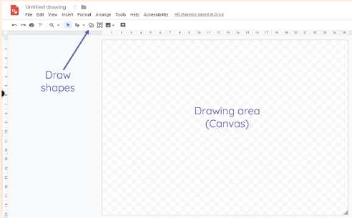
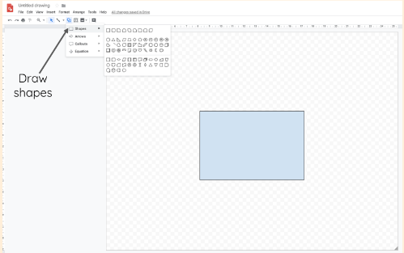
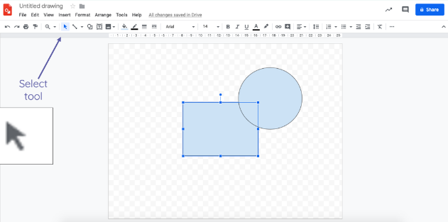
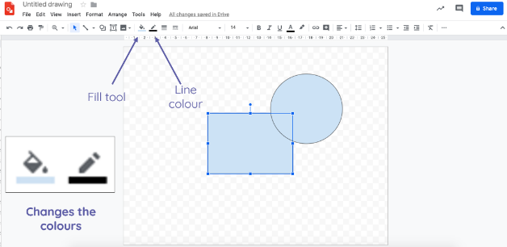
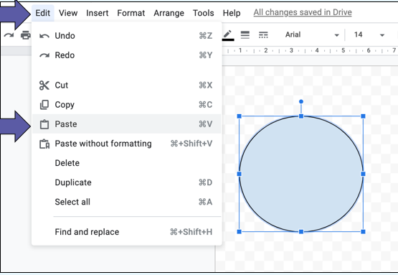
Year 5 Computing Knowledge Organiser: Introduction to vector graphics
What should I already know?
how to paint and draw digitally
How to use desktop publishing, how to create, save and edit files, pictures and drawings
What will I learn?
I will find out that vector images are made up of shapes
I will learn how to use the different drawing tools and how images are created in layers
I will explore the ways in which images can be grouped and duplicated to understand how to create more complex pieces of work
I will complete the unit using the Google drawings app
Key Vocabulary
vector | using lines to construct the outlines of object
rotate | move or cause to move in a circle around an axis or centre
layering | arranging something in layers
alignment | arrangement in a straight line or in the correct position
How to create a vector drawing in Google drawings app

Slide 14
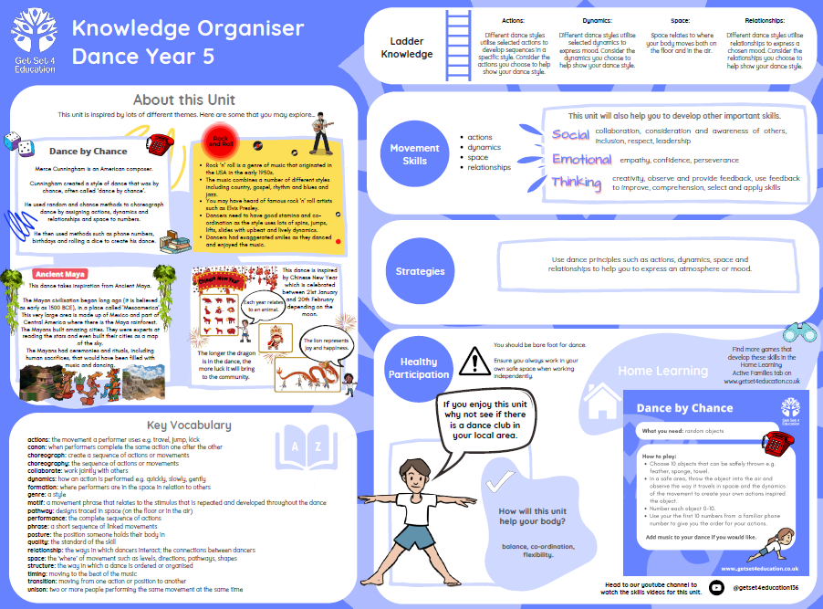

Slide 15
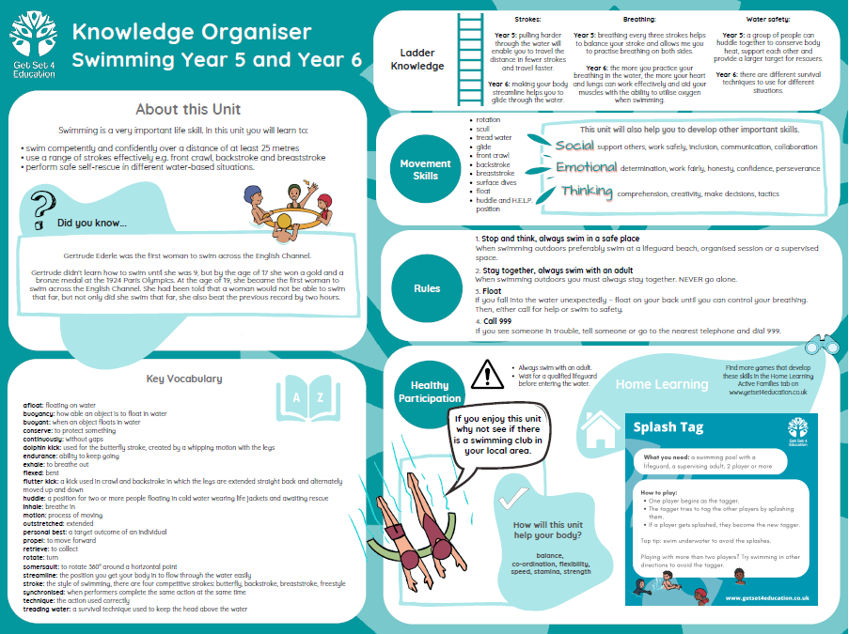

Slide 16
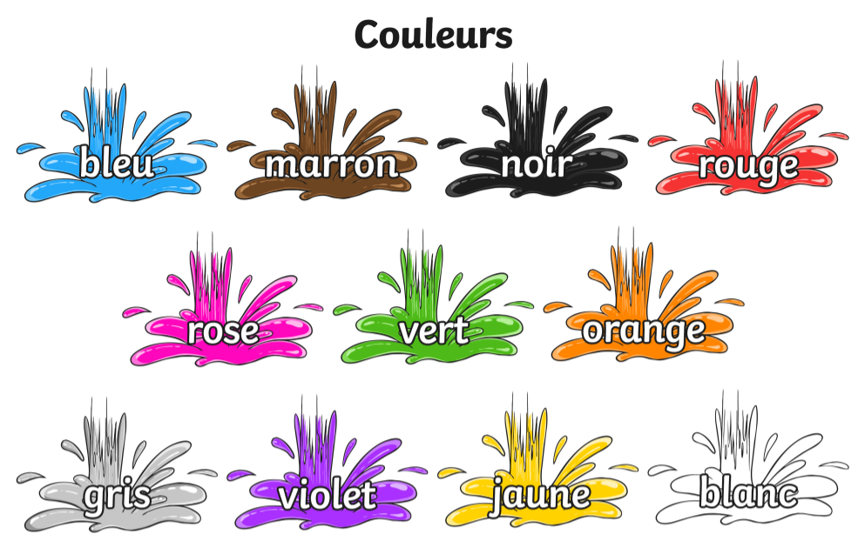
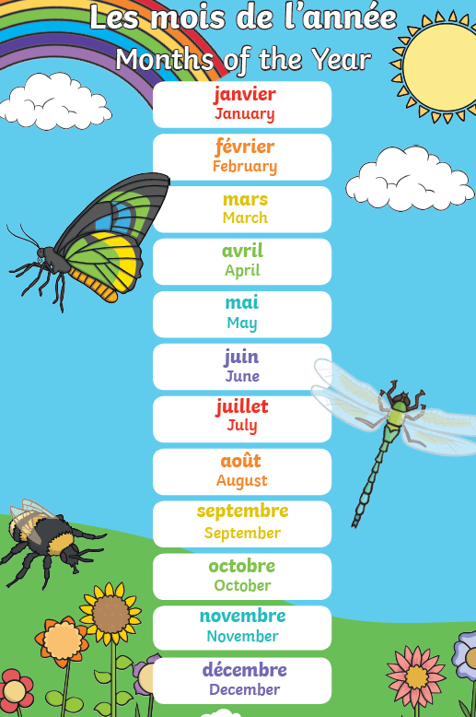
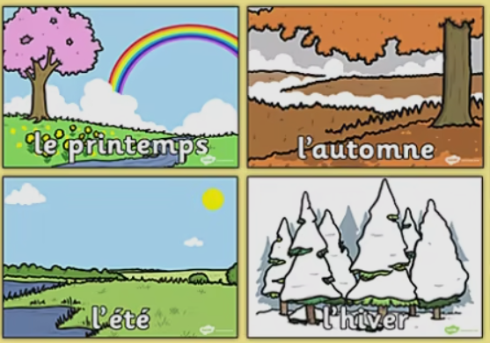
FRENCH KNOWLEDGE ORGANISER
All around me
Prior Learning
I will already know: “Qu'est-ce que c'est?” colours
Key Vocabulary
une semaine | a week
un mois | a month
une année | a year
l’arbre | tree
la fleur | flower
l’oiseau | bird
l’herbe | grass
Key Learning
I will: recognise the names of the seasons remember the names of some of the months of the year with adult help say why I like a season or month know some of the countries of the world and where they speak French
Grammar
J’aime parce que.. J’adore parce que.. Je n’aime pas parce que.. Je déteste parce que…

Slide 17
