Slide 1

Year 6 Curriculum
Summer 1 2024 - 2025

Slide 2
Swallowdale Curriculum
Dear Families,
This booklet contains the Long Term Plan, information for English, maths and the knowledge organisers which outline the units of work that your child will be covering in our wider curriculum this half term. These will show you the main elements of learning for your child and we hope you find them useful.
Please note that history and geography, art, and design and technology are taught in alternate half terms.
To support your child’s learning at home please read with them regularly and sign your child’s reading diary.
More information about our curriculum can be found on the school’s website.
Thank you for your support.

Slide 3
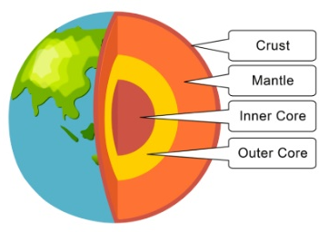
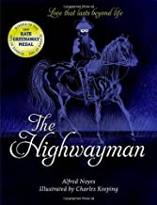




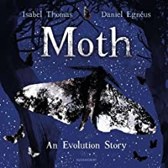
Year 6 Long Term Plan 2024 – 2025
 | Autumn 1 | Autumn 2 | Spring 1 | Spring 2 | Summer 1 | Summer 2
English | Reading Writing including grammar, spelling and punctuation | Reading Writing including grammar, spelling and punctuation | Reading Writing including grammar, spelling and punctuation | Reading Writing including grammar, spelling and punctuation | Reading Writing including grammar, spelling and punctuation | Reading Writing including grammar, spelling and punctuation
Maths | Place Value Four operations | Fractions, Decimals and percentages Position and Direction Multiplication and Division | Shape Converting units | Area and Perimeter Volume Statistics | Ratio Algebra | Consolidation Problem Solving
Science | Electricity | Animals, including humans | Living Things and Their Habitats | Adaptation, Evolution and Inheritance | Adaptation, Evolution and Inheritance | Light
History and Geography | Twentieth Century Conflict: WWII | Local Fieldwork | Civil Rights | Earthquakes and Volcanoes | Industrial Revolution
Art and Design and Technology | Construction: Anderson Shelters | Drawing: Yayoi Kusama | Sculpture: Yinka Shonibari | Textiles: Device Case | Painting: Banksy | Food and Nutrition: Come Dine With Me
Religion and Worldviews | Why does religion look different around the world? | Why does religion look different around the world? | Why is it better to be there in person? | Why is there suffering? | Why is there suffering? | What place does religion have in our world today?
PSHE | Being Me In My World | Celebrating Difference | Healthy Me | Staying Safe | Relationships | Changing Me
Computing | Communication and Collaboration | Web page creation | Variables in Games | Introduction to Spreadsheets | 3D modelling | Sensing Movement
Physical Education | Fitness / Swimming | Swimming / OAA | Basketball / Yoga | Athletics / Football | Gymnastics / Netball | Dance / Cricket
Music | Developing Melodic Phrases | Developing Ensemble Skills | Creative Composition | Musical Styles Connect Us | Improvising with Confidence | Farewell Tour
French | All About France |  | My Family |  | The Future

Slide 4

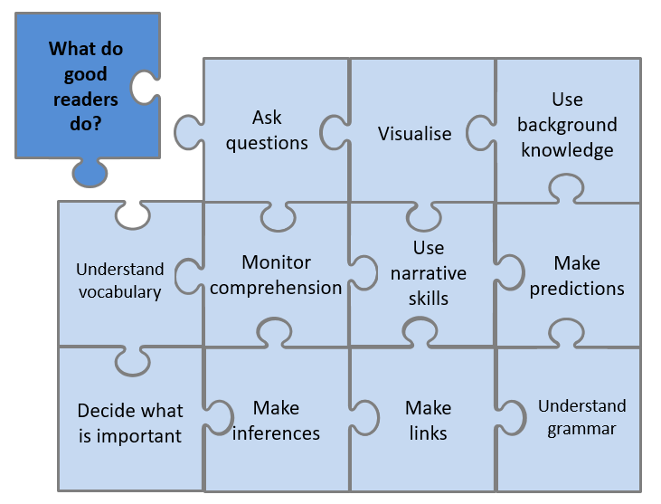
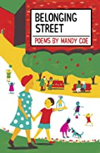
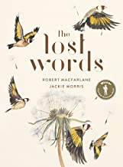
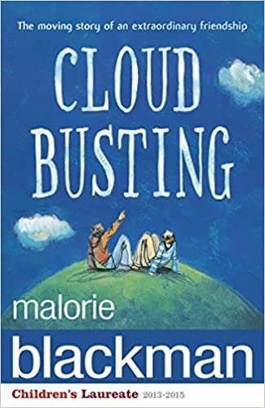
Year 6 English Reading
Reading Lessons
Using our school jigsaw, I will consider what good readers do in the moment of reading and after reading, and these skills will be modelled and practised during my lessons. I will practise reading aloud to develop my fluency and prosody. I will read a range of fiction, non-fiction and poetry each term. My reading work will be recorded in my reading journal.
Independent Reading
I will have a book linked to my reading level which I may read in school and at home. The reading level of my book is shown by the coloured dot at the back of the book. My reading level is assessed at school using a Benchmarking assessment and this will be checked throughout the year. My reading book should not be too tricky as this book is for me to read fluently and to understand what I have read so I can enjoy it.
I may also select a book from the class or school library. I should record my independent reading in my school reading diary each week and show my teacher.
Our Class Poetry Books
Reading for Pleasure - Our Class Book
Despite his Mum's insistence, Sam doesn't want to be friends with Davey, he thinks Davey's a first class, grade A, top of the dung heap moron. But one day Davey saves Sam's life and a bond is formed between them. Sam is still embarrassed to be seen with Davey, but little by little he has to admit, when it's just the two of them, Davey is a lot of fun. But then something terrible happens to Davey. . . Told in verse, in first person, this is the touching story of an extraordinary friendship, that changes two boys lives forever…
This is the book we will read and discuss in class each day.

Slide 5
Statutory Spelling Words for Year 5 and Year 6
accommodate | category | determined | forty | marvellous | programme | soldier
accompany | cemetery | develop | frequently | mischievous | pronunciation | stomach
according | committee | dictionary | government | muscle | queue | sufficient
achieve | communicate | disastrous | guarantee | necessary | recognise | suggest
aggressive | community | embarrass | harass | neighbour | recommend | symbol
amateur | competition | environment | hindrance | nuisance | relevant | system
ancient | conscience | equipment | identity | occupy | restaurant | temperature
apparent | conscious | equipped | immediate | occur | rhyme | thorough
appreciate | controversy | especially | immediately | opportunity | rhythm | twelfth
attached | convenience | exaggerate | individual | parliament | sacrifice | variety
available | correspond | excellent | interfere | persuade | secretary | vegetable
average | criticise | existence | interrupt | physical | shoulder | vehicle
awkward | curiosity | explanation | language | prejudice | signature | yacht
bargain | definite | familiar | leisure | privilege | sincere
bruise | desperate | foreign | lightning | profession | sincerely

Slide 6

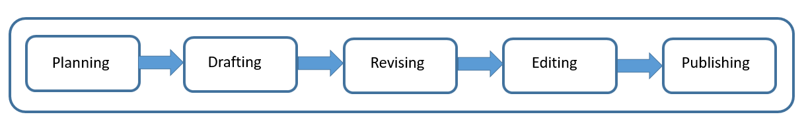
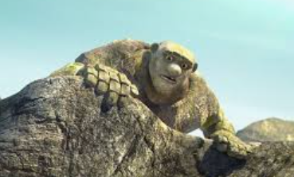
Year 6 English Writing
At Swallowdale, we follow a five-stage process for writing and in Y6 I will write for different purposes: to entertain, to inform, to discuss and to persuade. I will also write for a range of audiences.
Content to be taught and applied in writing this year
Word | The difference between vocabulary typical of informal speech and vocabulary appropriate for formal speech and writing
Sentence | Use of the passive to affect the presentation of information in a sentence (e.g. John broke the window in the greenhouse. / The window in the greenhouse was broken) The difference between structures typical of informal speech and structures appropriate for formal speech and writing (e.g. the use of question tags or the subjunctive form)
Text | Linking ideas across paragraphs using a wider range of cohesive devices (e.g. repetition of a word or phrase, chains of reference, grammatical connections, punctuation) Layout devices to structure text
Punctuation | Use of the semi-colon, colon and dash to mark the boundary between independent clauses Use of the colon to introduce a list and use of semi-colons within lists How hyphens can be used to avoid ambiguity (e.g. man eating shark / man-eating shark, or recover / re-cover) Use of ellipses (as a cohesive device) Use of dashes for parenthesis
Terminology | subject, object, active, passive ellipsis, hyphen, colon, semi-colon, dash
Spelling
I will use the Sounds and Syllables approach in my spelling lessons and when I am writing.
I will also learn to read and spell the statutory words for UKS2.
What will I be writing?
Using the animated film Broken: rock, paper scissors as a spark I will write a detailed narrative. I will use a range of techniques to create atmosphere and I will use dialogue to advance the action. I will aim to use a range of punctuation.

Slide 7
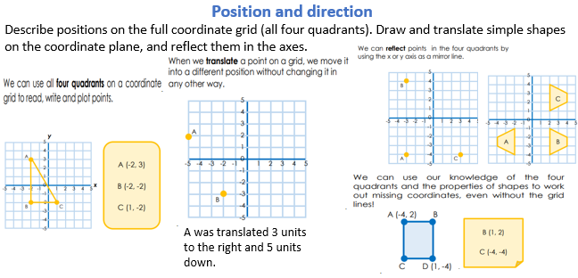
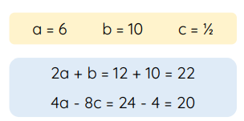
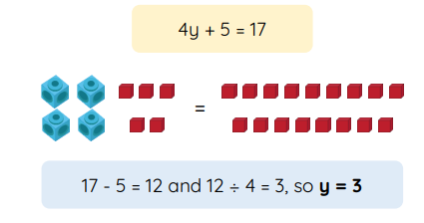

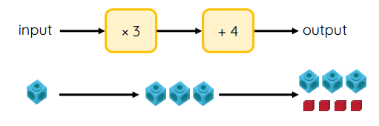


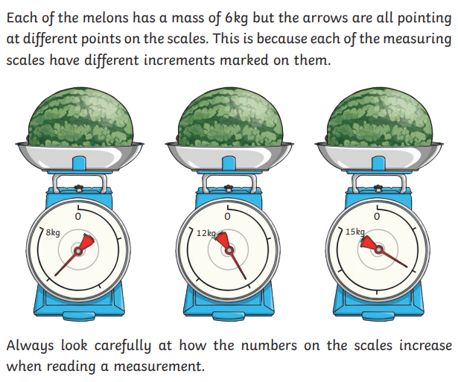
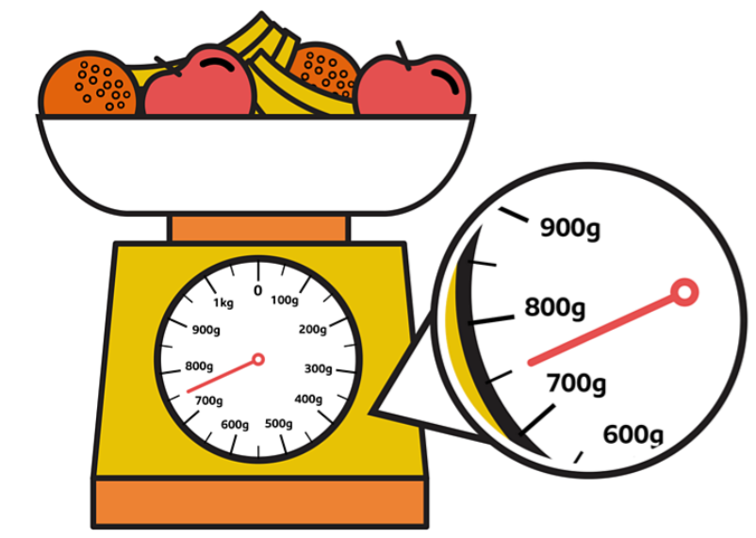
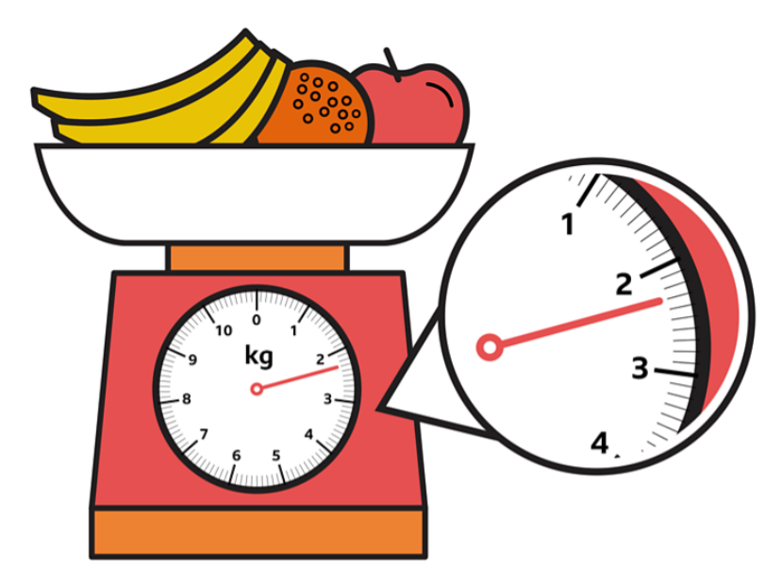
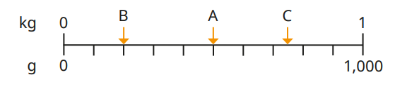
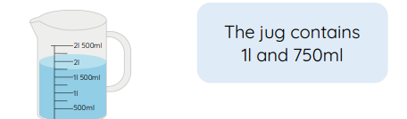
Year 6 Mathematics – Summer
.
Algebra
Use simple formulae.
Generate and describe linear number sequences.
Express missing numbers that satisfy an equation with 2 unknowns.
33y + 4=
Reading scales
Read different scales and compare masses, length, capacities and temperature.
What is the value of each interval?

Slide 8

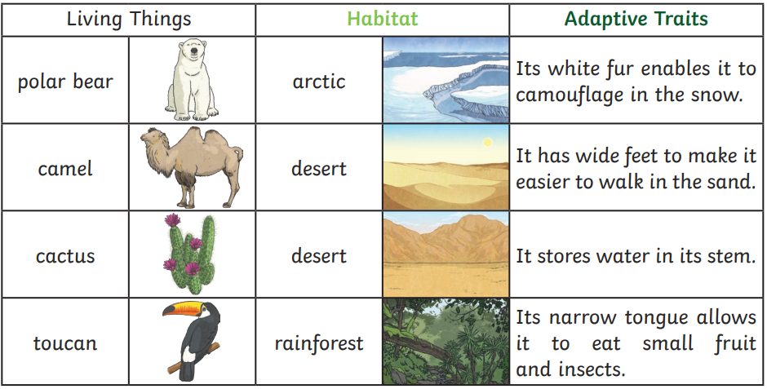
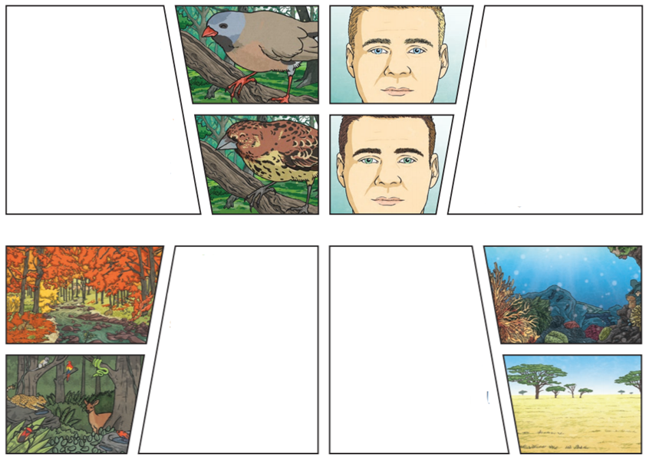
Year 6 Science Knowledge Organiser
Adaptation
What will I know by the end of the unit?
Identify how animals and plants are adapted to suit their environment in different ways.
Key vocabulary
Living things: Things that are alive. They need food, water and air to stay alive. They can reproduce, grow and change on their own and can respond to changes in the environment. species: Closely related organisms that are very similar to each other. We are the human species. offspring: The young animal or plant that is produced by the reproduction of that species. habitat: A specific area in which particular animals and plants can live. environment: An environment contains many habitats and includes areas where there are both living and non-living things. adapted: Animals and plants are adapted to their environment. Their bodies are suited to the way they live. characteristics: The features, qualities, traits that are specific of a species. adaptive traits: Genetic features that help a living thing to survive. inherited traits: Traits you get from your parents. Within a family you will often see similar traits E.g. curly hair.
Adaptive Traits
Characteristics influenced by the environment the living things live in. These adaptations can develop as a result of many things, such as climate and food.
Inherited Traits
Eye colour is an example of an inherited trait so are things like hair colour, the shape of your earlobes and whether or not you can smell certain flowers.
Habitats
A good habitat should provide shelter, water, enough space and plenty of food.
Environments
Polar regions. deserts, rainforests, oceans, rivers, and grasslands are all examples of environments.

Slide 9


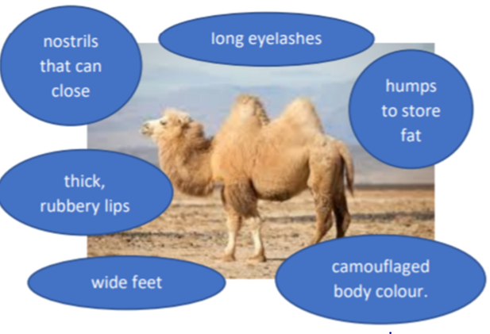
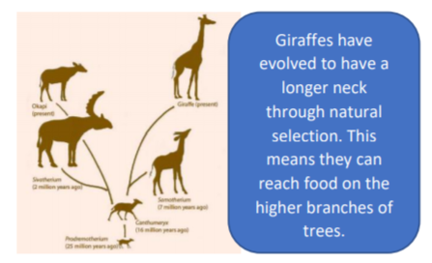
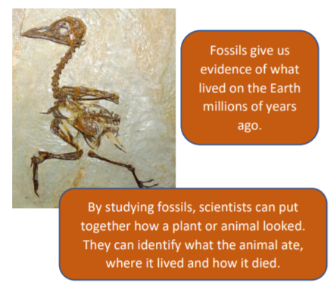
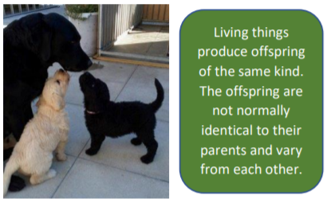
Year 6 Science Knowledge Organiser
Evolution and Inheritance
Key vocabulary
adaptation: An adaptation is a trait changing to increase a living thing’s chances of surviving and reproducing. evolution: Adaptation over a very long time. species: Closely related organisms that are very similar to each other. We are the human species. offspring: The young animal or plant that is produced by the reproduction of that species. characteristics: The features, qualities, traits that are specific of a species. habitat: A specific area in which particular animals and plants can live. environment: An environment contains many habitats and includes areas where there are both living and non-living things. natural selection: The process where organisms that are better adapted to their environment then to survive and produce more offspring. . adaptive traits: Genetic features that help a living thing to survive. inherited traits: Traits you get from your parents. Within a family you will often see similar traits E.g. curly hair.
What will I know by the end of the unit?
Recognise that living things have changed over time and that fossils provide information about living things that inhabited the Earth millions of years ago. Recognise that living things produce offspring of the same kind, but normally offspring vary and are not identical to their parents. Identify how animals and plants are adapted to suit their environment in different ways and that adaptation may lead to evolution
Significant scientist
Charles Darwin
(1809 – 1882) was born in Shrewsbury and was an English naturalist and biologist. His scientific theory by natural selection became the foundation of modern evolutionary studies.
Key knowledge
Adaptation
Plants and animals have characteristics that make them suited to their environment.
Evolution
Adaptation can lead to evolution if the environment changes. Fossils of giraffes show that they used to have shorter necks. They have gradually evolved through natural selection to have longer necks.
Fossils
The naturally preserved remains or traces of animals or plants that lived long ago.
Offspring

Slide 10

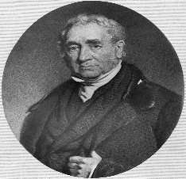
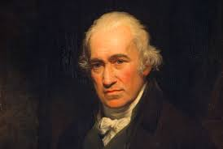
Year 6 History Knowledge Organiser
Industrial Revolution
Enquiry Question
Why was the Industrial Revolution so important to the progress of the UK?
Key Historical Threads
Societal change Invention
Key Vocabulary
famine: where there is not enough food for a great number of people, causing illness and death industrial: related to industry, using machinery often in factories legislation: a group of laws (e.g. factory legislation) poverty: the lack of basic human needs such as clean water, nutrition, healthcare, education and shelter revolution: a change in the way a country works, usually to a different political system or way of life
Key Knowledge
(1837 – 1901)
The industrial revolution had a huge effect on Leicester resulting in the population growing from 40,000 to 212,000 during this period.
James Watts
He was known as the ‘Father of the Industrial Revolution’.
George Stephenson
A British civil and mechanical engineer.
What will I know by the end of the unit?
I will know Britain changed from a rural society to an urban society as jobs changed from agricultural to industrial. I will be able to name some causes of the Industrial Revolution including population booms, increased transport and growth of the British Empire. I can explore ways in which the Industrial Revolution impacted the locality.
Timeline
1765 | 1825 | 1851 | 1862 | 1876 | 1878 | 1881 | 1885 | 1890
The steam engine was invented by James Watts. | The first passenger railway was built. George Stephenson invented the first passenger steam locomotive. | The Great Exhibition opened in London and ran from May until October. | The first route on the London Underground began carrying passengers using steam locomotives. | The telephone was invented by Alexander Graham Bell. | Joseph Wilson Swan invented the electric lamp. | The Education Act was passed, making school compulsory for all children between the ages of five and ten. | Karl Benz invented the automobile. This meant that people could travel to places faster. | The London Underground began carrying passengers on electrified trains.

Slide 11

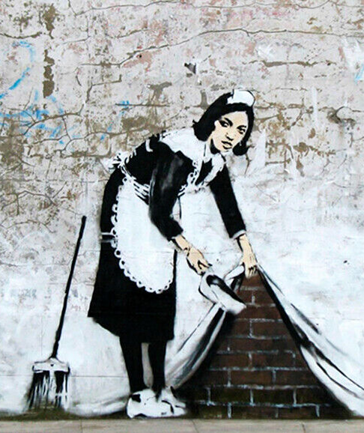
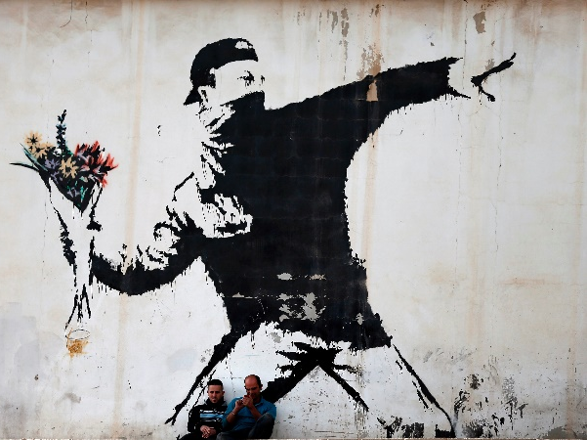
Art Knowledge Organiser: Year 6 Painting
I will explore painting.
During my art lessons I will:
Paint based on observations and convey realism or an impression of what I observe.
Look at and respond to the work of different artists and discuss their impact on art history and culture.
Experiment with adding materials to paint to change texture.
Develop control of consistency and add more detail in my paintings.
Discuss the work of other artists and apply their ideas to my own work.
Artist Focus: Banksy
Banksy is a pseudonymous England-based street artist, political activist, and film director whose real name and identity remain unconfirmed and the subject of speculation. Banksy uses a technique called stencilling to make his art. His art is often about politics, the environment and economic issues in society.
Vocabulary | Definition
stencil | Stencilling produces an image or pattern on a surface by applying pigment to a surface through a shape, with designed holes in the intermediate object.
perspective | Representing a 3D object accurately.
portrait | A picture of a person.

Slide 12
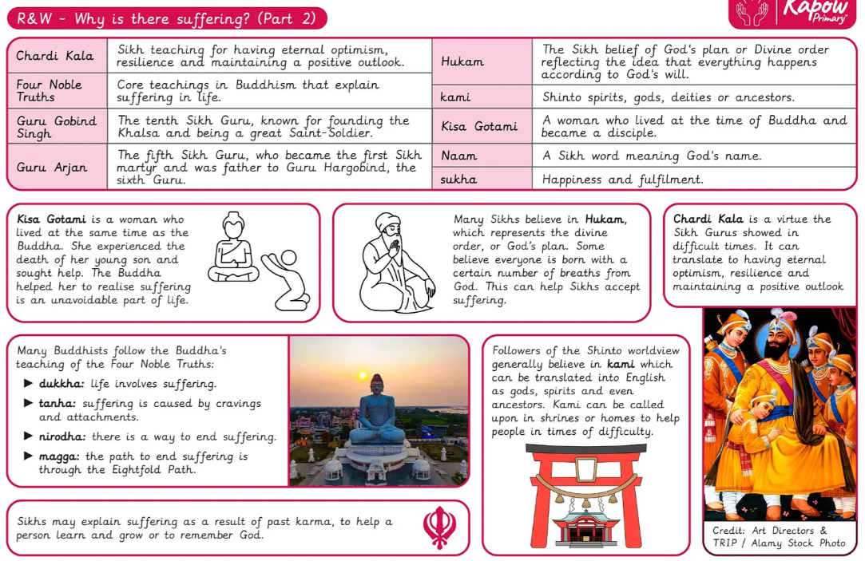

Slide 13
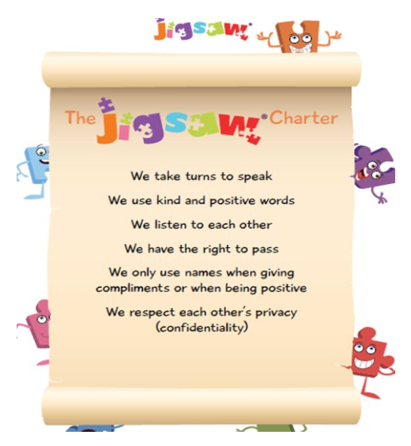
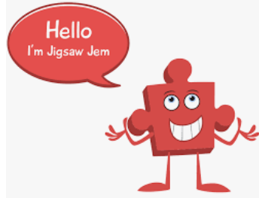
Year 6 Jigsaw Unit 5 Relationships
I have already learnt to… | Now I will learn to…
I have an accurate picture of who I am as a person in terms of my characteristics and personal qualities. | I understand there are different stages of grief and there are different types of loss that cause people to grieve.
I understand how it feels to be attracted to someone and what having a boyfriend or girlfriend means. | I understand how technology can be used to try to gain power or control and I can use strategies to prevent this from happening.
I understand how to stay safe when using technology to communicate with my friends. | I can use technology positively and safely to communicate with my friends and family.
I will understand this vocabulary…
relationships | A loving and/ or friendship between two people.
emotions | A strong feeling such as love, fear or anger; the part of a person’s character that consists of emotions.
bereavement | The state of having lost a relative or close friend because they have died.
grief | A very sad feeling, especially when somebody dies.
coping strategies | Ways that enables somebody to deal with something difficult.
control | The ability to make somebody or something do what you want.
bullying | Behaviour that is repeated and intended to hurt or frighten someone either physically or emotionally.
safety | To feel safe and protected from danger or harm.
I can answer these reflective questions…
Who are the most special people to me?
What strategies can help with sadness and loss?
What are good ways I can keep myself safe when using technology?

Slide 14

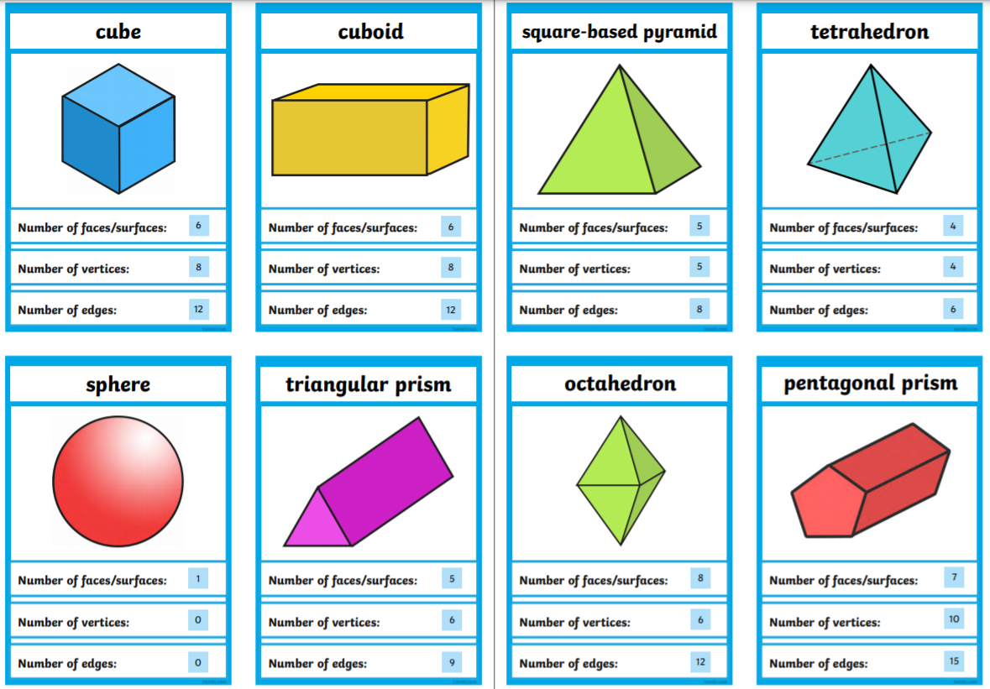
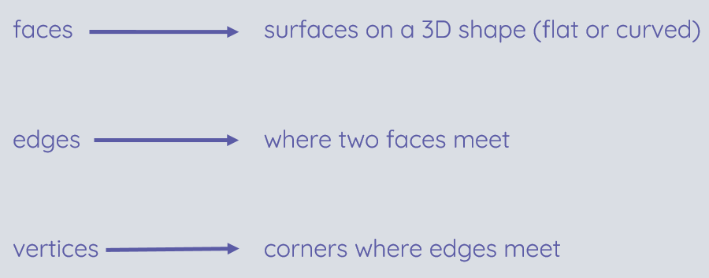
Year 6 Computing Knowledge Organiser: 3D Modelling
What should I already know?
how to paint and draw digitally
about desktop publishing, how to create, save and edit files, pictures and drawings
how to draw using vectors using 2D shapes
What will I learn?
I will develop your knowledge and understanding of using a computer to produce 3D models
I will initially familiarise myself with working in a 3D space, including combining 3D objects to make a house and examining the differences between working digitally with 2D and 3D graphics
I will progress to making accurate 3D models of physical objects, such as a pencil holder, which includes using 3D objects as placeholders.
I will examine the need to group 3D objects, then go on to plan, develop, and evaluate my own 3D model of a photo frame
I will use Tinkercad software
Key Vocabulary
three dimensional (3D) | having, or seeming to have, the dimension of depth as well as width and height
modelling | making a model
CAD | Computer Aided Design

Slide 15
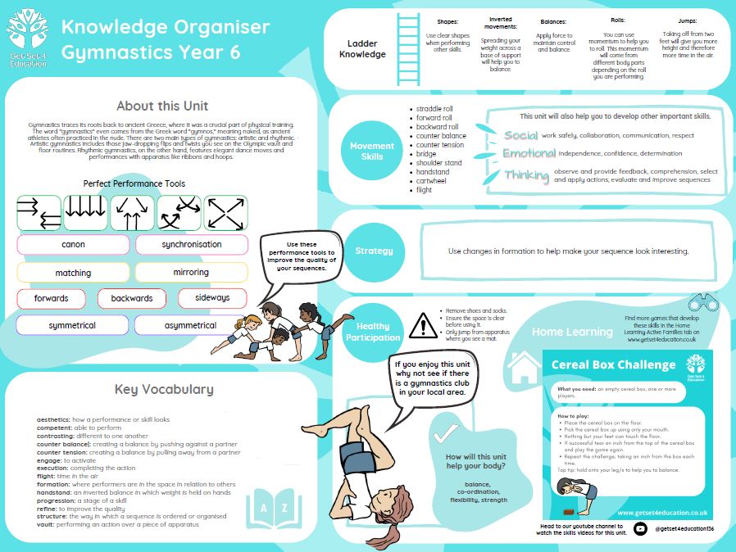

Slide 16
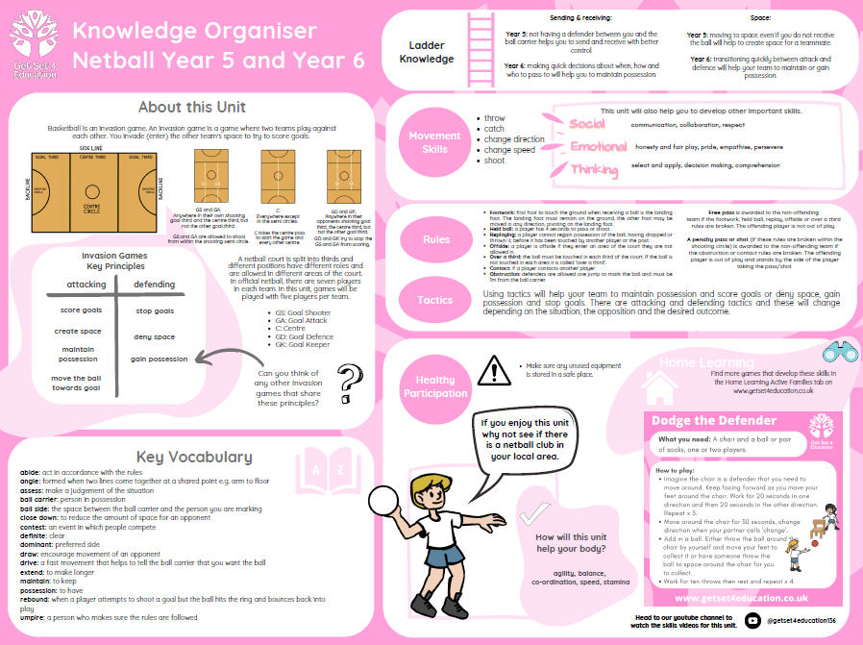

Slide 17
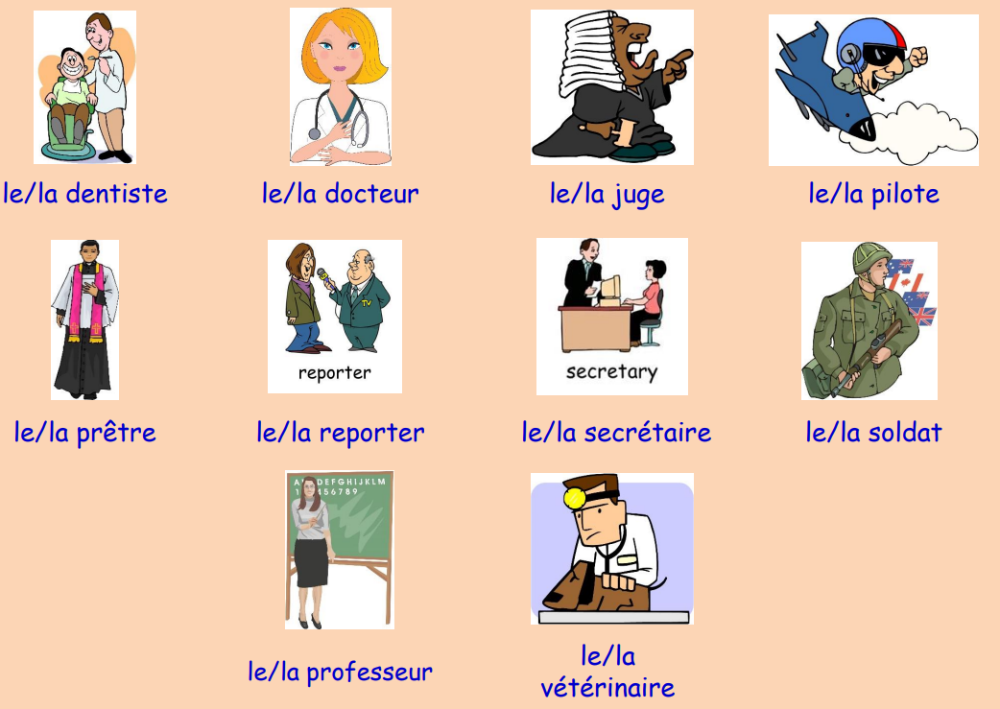
FRENCH KNOWLEDGE ORGANISER
The Future
Key Learning
I will: be able to ask questions in the future tense be able to answer questions in the future tense be able to use different words to say how I am feeling be able to name different jobs in both masculine and feminine form say who works where be able to say what I want to do
C’est quel emploi?
Grammar
I will know the immediate future tense by using Je vais or Tu vas followed by the infinitive verb e.g. Je vais regarder = I am going to watch

Slide 18
