Slide 1
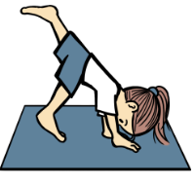


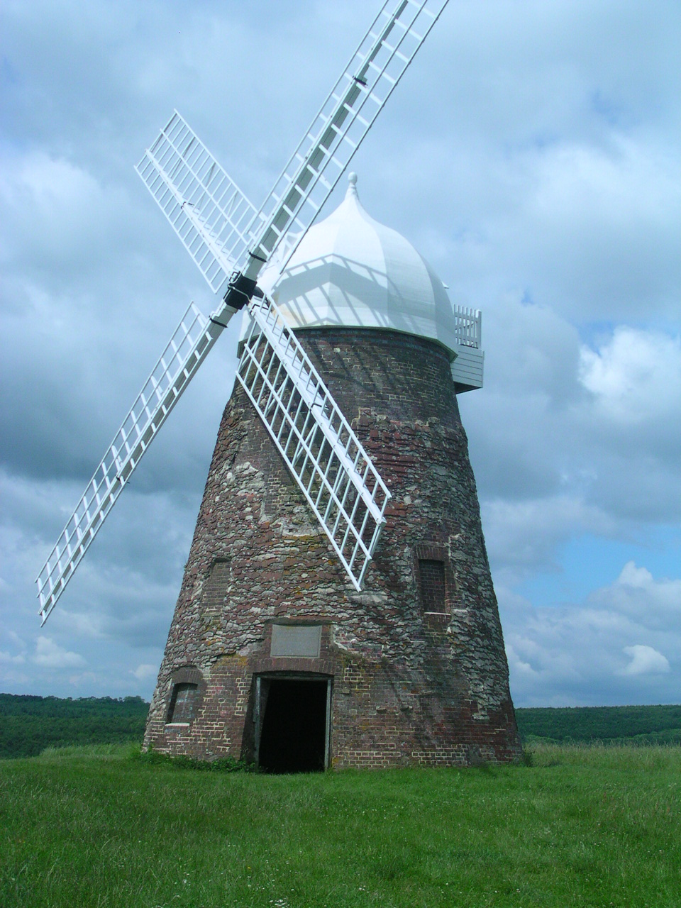
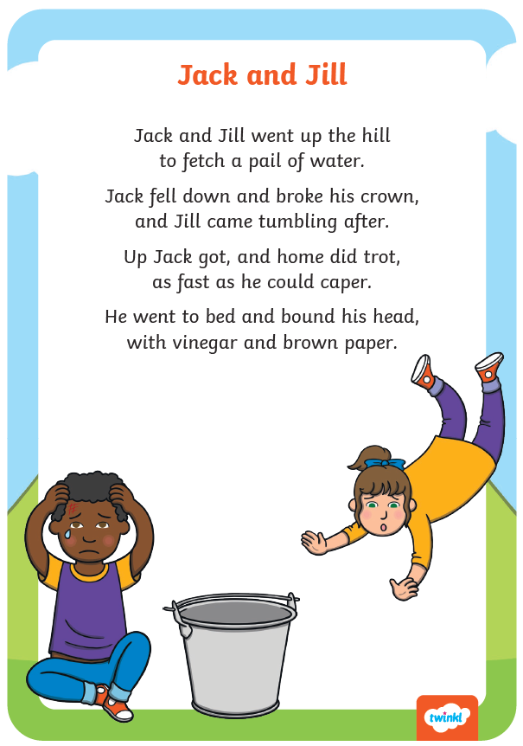
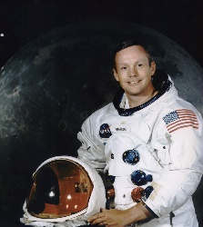

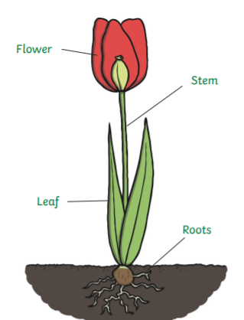
Year 1 Long Term Plan 2026 – 20276
 | Autumn 1 | Autumn 2 | Spring 1 | Spring 2 | Summer 1 | Summer 2
English | Phonics Reading Writing including grammar and punctuation | Phonics Reading Writing including grammar and punctuation | Phonics Reading Writing including grammar and punctuation | Phonics Reading Writing including grammar and punctuation | Phonics Reading Writing including grammar and punctuation | Phonics Reading Writing including grammar and punctuation
Maths | Place Value Addition Subtraction | Addition Subtraction Shape Length and Height | Place Value Addition Subtraction | Place Value Mass and Volume Multiplication Division | Multiplication Division ‘Fractions Place Value | Place Value Money Time Position and Direction
Science | Seasonal Changes | Seasonal Changes Animals - Humans | Seasonal Changes​ Forces​ | Seasonal Changes Plants​​ | Seasonal Changes Animals | Seasonal Changes Everyday Materials
History and Geography | My School | Travel and Transport | My Town | History of Toys | Great Explorers | The UK
Art and Design and Technology | Drawing: Angelina A’Court | Food and Nutrition: Fruit Salad | Collage: Peter Clayton | Mechanisms: Moving Pictures | Sculpture: Barbara Hepworth | Construction: Windmill House
Religion and Worldviews | How did the world begin? | What do some people believe God looks like? | What is God’s job? | Why should we care for the world? | How do we know that new babies are special? | Why should we care for others?
PSHE | Being Me In My World | Celebrating Difference | Healthy Me | Staying Safe | Foundations for Wellbeing | Changing Me
Computing | Technology Around Us | Digital Painting | Moving a Robot | Digital Writing | Digital Writing | Animation
Physical Education | Fundamentals / Ball Skills | Yoga / Sending and Receiving | Target Games / Gymnastics | Team Building / Invasion Games | Striking and Fielding/ Dance | Athletics / Net and Wall
Music | My Musical Heartbeat | Dance, Sing and Play | Exploring Sounds | Learning to listen | Having Fun with Improvisation | Let’s Perform Together

Slide 2
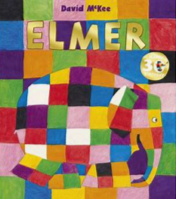





Year 1 Long Term Plan 2026 – 2027
 | Autumn 1 | Autumn 2 | Spring 1 | Spring 2 | Summer 1 | Summer 2
English | Phonics Reading Writing including grammar and punctuation | Phonics Reading Writing including grammar and punctuation | Phonics Reading Writing including grammar and punctuation | Phonics Reading Writing including grammar and punctuation | Phonics Reading Writing including grammar and punctuation | Phonics Reading Writing including grammar and punctuation
Maths | Place Value Addition Subtraction | Addition Subtraction Shape Length and Height | Place Value Addition Subtraction | Place Value Mass and Volume Multiplication Division | Multiplication Division ‘Fractions Place Value | Money Time Position and Direction
Science | Seasonal Changes | Seasonal Changes Animals - Humans | Seasonal Changes​ Everyday Materials​ | Seasonal Changes Plants​​ | Seasonal Changes Animals | Seasonal Changes Forces
History and Geography | My School | Travel and Transport | My Town | History of Toys | Great Explorers | The UK
Art and Design and Technology | Drawing: Angelina A’Court | Food and Nutrition: Fruit Salad | Collage: Peter Clayton | Mechanisms: Moving Pictures | Sculpture: Andy Goldsworthy | Construction: Windmill House
Religion and Worldviews | How did the world begin? | What do some people believe God looks like? | What is God’s job? | Why should we care for the world? | How do we know that new babies are special? | Why should we care for others?
PSHE | Being Me In My World | Celebrating Difference | Healthy Me | Staying Safe | Relationships | Changing Me
Computing | Technology Around Us | Digital Painting | Moving a Robot | Digital Writing | Digital Writing | Animation
Physical Education | Fundamentals / Ball Skills | Yoga / Sending and Receiving | Target Games / Gymnastics | Team Building / Invasion Games | Striking and Fielding/ Dance | Athletics / Net and Wall
Music | My Musical Heartbeat | Dance, Sing and Play | Exploring Sounds | Learning to listen | Having Fun with Improvisation | Let’s Perform Together

Slide 3
Science – swapped when forces/materials units are being taught. For 2026/2027:
Sp1 Materials taught first to introduce materials to children.
Sp2 History of toys builds on this learning (what toys in the past/present are made of and how this has changed over time).
Su2 Forces. Uses materials prior learning to introduce forces (e.g. friction). Smoother/rougher materials affect the friction produced, etc.
Art. For 2026/2027:
Sp1 Collage : Keep Peter Clayton as artist.
Su1 Sculpture: artist swapped back to Andy Goldsworthy (taught 2024/2025). More opportunity for different types of sculptures to be made (not just clay, but also using natural materials). More scope for abstract sculptures using our lovely outdoor area)
Maths. For 2026/2027:
Taken Place Value out of Su2 as it will be all covered in Su1 due to term length Su1 being longer next year.
PSHE. For 2026/2027:
Foundations for Wellbeing will be taught during one term (replace a Jigsaw unit). Unsure yet when it will be taught. This will need to be added when decided. DC/HT

