Slide 1
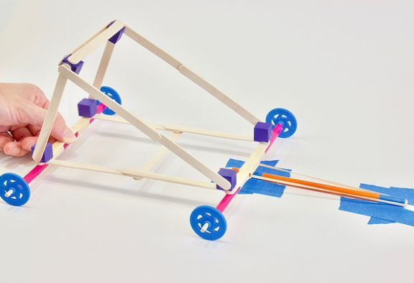
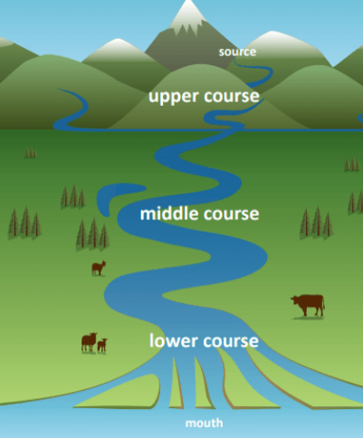

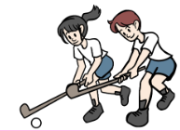


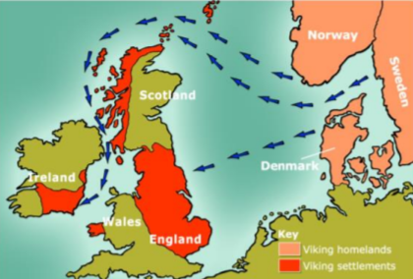
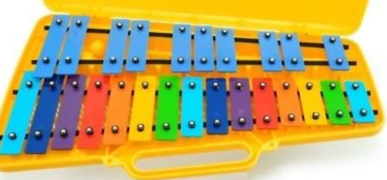






Year 3/4 Long Term Plan 2026-2027
 | Autumn 1 | Autumn 2 | Spring 1 | Spring 2 | Summer 1 | Summer 2
English | Reading Writing including grammar, spelling and punctuation | Reading Writing including grammar, spelling and punctuation | Reading Writing including grammar, spelling and punctuation | Reading Writing including grammar, spelling and punctuation | Reading Writing including grammar, spelling and punctuation | Reading Writing including grammar, spelling and punctuation
Maths | Place Value Addition Subtraction | Multiplication Division Length and Perimeter Area | Multiplication Division Money | Fractions Decimals | Time Shape | Position and Direction Statistics
Science | ​Living things and their habitats​ | ​Animals, including humans​ | ​Electricity​ | ​Sound​ | ​States of matter​ | ​States of matter​
History and Geography | Rivers | Roman Britain | Natural Resources | Anglo Saxons | Vikings | Europe
Art and Design and Technology | Drawing: Phlegm | Mechanisms: Slingshot Car | Collage: Danielle Vaughn | Construction: Pavilion | Painting: Pablo Picasso | Food and Nutrition: Biscuits
Religion and Worldviews | Are all religions equal? | What makes some texts sacred? | Just how important are our beliefs? | Who was Jesus? | Why is the bible the best-selling book of all time? | Does the language of scripture matter?
PSHE | Being Me In My World | Celebrating Difference | Healthy Me | Staying Safe | Relationships | Changing Me
Computing | The Internet | Audio Production | Repetition in Shapes | Photo editing | Repetition in Games | Data logging
Physical Education | Fitness / OAA | Ball skills / Yoga | Parkour / Football | Basketball / Dance | Cricket / Dodge ball | Tennis / Athletics
Music | Musical Structures | Exploring Feelings When You Play | Compose With Your Friends | Feelings Through Music | Expression Through Improvisation | The Show Must Go On
French | People and Our Bodies |  | Where I Live |  | My School

