Slide 1

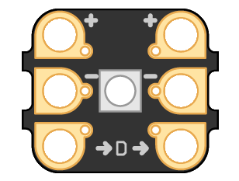


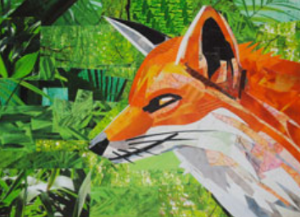






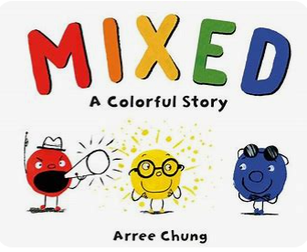

Year 5 Long Term Plan 2025 – 2026
 | Autumn 1 | Autumn 2 | Spring 1 | Spring 2 | Summer 1 | Summer 2
English | Reading Writing including grammar, spelling and punctuation | Reading Writing including grammar, spelling and punctuation | Reading Writing including grammar, spelling and punctuation | Reading Writing including grammar, spelling and punctuation | Reading Writing including grammar, spelling and punctuation | Reading Writing including grammar, spelling and punctuation
Maths | Place Value Addition Subtraction | Multiplication/Division Shape Fractions | Multiplication/Division Fractions Perimeter and Area | Decimals Percentages Volume | Position and Direction Decimals Converting Units | Negative Numbers Statistics
Science | ​Forces and Magnets​ | ​Earth and Space​ | ​Materials​ | ​Materials​ | Living things and their habitats​ ​ | ​​ Animals, including humans
History and Geography | Climate Zones | Benin (West Africa) | Crime and Punishment | North America | Richard III: Dynasty, Death and Discovery | Economic Activity
Art and Design and Technology | Drawing: Olivier Leger | Mechanisms: Electronic Cards | Painting: Paul Wright | Textiles: Stuffed Toy | Collage: Megan Coyle | Food and Nutrition: Improving a Pie Recipe
Religion and Worldviews | Why do people have to stand up for what they believe in? | Why doesn’t Christianity always look the same? | What happens when we die? | What happens when we die? | Who should be in charge? | Why are some places in the world significant?
Everyone’s Welcome
PSHE | Being Me In My World | Celebrating Difference | Dreams and Goals | Healthy Me | Relationships | Changing Me
Computing | Systems and Searching | Video Production | Selection in Physical Computing | Flat file Data Bases | Introduction to Vector Graphics | Selection in Quizzes
Physical Education | Dance/Basketball | Fitness/Tag Rugby | Swimming | Swimming | OAA / Athletics | Golf / Gymnastics
Music | Getting Started with Music Tech | Sing and Play in Different Styles | Composing and Chords | Enjoying Musical Styles | Freedom to Improvise | Battle of the Bands
French | Food |  | Hobbies |  | All Around Me

