Slide 1
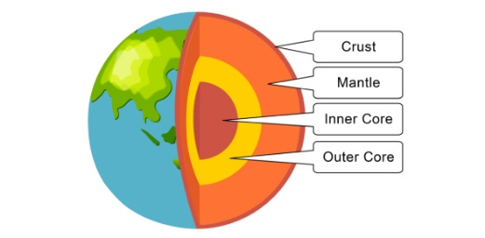







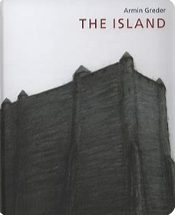





Year 6 Long Term Plan 2026 – 2027
 | Autumn 1 | Autumn 2 | Spring 1 | Spring 2 | Summer 1 | Summer 2
English | Reading Writing including grammar, spelling and punctuation | Reading Writing including grammar, spelling and punctuation | Reading Writing including grammar, spelling and punctuation | Reading Writing including grammar, spelling and punctuation | Reading Writing including grammar, spelling and punctuation | Reading Writing including grammar, spelling and punctuation
Maths | Place Value Four Operations | Fractions, Decimals and Percentages Position and Direction | Shape Area and Perimeter Volume | Converting Units Statistics Ratio Algebra | Consolidation | Problem Solving Investigations
Science | Electricity | Living Things and Their Habitats | Adaptation, Evolution and Inheritance | Adaptation, Evolution and Inheritance | Animals, including humans | Light
History and Geography | Twentieth Century Conflict: WWII | Local Fieldwork | Civil Rights | Earthquakes and Volcanoes | Industrial Revolution
Art and Design and Technology | Construction: Anderson Shelters | Textiles: Case | Drawing: Yayoi Kusama | Sculpture: Yinka Shonibari | Painting: Banksy | Food and Nutrition: Come Dine With Me
Religion and Worldviews | Why does religion look different around the world? | Why does religion look different around the world? | Why is it better to be there in person? | Why is there suffering? | Why is there suffering? | What place does religion have in our world today?
PSHE | Being Me In My World | Celebrating Difference | Healthy Me | Staying Safe | Relationships | Changing Me
Computing | Communication and Collaboration | Web page creation | Variables in Games | Introduction to Spreadsheets | 3D modelling | Sensing Movement
Physical Education | Fitness / OAA | Football / Yoga | Tag Rugby / Swimming | Netball / Swimming | Athletics / Gymnastics | Golf / Dance
Music | Music and Technology | Developing Ensemble Skills | Creative Composition | Musical Styles Connect Us | Improvising with Confidence | Farewell Tour
French | All About France |  | My Family |  | The Future

